Slide 1

Lean Six Sigma Yellow Belt Training
Featuring Examples from Minitab 18

Slide 2
1.0 Define Phase

Slide 3
1.1 Overview of Six Sigma

Slide 4
Yellow Belt Training: Define Phase
1.1 Six Sigma Overview
1.1.1 What is Six Sigma
1.1.2 Six Sigma History
1.1.3 Six Sigma Approach Y = f(x)
1.1.4 Six Sigma Methodology
1.1.5 Roles and Responsibilities
1.2 Six Sigma Fundamentals
1.2.1 Defining a Process
1.2.2 VOC and CTQs
1.2.3 QFD
1.2.4 Cost of Poor Quality (COPQ)
1.2.5 Pareto Analysis (80 : 20 rule)
1.3 Lean Six Sigma Projects
1.3.1 Six Sigma Metrics
1.3.2 Business Case and Charter
1.3.3 Project Team Selection
1.3.4 Project Risk Management
1.3.5 Project Planning
1.4 Lean Fundamentals
1.4.1 Lean and Six Sigma
1.4.2 History of Lean
1.4.3 The Seven Deadly Muda
1.4.4 Five-S (5S)

Slide 5
1.1.1 What is Six Sigma

Slide 6
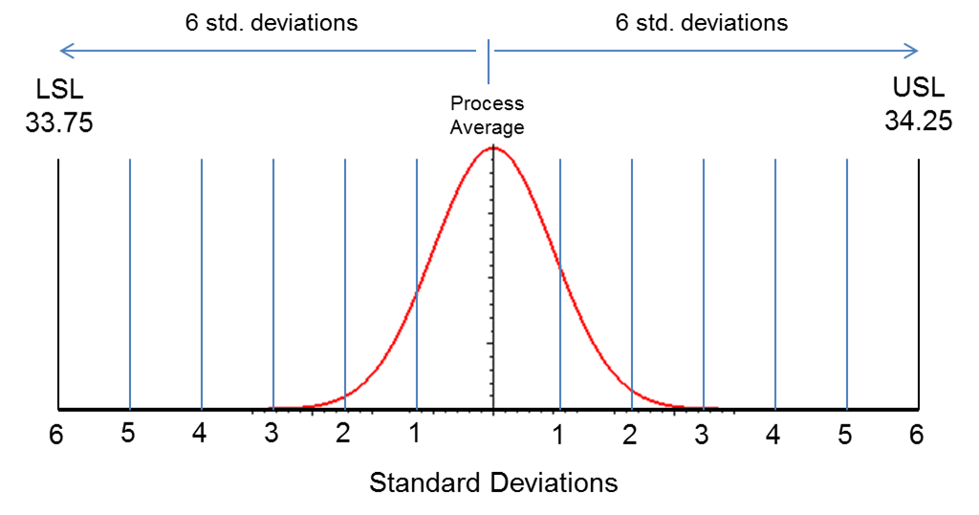
What is Six Sigma?
What is “sigma”?
  In statistics, sigma (σ) refers to “standard deviation,” which is a measure of variation.
  You will come to learn that variation is the enemy of any quality process. We need to understand, manage, and minimize process variation.
What is “Six Sigma”?
  Six Sigma is an aspiration or goal of process performance.
  A Six Sigma “goal” is for a process average to operate approximately 6σ away from customer’s high and low specification limits.
Notes:
Most people think of Six Sigma as a disciplined, data-driven approach to eliminating defects and solving business problems.
If you break down the two words, “Six Sigma,” they really describe a measure of quality that strives for near perfection.
Sigma and standard deviation are the same thing, a measure of variation.
Variation is the enemy of quality; it makes it much more difficult to meet a customer’s expectation for a product or service.
The aspiration is to limit the variation to such a degree that 6 “sigmas” (or standard deviations) above or below your mean will fall within the limits that are acceptable to customers.

Slide 7
What is Six Sigma?
A process whose average is about 6σ away from the customer’s high and low specification limits has abundant room to “float” before approaching the customer’s specification limits.
A Six Sigma process only yields 3.4 defects for every million opportunities! In other words, 99.9997% of the products are defect-free!
Notes:
The more variation that can be reduced in the process (by narrowing the distribution), the more easily the customer’s expectations can be met.
A Six Sigma process will yield only 3.4 defects for every million opportunities, but some processes require more quality and some require less.
It is important to note that a Six Sigma level of quality does not come without cost, so one must consider what level of quality is needed or acceptable and how much can be spent on resources to remove the variation.

Slide 8
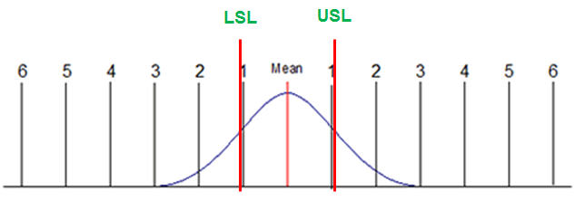
What is Six Sigma: Sigma Level
Sigma level measures how many “sigma” there are between your process average and the nearest customer specification.
Let us assume that your customers upper and lower specifications limits (USL & LSL) were narrower than the width of your process spread.
The USL & LSL below stay about 1 standard deviation away from the process average. Therefore, this process operates at 1 sigma.
Notes:
On the previous page, the LSL and USL were at 6 standard deviations from the mean. Would that process be more or less forgiving than the one that is pictured?
This process is much less forgiving. It is a 1 sigma process because the USL and LSL are only 1 standard deviations from the mean.
The area under the blue curve to the left of the LSL and to the right of the USL represents process defects.

Slide 9

What is Six Sigma: Sigma Level
A process operating at 1 sigma has a defect rate of approximately 70%.
          This means that the process will generate defect-free products only 30% of the time.
What about processes with more than 1 sigma level?
A higher sigma level means a lower defect rate.
Let us take a look at the defect rates of processes at different sigma levels.
Notes:
A 1 sigma process will generate defects 70% of the time, so for every 3 units that are good, there are 7 defective.
A 1 sigma process is not desirable anywhere. What are the implications of such a process? High customer claims, high process waste, lost reputation…any others?

Slide 10
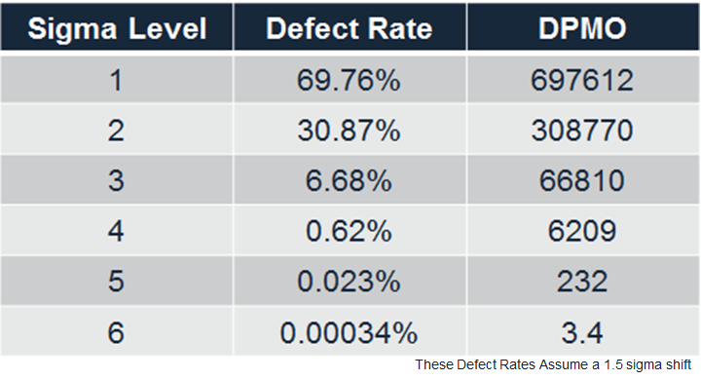
What is Six Sigma: Sigma Level
This table shows each sigma level’s corresponding defect rate and DPMO (defects per million opportunities).
The higher the sigma level, the lower the defective rate and DPMO.
How does this translate into things you might easily relate to?
Notes:
The table on this page shows how dramatically the quality can improve when moving from a 1 sigma process, to 2 sigma, to 3, and so on.
On the next page we will look at how this concept applies to some everyday applications.

Slide 11
What is Six Sigma: Sigma Level
Let us take a look at processes operating at 3 sigma.
3 sigma processes have a defect rate of approximately 7%. What would happen if processes operated at 3 sigma?
  Virtually no modern computer would function*.
  10,800,000 health care claims would be mishandled each year.
  18,900 US savings bonds would be lost every month.
  54,000 checks would be lost each night by a single large bank.
  4,050 invoices would be sent out incorrectly each month by a modest-sized telecommunications company.
  540,000 erroneous call details would be recorded each day from a regional telecommunications company.
  270 million erroneous credit card transactions would be recorded each year in the United States.
(*http://www.qualityamerica.com)
Notes:
Can you imagine what a 3 sigma process would look like in the tech industry, in health care, in banking?
Can you apply this concept to a process that you relate to?

Slide 12
What is Six Sigma: Sigma Level
What if processes operated with 1% defect rate?
  20,000 lost articles of mail per hour*.
  Unsafe drinking water almost 15 minutes per day.
  5,000 incorrect surgical operations per week.
  Short or long landings at most major airports each day.
  200,000 wrong drug prescriptions each year.
  No electricity for almost 7 hours per month.
Even at 1% defect rate, some processes would be unacceptable to you and many others.
So what is Six Sigma?
  Sigma level is the measure!
  Six is the goal!
(* Implementing Six Sigma – Forest W. Breyfogle III)

Slide 13
What is Six Sigma: The Methodology
Six Sigma itself is the goal, not the method.
In order to achieve Six Sigma, you need to improve your process performance by:
  Minimizing the process variation so that your process has enough room to fluctuate within customer’s spec limits
  Shifting your process average so that it is centered between your customer’s spec limits.
Accomplishing these two process improvements (along with stabilization and control), you can achieve Six Sigma.
DMAIC is the systematic methodology prescribed to achieve Six Sigma.
Notes:
While Six Sigma is often associated with the methodology, it is actually the goal.
To achieve the goal, process performance must be achieved by reducing the variation and/or shifting the process average.
By doing this, the process is more capable of meeting the specification limits that are set by the customer.
Stabilization and control refer to the ability to maintain the process improvements or level of quality over time.
The methodology that should be used to achieve the goal is called DMAIC.

Slide 14
What is Six Sigma: The Methodology
DMAIC is a systematic and rigorous methodology that can be applied to any process in order to achieve Six Sigma.
It consists of 5 phases of a project:
  Define
  Measure
  Analyze
  Improve
  Control.
You will be heavily exposed to many concepts, tools, and examples of the DMAIC methodology through this training.
You will be capable of applying the DMAIC methodology to improve the performance of any process at the completion of the curriculum.
Notes:
DMAIC is the path to Six Sigma. It is a disciplined, rigorous, data-driven approach that can be applied to any process.
The phases are DEFINE, MEASURE, IMPROVE, ANALYZE, and CONTROL.
The goal of this training is to teach you how to apply DMAIC and leverage the many concepts and tools within it.

Slide 15
1.1.2 Six Sigma History

Slide 16
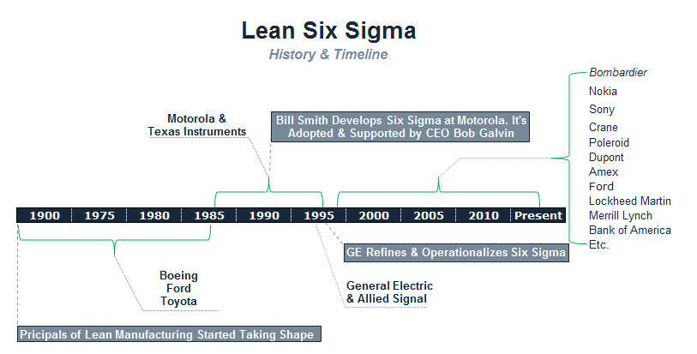
Six Sigma History
Polaroid
Notes:
Six Sigma was originally developed by Motorola in 1986, but really became popular when Jack Welch at GE made it the focus of his business strategy. Since the late 90s, it has become widely used across many industries. Maybe you have heard of a few of these?
While the term “Lean” was coined in the 1990s, the methodology is mainly based on the concepts of the Toyota Production System, which was developed by Taiichi Ohno, Shigeo Shingo, and Eiji Toyoda at Toyota between 1948 and 1975.

Slide 17
Six Sigma History
The “Six Sigma” terminology was originally adopted by Bill Smith at Motorola in the late 1980s as a quality management methodology.
As the “Father of Six Sigma,” Bill forged the path for Six Sigma through Motorola’s CEO Bob Galvin who strongly supported Bill’s passion and efforts.
Starting from the late 1980s, Motorola extensively applied Six Sigma as a process management discipline throughout the company, leveraging Motorola University.
In 1988, Motorola was recognized with the prestigious Malcolm Baldrige National Quality Award for its achievements in quality improvement.
Notes:
Bill Smith originally approached Bob Galvin with what he referred to as the “theory of latent defect.”
The core principle of the theory is that variation in manufacturing processes is the main driver for defects, and eliminating variation will help eliminate defects. In turn, it will eliminate the wastes associated with defects, saving money and increasing customer satisfaction.
The threshold agreed to by Motorola was 3.4 defects per million opportunities…does it sound familiar?

Slide 18
Six Sigma History
Six Sigma has been widely adopted by companies as an efficient way of improving the business performance since General Electric implemented the methodology under the leadership of Jack Welch in the 1990s.
As GE connected Six Sigma results to its executive compensation and published the financial benefits of Six Sigma implementation in their annual report, Six Sigma became a highly sought-after discipline of quality.
Notes:
In the 1990s, Six Sigma became widely popular after it was implemented at GE under the leadership of Jack Welch.
Companies across many industries followed suit. In some cases GE taught companies how to deploy the methodology, and in many cases experts from GE and other pioneer companies were heavily recruited to companies that were new to methodology.

Slide 19
Six Sigma History
Most Six Sigma programs cover the aspects, tools, and topics of Lean or Lean Manufacturing.
The two work hand in hand, benefitting each other.
  Six Sigma focuses on minimizing process variability, shifting the process average, and delivering within customer’s specification limits.
  Lean focuses on eliminating waste and increasing efficiency.
Lean and its popularity began to form and gain significant traction in the mid 1960s with the Toyota initiative “TPS” or Toyota Production System.
The concepts and methodology of Lean, however, were fundamentally applied much earlier by both Ford and Boeing in the early 1900s.
Notes:
The DMAIC methodology is essentially an ordered collection of concepts and tools that were not unique to Six Sigma. The concepts and tools are leveraged in a way that leads down a problem solving path.
Another methodology that is complementary to Six Sigma is Lean or Lean Manufacturing.
While Six Sigma focuses on process variability, Lean focuses on eliminating waste and improving process flow and efficiency.
Although the concepts have been applied all the way back in the early 1900s by Ford and Boeing, they were made popular by Toyota in the 1960s with what was originally known as the “just-in-time production system,” and became known as the Toyota Production System.

Slide 20
Six Sigma History
Despite the criticism and immaturity of Six Sigma in many aspects, its history continues to be written with every company and organization striving to improve its business performance.
Polaroid
Notes:
The track record for many of these companies, after implementing Six Sigma, speaks for itself.

Slide 21
1.1.3 Six Sigma Approach

Slide 22
Six Sigma Approach: Y = f(x)
The Six Sigma approach to problem solving uses a transfer function.
A transfer function is a mathematical expression of the relationship between the inputs and outputs of a system.
Y = f(x) is the relational transfer function that is used by all Six Sigma practitioners.
It is absolutely critical that you understand and embrace this concept.

Slide 23
Six Sigma Approach: Y = f(x)
“Y” refers to the measure or output of a process.
  Y is usually your primary metric
  Y is the measure of process performance that you are trying to improve.
f(x) means “function of x.”
  x’s are factors or inputs that affect the Y
Combined, the Y = f(x) statement reads “Y is a function of x.”
In simple terms: “My process performance is dependent on certain x’s.”
The objective in a Six Sigma project is to identify the critical x’s that have the most influence on the output (Y) and adjust them so that the Y improves.
Notes:
You might have been introduced to the transfer function in middle school algebra, but it means so much more than symbolizing an algebraic equation.
It is important to keep in mind this concept throughout the DMAIC process. The system (or process) outputs (Y’s) are a function of the inputs (x’s).

Slide 24
Six Sigma Approach: Y = f(x)
Let us look at a simple example of a pizza delivery company that desires to meet customer expectations of on-time delivery.
  Measure = on-time pizza deliveries
    Y = percent of on-time deliveries
  f(x) would be the x’s or factors that heavily influence timely deliveries
    x1: might be traffic
    x2: might be the number of deliveries per driver dispatch
    x3: might be the accuracy of directions provided to the driver
    x4: might be the reliability of the delivery vehicle
    etc.
The statement Y = f(x) in this example will refer to the proven x’s determined through the steps of a Six Sigma project.
Notes:
Most would agree that an important requirement of pizza delivery is to be fast or “on-time.” In this example, let us consider factors that might cause variation in Y (percent of on-time deliveries).
In the DMAIC process, the goal is to determine which inputs (x’s) are the main drivers for the variation in Y.

Slide 25

Six Sigma Approach: Y = f(x)
X₃
X₂
With this approach, all potential x’s are evaluated throughout the DMAIC methodology.
The x’s should be narrowed down until the vital few x’s that significantly influence “on-time pizza deliveries” are identified!
X₇
X₄
X₅
X₈
X₁
X₆
Y=f(x)
Notes:
One might think of the DMAIC process as a funnel to narrow down all the possible x’s to the vital few.
Why might it be important to know what the vital few x’s are? To focus improvement where the most impact can be affected through changing the inputs.

Slide 26
Six Sigma Approach: Y = f(x)
This approach to problem solving will take you through the process of determining all potential x’s that might influence on-time deliveries and then determining through measurements and analysis which x’s do influence on-time deliveries.
Those significant x’s become the ones used in the Y = f(x) equation.
The Y = f(x) equation is a very powerful concept and requires the ability to measure your output and quantify your inputs.
Measuring process inputs and outputs is crucial to effectively determining the significant influences to any process.
Notes:
The approach will funnel the possible x’s to the few that do influence Y. The measurement of those x’s and their effect on the Y then become the focus to determine which have the most significant impact.
By determining which have the most impact, resources can be focused on changing those inputs to achieve the desired process output.

Slide 27
1.1.4 Six Sigma Methodology

Slide 28
Six Sigma Methodology
Six Sigma follows a methodology that is conceptually rooted in the principles of a five-phase project.
Each phase has a specific purpose and specific tools and techniques that aid in achieving the phase objectives.
The 5 phases of DMAIC:
  Define
  Measure
  Analyze
  Improve
  Control
Notes:
Six Sigma is a data-driven methodology for solving problems, improving, and optimizing business problems.
It has 5 phases, each with a specific and important purpose toward achieving the goal of the project.

Slide 29
Six Sigma Methodology
Define
Define and quantify the problem and objective
Measure
Baseline process, validate measures, and identify all possible x’s and dependent Y’s
Analyze
Analyze and validate causes identifying critical factors
Improve
Control
Develop solutions
Implement and sustain solutions
Notes:
DEFINE – the main goal is to “define” what the project is setting out to do and scope the effort.
MEASURE – To establish a baseline for the process, ensure the measurement system is reliable, and identify all possible root causes for a problem.
ANALYZE – To narrow down all possible root causes to the critical few that are the primary drivers of the problem.
IMPROVE – To develop the improvements for the process.
CONTROL – To implement the fix and a control plan to ensure the improvements are sustained over time.
In terms of the transfer function:
DEFINE – Understand the project Y’s and how to measure them.
MEASURE – Prioritize potential x’s and measure x’s and Y’s.
ANALYZE – Test x-Y relationships and verify/quantify important x’s.
IMPROVE – Implement solutions to improve Y’s and address important x’s.
CONTROL – Monitor important x’s and the Y’s over time.

Slide 30
Six Sigma Methodology: Define Phase
The goal of the Define phase is to establish a solid foundation and business case for a Six Sigma project.
Define is arguably the most important aspect of any Six Sigma project.
All successful projects start with a current state challenge or problem that can be articulated in a quantifiable manner.
  It is not enough to just know the problem, you must quantify it and also determine the goal.
Once problems and goals are identified and quantified, the rest of the define phase will be about valuation, team, scope, project planning, timeline, stakeholders, Voice Of the Customer (VOC), and Voice Of the Business (VOB).
Notes:
DEFINE is a critical phase. It sets the foundation for the project, and if it is not done well and properly thought, it is very easy for a project to go off-track.
All problems start with a quantifiable problem statement – without a baseline and a goal, it is very difficult to keep boundaries around the project. Without knowing how much improvement is needed or desired, it can be very difficult to control the scope of the project.

Slide 31
Six Sigma Methodology: Define Phase
Define Phase Tools and Deliverables
  Project Charter – Establish the:
      Business Case
      Problem Statement
      Project Objective
      Project Scope
      Project Timeline
      Project Team.
  Stakeholder Assessment
  High-Level Pareto Chart Analysis
  High-Level Process Map
  VOC/VOB and CTQs Identified and Defined
  Financial Assessment
Notes:
The project charter is essentially a contract formed between a project team, the champion, and the stakeholders. It defines what the project is going to do, why they are going to do it, when it will be done, and by whom. It includes the business case, problem statement, project objective, scope, timeline, and team.
A stakeholder assessment is done to understand where there are gaps in stakeholder support and develop strategies to overcome them.
High-level Pareto chart and process maps, along with VOC (voice of customer), VOB (voice of business), and CTQs (critical to quality requirements) also help to develop the scope and put some guardrails around the process.

Slide 32
Six Sigma Methodology: Measure Phase
The goal of the Measure phase is to gather baseline information about the process (process performance, inputs, measurements, customer expectations etc.).
Throughout the Measure phase you will seek to achieve a few important objectives:
  Gather All Possible x's
  Assess Measurement System and Data Collection Requirements
  Validate Assumptions
  Validate Improvement Goals
  Determine COPQ (Cost of Poor Quality)
  Refine Process Understanding
  Determine Process Stability
  Determine Process Capability.
Notes:
The MEASURE phase is necessary to establish the baseline performance for the process, determine if the measurement system(s) is (are) reliable. It is also important to determine if the process is stable and how capable the process is of meeting the customer’s specifications.
There are a few important objectives: identify all the possible x’s, plan what data needs to be collected, assess measurement systems for reliability, validate assumptions and improvement goals, determine the Cost of Poor Quality (COPQ), determine if the process is stable and if the process is capable of meeting customer requirements.

Slide 33
Six Sigma Methodology: Measure Phase
Measure Phase Tools and Deliverables
  Process Maps, SIPOC, Value Stream Maps
  Failure Modes and Effects Analysis (FMEA)
  Cause-and-Effect Diagram
  XY Matrix
  Six Sigma Statistics
    Basic Statistics
    Descriptive Statistics
  Measurement Systems Analysis
    Variable and/or Attribute Gage R&R
    Gage Linearity and Accuracy or Stability
  Basic Control Charts
  Process Capability (Cpk, Ppk) and Sigma Levels
  Data Collection Plan
Notes:
There are many powerful tools that will be introduced to you throughout the MEASURE phase.
There are many different types of maps to visualize a process:
A SIPOC or a Value Stream Map
An FMEA (Failure Modes and Effects Analysis) to identify possible process failure modes and prioritize them
Tools to brainstorm possible root causes for defects (Cause and Effect) and prioritize those (XY matrix)
Some basic statistical tools to understand more about your process data (Basic and Descriptive Statistics)
Measurement system analysis tools to establish repeatability, reproducibility, linearity, accuracy, and stability
Basic control charts to assess process stability
Tools to assess and quantify a process’ ability to meet customer specification limits
A data collection plan to ensure that when data is collected, it is done properly.

Slide 34
Six Sigma Methodology: Analyze Phase
The Analyze phase is all about establishing verified drivers.
In the DMAIC methodology, the Analyze phase uses statistics and higher-order analytics to discover relationships between process performance and process inputs (in other words, what are the root causes or drivers of the improvement effort).
Ultimately, the Analyze phase establishes a reliable hypothesis for improvement solutions.
  Establish the Transfer Function Y = f(x)
  Validate the List of Critical x's and Impacts
  Create a Beta Improvement Plan (e.g., pilot plan).
Notes:
The ANALYZE phase is where the potential root causes are narrowed down to the critical root causes.
Statistical tools are used to determine whether or not there are relationships between process performance and the potential root causes.
Where the strong relationships are discovered, these become the foundation for the solution to improve the process.
This is where the transfer function, Y = f(x), is established and the project can establish a hypothesis for improved results.

Slide 35
Six Sigma Methodology: Analyze Phase
Analyze Phase Tools and Deliverables
  The Analyze phase is about proving and validating critical x’s using the appropriate and necessary analysis techniques. Examples include:
    Hypothesis Testing
      Parametric and Non-Parametric
    Regression
      Simple Linear Regression
      Multiple Linear Regression
  The Analyze phase is also about establishing a set of solution hypotheses to be tested and further validated in the Improve phase.
Notes:
There are many tools that are used to prove and validate the critical x’s:
Hypothesis tests such as t-tests, ANOVA, Chi-Square, to name a few
Different types of regression to establish quantitative and predictive relationships between the x’s and Y’s
The tools help to formulate a hypothesis about how much improvement can be expected in the Y, given a change in the x.

Slide 36
Six Sigma Methodology: Improve Phase
The goal of the Improve phase is. . .you guessed it! "make the improvement." Improve is about designing, testing, and implementing your solution.
To this point you have defined the problem and objective of the project, brainstormed possible x's, analyzed and verified critical x's. Now it's time to make it real!
  Statistically Proven Results from Active Study/Pilot
  Improvement/Implementation Plan
  Updated Stakeholder Assessment
  Revised Business Case with Return on Investment (ROI)
  Risk Assessment/Updated FMEA
  New Process Capability and Sigma.
Notes:
Methodologies for the IMPROVE phase include:
Experiments and planned studies
Pilots or tests designed to validate relationships and determine how much change in an input is needed to induce the desired result in the output.
Implementation plan to stimulate thoughts and planning for any necessary communications, training, and preparations to implement the process improvement

Slide 37
Six Sigma Methodology: Improve Phase
Improve Phase Tools and Deliverables
  Any Appropriate Tool from Previous Phases
  Design of Experiment (DOE)
    Full Factorial
    Fractional Factorial
  Pilot or Planned Study Using:
    Hypothesis Testing
    Valid Measurement Systems
  Implementation Plan
Notes:
Other important and less often discussed elements of the IMPROVE phase are extensions of other tools introduced in earlier phases:
An updated stakeholder assessment to ensure the right support exists to make the process change.
An updated business case to justify the change.
An updated FMEA to ensure the solution is robust and proper control points are identified.
A revisited process capability and sigma level to quantify how well the improved process will perform against customer specifications.

Slide 38
Six Sigma Methodology: Control Phase
The last of the 5 core phases of the DMAIC methodology is the Control phase.
The goal of the Control phase is to establish automated and managed mechanisms to maintain and sustain your improvement.
A successful control plan also establishes a reaction and mitigation plan as well as an accountability structure.
Notes:
The CONTROL phase is a common failure point for projects.
Improvements are made, but gains will only be temporary if the proper controls are not in place.
The purpose of the CONTROL phase is to establish the mechanisms to ensure the process sustains improved performance and a reaction/mitigation plan to activate by a process owner if it does not.

Slide 39
Six Sigma Methodology: Control Phase
Control Phase Tools and Deliverables
  Statistical Process Control (SPC/Control Charts)
    IMR, XbarS, XbarR, P, NP, U, C etc.
  Control Plan Documents
    Control Plan
    Training Plan
    Communication Plan
    Audit Checklist
  Lean Control Methods
    Poka-Yoke
    Five-S
    Kanban
Notes:
Control charts are useful for monitoring process inputs and outputs for stability and quickly identifying when the process goes “out of control.”
Control plans are used to ensure control points are identified and accountability for monitoring them is taken.
A training plan is needed to ensure employees are properly trained to perform process changes.
A communication plan is useful to alert any stakeholders of a change.
Lean tools can be used to “poka-yoke” (mistake proof) a process.
Five-S can be used to organize the workplace and make it more visual.

Slide 40
Six Sigma Methodology
Six Sigma DMAIC Roadmap
Define
Goal: Problem Statement, Objective, Business Case, Project Scope, Team
Main Tools: Project Charter, Pareto, Process Maps
Measure
Goal: Brainstorm/Prioritize Possible x’s, Validate measurement, Capability
Tools: Basic Statistics, C & E, XY Matrix, Capability Analysis, MSA, Process Maps, Control Charts
Analyze
Goal: Identify critical x’s
Goal: Lock-in the Improvement
Improve
Control
Tools: Hypotheses Tests (Normal/Non Normal), Regression and Correlation
Goal: Design, Test, and Implement Improvement
Tools: DOE, Implementation/Change/Communication Plan
Tools: Control Plan, Poka-Yoke, SPC, SOPs, Training Plans etc.
Notes:
This slide provides a high-level view of the DMAIC phases and basic tools. It can be turned into a nice wall-chart or placemat to jog your memory.

Slide 41
1.1.5 Roles and Responsibilities

Slide 42
Roles and Responsibilities
The various roles in a Six Sigma program are commonly referred to as “Belts.”
In addition to Belts, there are also other key roles with specific responsibilities.
Let us explore the different roles and their corresponding responsibilities in a Six Sigma program.
Notes:
It is important to know the many roles in Six Sigma to understand where responsibilities lie to execute a project.
Most commonly known are Belts (Black Belt, Green Belt, Master Black Belt, and Yellow Belt).
There are other roles as well, such as Champion, Sponsor, and Stakeholder.

Slide 43
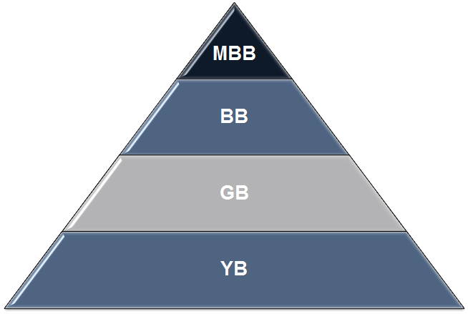
Roles and Responsibilities
Each of the four Six Sigma belts represents a different level of expertise in the field of Six Sigma.
  Six Sigma Master Black Belt (MBB)
  Six Sigma Black Belt (BB)
  Six Sigma Green Belt (GB)
  Six Sigma Yellow Belt (YB)
In addition to Belts, there are other critical and complementary roles:
  Champions
  Sponsors
  Stakeholders
  Subject Matter Experts (SMEs).
Expert
Novice
Notes:
Different Belt levels are associated with differing levels of expertise in Six Sigma, with Master Black Belt being the most highly trained expert, to Yellow belt having very basic knowledge.
There are also other roles that are very important to the success of Six Sigma initiatives, such as Champions, Sponsors, Stakeholders, and Subject Matter Experts.

Slide 44
Roles and Responsibilities: MBB
The Master Black Belt (MBB) is the most experienced, educated, and capable Six Sigma expert.
A typical MBB has managed dozens of Black Belt level projects.
The MBB can simultaneously lead multiple Six Sigma Belt projects while mentoring and certifying Black Belt and Green Belt candidates.
The MBB typically works with high-level operations directors, senior executives, and business managers to help with assessing and planning business strategies and tactics.
Notes:
The MBB is often thought of as a trusted advisor to high-level leaders.
The MBB often guides or coaches Black Belts and Green Belts and ensures the proper and consistent application of Six Sigma across departments.
While an MBB is typically technically savvy with all of the concepts and tools, it is critical that he or she has the skills to communicate in a practical manner with those that are not well-versed in Six Sigma.
Also, the MBB needs to have a strong ability to communicate with and influence leaders at all levels of an organization.

Slide 45
Roles and Responsibilities: MBB
MBB commonly advises management team on the cost of poor quality of an operation and consults on methods to improve business performance.
Typical Responsibilities of a MBB
  Identifies and defines the portfolio of projects required to support a business strategy
  Establishes scope, goals, timelines, and milestones
  Assigns and marshals resources
  Trains and mentors Green Belts and Black Belts
  Facilitates tollgates or checkpoints for Belt candidates
  Reports-out/updates stakeholders and executives
  Establishes organization’s Six Sigma strategy/roadmap
  Leads the implementation of Six Sigma.
Notes:
A MBB often is a trusted advisor to senior leaders in an organization, articulating the cost of poor quality and consulting with them about how to go about improving performance.
A MBB is responsible for defining a project portfolio to solve the businesses problems and drive the strategy.
He or she shapes the work by establishing scope, goals, and timelines.
He or she gathers resources, trains Belts, facilitates tollgates, and reports out to stakeholders and executives.
Finally, the MBB establishes a strategy for Six Sigma implementation and leads the way.

Slide 46
Roles and Responsibilities: BB
The Black Belt (BB) is the most active and valuable experienced Six Sigma professional among all the Six Sigma Belts.
A typical BB has
  led multiple projects
  trained and mentored various Green Belts candidates
  understood how to define a problem and drive effective solution.
The BB is well rounded in terms of project management, statistical analysis, financial analysis, meeting facilitation, prioritization, and a range of other value-added capabilities, which makes a BB highly valuable asset in the business world.
Notes:
The Black Belt is the key to success among all the other Belts.
The role of a Black Belt is to lead multiple projects, train and mentor Green Belts, define a problem, and drive change effectively.
The Black Belt incorporates many skills that are critical to successfully and quickly implementing a process improvement initiative through the DMAIC methodology.

Slide 47
Roles and Responsibilities: BB
BBs commonly serve as the dedicated resource continuing their line management role while simultaneously achieving a BB certification.
Typical Responsibilities of a BB
  Project Management
    Defines projects, scope, teams etc.
    Marshals resources
    Establishes goals, timelines, and milestones
    Provides reports and/or updates to stakeholders and executives.
Notes:
Often Black Belts are dedicated to improvement efforts, but typically pursue certification while simultaneously performing their normal line role.
Responsibilities include project definition, resource gathering, planning, and reporting outs.

Slide 48
Roles and Responsibilities: BB
Typical Responsibilities of a BB (continued)
  Task Management
    Establishes the team’s Lean Sigma roadmap
    Plans and implements the use of Lean Sigma tools
    Facilitates project meetings
    Does project management of the team’s work
    Manages progress toward objectives.
  Team Management
    Chooses or recommend team members
    Defines ground rules for the project team
    Coaches, mentors, and directs project team
    Coaches other Six Sigma Belts
    Manages the team’s organizational interfaces.
Notes:
The BB typically performs the role of a project manager, planning the project, facilitating project meetings, and managing toward objectives.
The BB plays a key role in forming, directing, mentoring, and coaching the team.

Slide 49
Roles and Responsibilities: GB
The Green Belt (GB) is considered as a less intense version of Six Sigma professional than the Black Belt (BB).
A GB is exposed to all the comprehensive aspects of Six Sigma with less focus on the statistical theories and some other advanced analytical methodologies such as Design of Experiment (DOE).
When it comes to project management, a GB has almost the same responsibilities as a BB.
In general, the GB works on less complicated and challenging business problems than a BB.
Notes:
While a Black Belt’s sole business responsibility could be the implementation of projects, Green Belts often implement projects in addition to other job responsibilities. Therefore, the Green Belt typically works on less complicated business problems.
A Green Belt takes direction and coaching from the Black Belt.
While exposed to all the concepts of Six Sigma, the Green Belt does not typically get deep into some of the more advanced statistical tools (at least not without significant direction from an expert Black Belt or Master Black Belt).

Slide 50
Roles and Responsibilities: GB
Typical Responsibilities of a Green Belt
  Project Management
    Defines the project, scope, team etc.
    Marshals resources
    Sets goals, timelines, and milestones
    Reports-out/updates stakeholders and executives.
  Task Management
    Establishes the team’s Lean Sigma Roadmap
    Plans and implements the use of Lean Sigma tools
    Facilitates project meetings
    Does Project Management of the team’s work
    Manages progress toward objectives.
  Team Management
    Chooses or recommends team members
    Defines ground rules for the project team
    Coaches, mentors, and directs project team
    Coaches other Six Sigma Belts
    Manages the team’s organizational interfaces.
Notes:
As you can see, the roles and responsibilities are identical to those of a Black Belt.
The key differences are the level of complexity and the dedication that a Black Belt has toward Six Sigma projects. Again, a Green Belt typically does projects in addition to his or her normal line job responsibilities.

Slide 51
Roles and Responsibilities: YB
The Yellow Belt (YB) understands the basic objectives and methods of a Six Sigma project.
YB has an elementary understanding about what other Six Sigma Belts (GB, BB, MBB) are doing to help them succeed.
In a Six Sigma project, YB usually serves as a subject matter expert regarding some aspects of the process or project.
Supervisors, managers, directors, and sometimes executives are usually trained at the YB level.
Notes:
Yellow Belts have enough understanding of Six Sigma so they can be effective in assisting other Six Sigma Belts to succeed with their projects, usually in the role of subject matter experts.
This level of training is important to have in an environment where Six Sigma projects are prevalent, such as when managing Belts.

Slide 52
Roles and Responsibilities: YB
Typical Responsibilities of a Yellow Belt
  Helps define process scope and parameters
  Contributes to team selection process
  Assists in information and data collection
  Participates in experiential analysis sessions (FMEA, Process Mapping, Cause and Effect etc.)
  Assists in assessing and developing solutions
  Delivers solution implementations.
Notes:
The Yellow Belt serves in a support role for Six Sigma projects.
The Yellow Belt participates in defining projects, assists in data collection, contributes in analysis sessions, and assists in assessing, developing, and implementing solutions.

Slide 53
Roles and Responsibilities: Champions & Sponsors
Champions and sponsors are those individuals (directors, executives, managers etc.) chartering, funding, or driving the Six Sigma projects that BBs and GBs are conducting.
Champions and sponsors need to have a basic understanding of the concepts, tools, and techniques involved in the DMAIC methodology so that they can provide proper support and direction.
Notes:
Champions and Sponsors’ roles are to set direction for projects and ensure that the path is clear for the Belts to succeed: obtain resources and funding, overcome stakeholder issues, and knock down other barriers to progress.

Slide 54
Roles and Responsibilities: Champions & Sponsors
Champions and sponsors play critical roles in the successful deployment of Six Sigma.
Strong endorsement of Six Sigma from the leadership team is critical for success.
Typical Responsibilities of a Champion/Sponsor
  Maintains a strategic oversight
  Establishes strategy and direction for a portfolio of projects
  Clearly defines success
  Provides resolution for issues such as resources or politics
  Establishes routine tollgates or project reviews
  Clears the path for solution implementation
  Assists in project team formation.
Notes:
Strong support from leadership is critical to success, and the Champions and Sponsors are responsible for building that support.
From a project standpoint, it is important for them to be highly engaged in the work.
It is their role to provide oversight and guidance to define success for the project(s).
They resolve issues when necessary, such as resource needs, stakeholder conflicts, or political issues.
They create the routines for tollgate reviews to ensure there are regular checkpoints with the project team.

Slide 55
Roles and Responsibilities: Stakeholders
Stakeholders are usually the recipients or beneficiaries of the success of a Six Sigma project.
Stakeholders are individuals owning the process, function, or production/service line that a Six Sigma Belt focuses on improving the performance of.
BBs and GBs need to keep strong working relationships with stakeholders because without their support, it would be extremely difficult to make the Six Sigma project a success.
Notes:
Generally speaking, a Stakeholder is anyone who has interest in a project; stakeholders are usually the beneficiaries of the process improvement.
A stakeholder can be a person, a group, or an organization that is affected by the project.
A lack of stakeholder support can cause a project to fail, either through active or passive resistance, so it is very important to be aware of how stakeholders feel about the work being done so the team can proactively manage their perceptions and level of support.

Slide 56
Roles and Responsibilities: SMEs
Subject Matter Experts (SMEs) are commonly known as the experts of the process or subject matter.
Six Sigma Belts should proactively look to key SMEs to round out their working project team.
SMEs play critical roles to the success of a project.
  Based on SMEs’ extensive knowledge about the process, they have the experience to identify which solutions can work and which cannot work.
  SMEs who simply do not speak up can hurt the chances of the process’ success.
  SMEs are also the same people who prefer to keep the status quo. Six Sigma Belts may find many of them unwilling to help implement the changes.
Notes:
A Subject Matter Expert is someone who is a known expert in the process or other aspect of the problem.
SMEs’ input is critical to ensure the team is leveraging accurate information when it comes to the process or evaluating data and information.
When selecting a SME, it is important to choose people who are vocal, but who also bring ideas. SMEs that are closed-minded to change may be vocal, but can be a barrier to making the necessary improvements.

Slide 57
Roles and Responsibilities
Throughout this module we have reviewed the various common roles and corresponding responsibilities in any Six Sigma program:
  Six Sigma Master Black Belt
  Six Sigma Black Belt
  Six Sigma Green Belt
  Six Sigma Yellow Belt
  Champion and Sponsors
  Stakeholders
  Subject Matter Experts (SMEs)
These Six Sigma belts and other roles are designed to deliver value to the business effectively and successfully.
Notes:
In review, there are many important roles in Six Sigma.
For a Six Sigma program to be effective, it is important to assign these roles to individuals who are well equipped to carry out the responsibilities.

Slide 58
1.2. Six Sigma Fundamentals

Slide 59
Yellow Belt Training: Define Phase
1.1 Six Sigma Overview
1.1.1 What is Six Sigma
1.1.2 Six Sigma History
1.1.3 Six Sigma Approach Y = f(x)
1.1.4 Six Sigma Methodology
1.1.5 Roles and Responsibilities
1.2 Six Sigma Fundamentals
1.2.1 Defining a Process
1.2.2 VOC & CTQs
1.2.3 QFD
1.2.4 Cost of Poor Quality (COPQ)
1.2.5 Pareto Analysis (80:20 rule)
1.3 Lean Six Sigma Projects
1.3.1 Six Sigma Metrics
1.3.2 Business Case and Charter
1.3.3 Project Team Selection
1.3.4 Project Risk Management
1.3.5 Project Planning
1.4 Lean Fundamentals
1.4.1 Lean and Six Sigma
1.4.2 History of Lean
1.4.3 The Seven Deadly Muda
1.4.4 Five-S (5S)

Slide 60
1.2.1 Defining a Process

Slide 61
Defining a Process
The basic method of defining and understanding a process is the process map.
Process maps help determine where and how a process begins as well as all the steps and decisions in between.
By learning the various types and methods of process maps, you can become adept at setting project scopes, identifying value-added and non-value-added steps, identifying problems in a process, etc.
This module covers:
  High-level process maps
  Detailed process maps
  Functional maps.
In the Measure section we will touch on several other types and methods of process mapping.
Notes:
The first and fundamental piece of defining and understanding a process is the process map.
A process map defines the order of the steps in a process, as well as any decision points between the steps.
There are many reasons why a process map is important.
A process map helps:
Define/narrow the scope of a process (e.g., Focus starts at step A and ends at step B)
Identify steps that are non-value added (which means they could be causing inefficiency in the process, unless they are required for some reason such as regulatory compliance)
Analyze the process for potential failure points.
Identify points where employees are not adhering to the process.

Slide 62
What is a Process Map?
A process map is a graphical representation of a process flow.
It illustrates how the business process is accomplished step by step.
It describes how the materials or information sequentially flow from one business entity to the next.
It illustrates who is responsible for what between the process boundaries.
It depicts the inputs and outputs of each individual process step.
Always encourage your project team to map the current state of the process instead of the ideal state. Be honest with each other!
Notes:
A process map is a visual representation of how a process flows, step by step.
It can describe the flow of information or materials used in a process.
It illustrates who is responsible for completing steps of the process.
It depicts what inputs are needed to complete a process, and what outputs are expected.
If the process has not already been mapped out in its current state, be sure to begin with the current state, not the target state (or ideal state). In order to identify where the potential failure points of a process are, it is critical to be honest with yourself when defining the current state.

Slide 63
Process Map Basic Symbols
The following four symbols are the most commonly used symbols in a process map.
Terminator (Oval):
Shows the start and end points in the process.
Process (Rectangle):
Indicates a single process step.
Decision (Diamond):
Indicates a question with two choices (e.g. Yes/No)
Flow Line (Arrow):
Shows the direction of the process flow.
Notes:
These are the basic symbols you can expect to see in most process maps: termination point, process step, decision point, and flow direction.

Slide 64
Additional Process Symbols
Additional Process Symbols:
Alternative Process:
Indicates a process step as an alternate of a normal step.
Predefined Process:
Indicates a formally-defined process step. Other documentation or instruction is needed to support further details of the step.
Manual Operation:
Indicates a process step conducted manually.
Preparation:
Indicates a preparation step.
Delay:
Indicates a waiting period in the process.
Notes:
Here are some additional steps that are helpful to know:
Alternative process step, meaning there is a different way of performing a normal process step.
Predefined process – this is used to hold the place of a pre-existing process, and is supported by other documentation that spells out the details of that process.
Manual process – as opposed to an “automated” step
Preparation step that leads to a process step
Delay indicating a waiting period.

Slide 65
Additional Process Symbols
Additional File and Information Related Symbols:
Data (I/O):
Shows the inputs and outputs of a process.
Document:
Indicates a process step that results in a document.
Multi-Document:
Indicates a process step that results in multiple documents.
Stored Data:
Indicates a process step that stores data.
Magnetic Disk:
Indicates a database.
Notes:
These are symbols that are helpful in defining how information flows in a process:
Data – as an input or output of a process step
Document – a process step with a document output
Stored Data – a process step that stores data
Magnetic Disk – a database that can either supply or receive data.

Slide 66
Additional Process Symbols
Additional Control of Flow Symbols:
Off-Page Connector:
Indicates the process flow continues onto another page.
Merge:
Indicates multiple processes merge into one.
Extract:
Indicates a process splits into multiple parallel processes.
Or:
Indicates a single data processing flow diverges to multiple branches with different criteria requirements.
Summing Junction:
Indicates multiple data processing flows converge into one.
Notes:
More symbols:
The Off-Page Connector helps the reader follow the process from one page to another.
Merge and Extract – where multiple processes or pieces of information come together or where a single process splits into multiple ones.
In a process map, the Merge symbol commonly indicates the storage of raw materials.
In a process map, the Extract symbol commonly indicates the storage of finished goods.
Or – indicates how the data processing flow splits into multiple branches based on the criteria that are applied to the data. It is important that each branch is labeled to indicate the criteria to follow the branch.
Summing junction – multiple data flows sum into a single data flow.
The “Or” and “Summing junction” symbols are commonly used in data processing flow diagrams.

Slide 67
How to Plot a Process Map
Step 1: Define the boundaries of the process you want to map.
  A process map can depict the flow of an entire process or a segment of it.
  You need to identify and define the beginning and ending points of the process before starting to plot.
  Use operational definitions where possible.
Notes:
The first step in plotting a process map is deciding what the beginning and end points are for the process you are trying to depict.
You might be trying to map a whole process that begins and ends with the customer, or maybe you are trying to map out a segment of it.
An operational definition is an exact description – in other words it is useful in removing ambiguity and reduces the chances of getting disparate results from a process when it is performed by different people.

Slide 68
How to Plot a Process Map
Step 2: Define and sort the process steps with the flow.
  Consult with process owners and SMEs or observe the process in action to understand how the process is actually performed.
  Record the process steps and sort them according to the order of their occurrence.
Notes:
Step 2 is to determine what the process steps are and sort them into the proper order.
There are a few ways to do this:
Consult with process SMEs or observe the process to see how it is actually performed
Usually it is a good idea to do both. Sometimes hearing what is “supposed” to happen might be different than what you observe, and this indicates a problem.

Slide 69
How to Plot a Process Map
Step 3: Fill the step information into the appropriate process symbols and plot the diagram.
  In the team meeting of process mapping, place the sticky notes with different colors on a white board so you can move them around while the map is under-construction.
  The flow lines can be plotted directly on the white board.
  Decision steps. Rotate the sticky note 45 degrees.
  When the map is completed on the white board, record the map using Excel, PowerPoint, Visio, Quality Companion, or other preferred software.
Notes:
Step 3 is to actually “map” the process using the appropriate symbols.
Mapping the process with sticky notes on a white board is a good practice because the map is easy to adjust until the team agrees that it is finished.
Use a dry-erase marker to draw the flow lines between the sticky notes.
When the team is satisfied that the process is accurate, record it using whatever software is appropriate for your business (MS Excel, Visio, PowerPoint, Word, or any other preferred software).

Slide 70
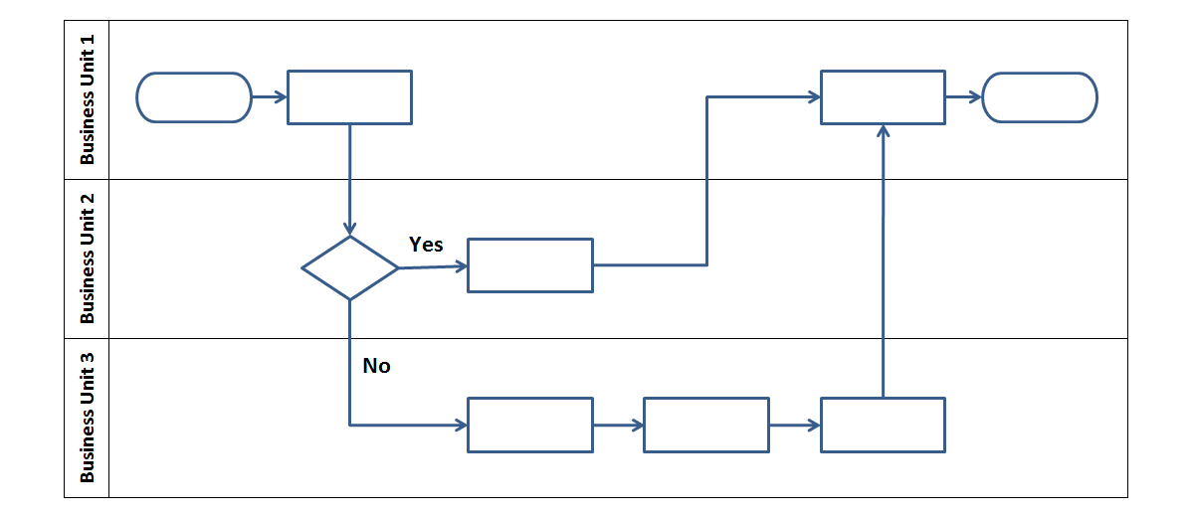
How to Plot a Process Map
Step 3:
  To illustrate the responsibility of different organizations involved in the process, use a Swim Lane Process Map.
Notes:
This is a “swim lane” diagram, or “swim lane” process map that depicts responsibilities for the process.
These diagrams can be drawn vertically or horizontally.
The swim lanes can show organizations, roles, or functions within a business.

Slide 71
How to Plot a Process Map
Step 4: Identify and record inputs/outputs and their corresponding specifications for each process step.
  The process map helps in understanding and documenting Y = f(x) of a process, where Y represents the outputs and x represents the inputs.
  The inputs of each process step can be controllable or non-controllable, standardized operational procedures, or noise.
  Inputs are the source of variation in the process and need to be analyzed qualitatively and quantitatively.
  The outputs of each process step can be products, information, services, etc. They are the little Y’s within the process.
Notes:
Step 4 is to identify and record the inputs and outputs for each process step.
Ideally, the specifications should be recorded for each step so it is clear what the inputs and outputs should look like to ensure process efficiency and quality.
Because inputs are the source of variation in a process, they need to be analyzed to understand how to monitor and control the variation.
Remember inputs are the x’s in the transfer function. Remember Y = f(x).
The outputs are the result of the process, or little y’s.

Slide 72
How to Plot a Process Map
Step 5: Evaluate the process map and adjust if needed.
  If the process is too complicated to be covered in one single process map, you may create additional detailed sub-process maps for further information.
  Number the process steps in the order of their occurrence for clarity.
Notes:
Step 5 is to evaluate and adjust the process map.
There may be some components of the process that you need to describe in more detail on a “sub-process” map or in a procedure document.
It is helpful to number the process maps for reference purposes.

Slide 73
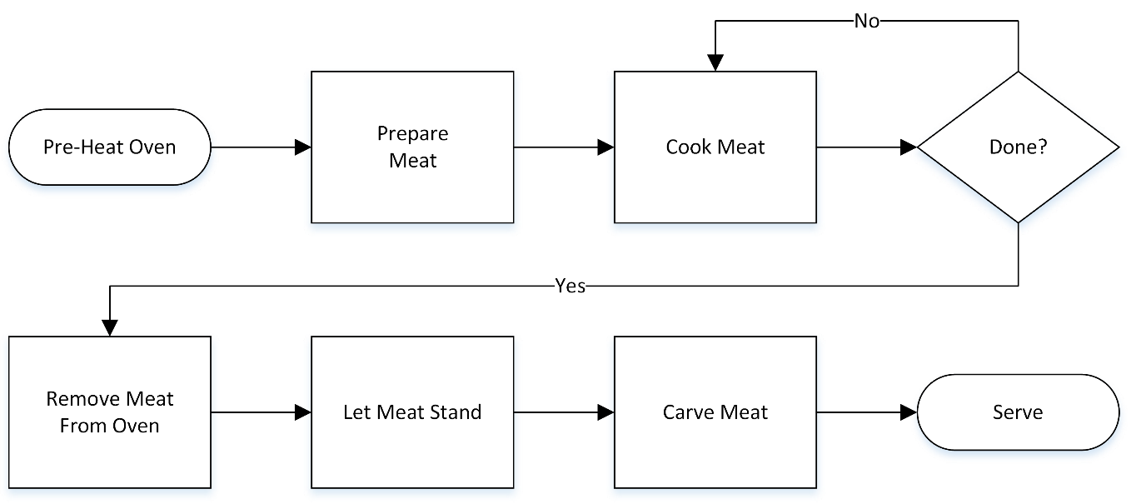
High Level Process Map
Most high-level process maps are also referred to as flow charts.
The key to a high-level process map is to over-simplify the process being depicted so that it can be understood in its most generic form.
As a general rule, high-level process maps should be no more than 4–6 steps.
Below is an oversimplified version of a high-level process map for cooking a 10lb prime rib for a dozen holiday guests.
Notes:
A high-level process map is an oversimplification of a process, meant to display it in its basic form.
This type of map helps facilitate discussion about a process, especially with senior management that may not be familiar with the details of the process.
It is also helpful in organizing work around a process by chunking it out.
Usually, a high-level process map should be no more than 4–6 steps.

Slide 74
Detailed Process Map
Detailed process maps or multi-level maps take the high-level map much further.
Detailed maps can be 2–4 levels deeper than your high-level process map.
A good guideline used to help create the second level is to take each step in the high level map and break it down into 2–4 steps (no more).
Repeat this process (level 3, level 4 etc.) until reaching the desired level of detail.
Some detailed maps are 2 or 3 levels deep, others can be 5–6 levels deep. Obviously, the deeper the levels, the more complex and the more burdensome.
Notes:
A detailed process map is exactly what is says it is – a much more detailed view of a process than a high-level process map.
Often, process maps can be depicted at many different levels, 2–4 levels deeper than the high-level map. This is usually a helpful way to index a process. So when you want to understand more about a specific part of a process later on, you can find it by starting at the high level and digging down into the process step(s) you are interested in.
Each level of the process map should break the higher level steps into two to four additional steps, until the desired level of detail is attained.
Detailed process maps can go deeper than the two to four levels mentioned earlier, but they become much more complex and burdensome to create and maintain.

Slide 75
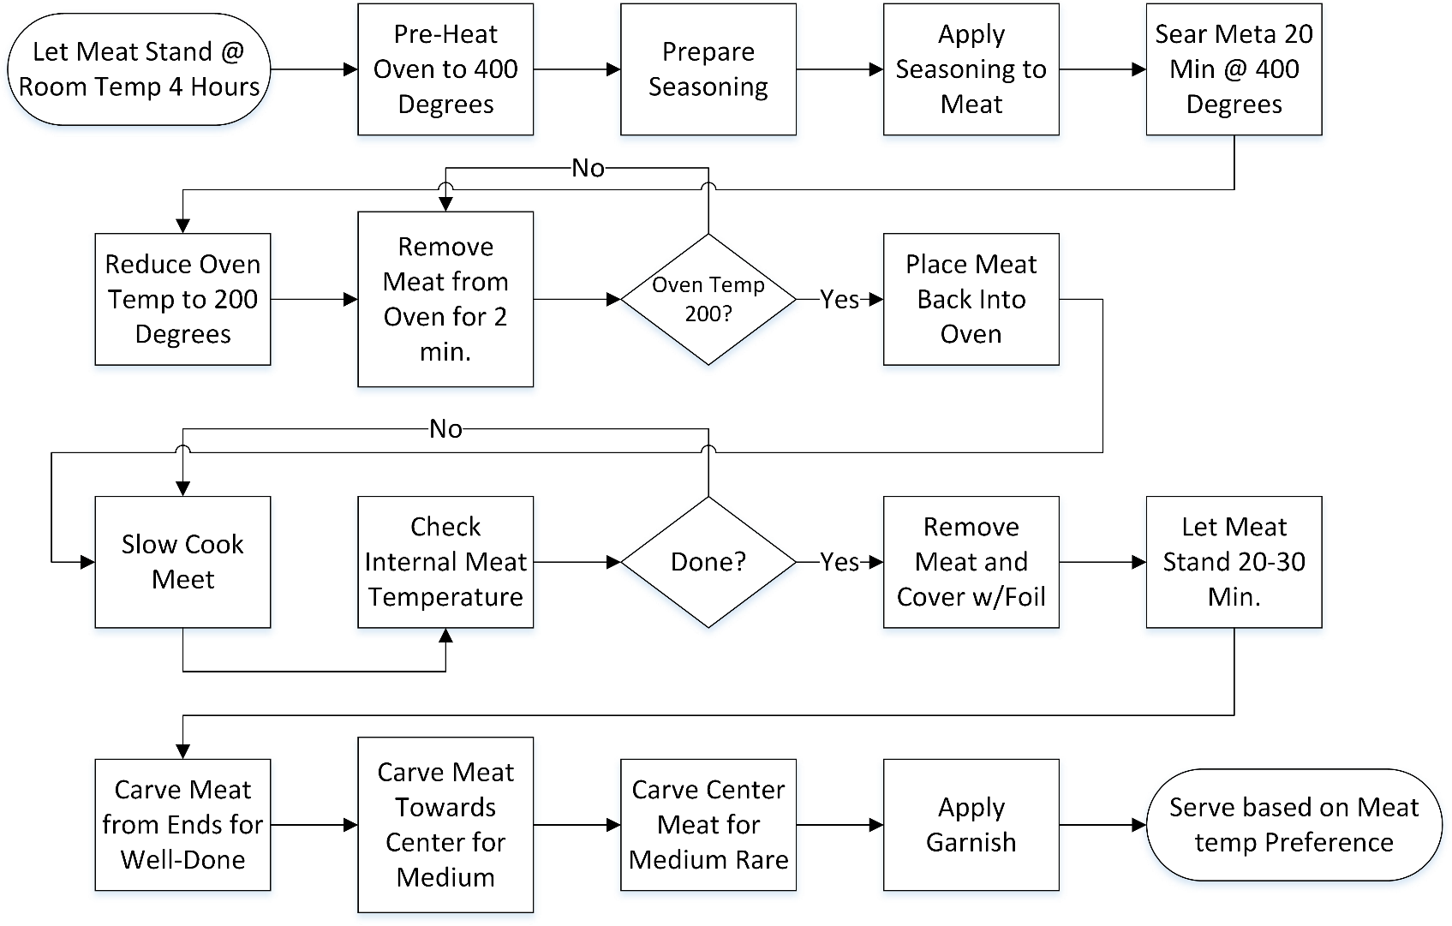
Detailed Process Map
At right is our prime rib cooking example at level 2 detail.
This process map has a few more decision points and process steps.
You can see that going only one more level deep adds a fair amount of information to the process map.
Notes:
This process map is the next level of detail of the “prime rib” example shown as a high-level process map.
You can see it went from about 5 steps to about 17 (not counting the decision boxes), adding quite a bit of detail to the process map.

Slide 76
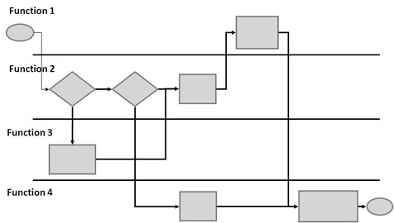
Functional Process Map
The functional map adds dimension to the high-level or detailed map.
The dimension added is identifying which function or job performs the step or makes the decision.
Below is a generic example of a functional map. Note that functions are identified in horizontal lanes and each process step is placed in the appropriate lane based on which function performs the step.
Notes:
The functional process map brings an additional dimension of information to a high-level or detailed process map.
This map conveys which function, role, job performs the step in a process or makes a decision.
The process step or decision is placed in the appropriate lane based on which function performs it.

Slide 77
1.2.2 VOC and CTQs

Slide 78

Voice of the Customer
VOC stands for “Voice of the Customer.”
Voice of the customer is a term used for a data-driven plan to discover customer wants and needs.
VOC is an important component to a successful Six Sigma project.
There are also other “Voices” that need to be heard when conducting projects. The 3 primary forms are:
  VOC: Voice of the Customer
  VOB: Voice of the Business
  VOA: Voice of the Associate.
Notes:
VOC is an acronym that means “voice of the customer,” and the term refers to data or information collected from the customers to understand what they want or need.
It is always important to understand the VOC when designing and improving any Six Sigma process.
There are other types of “Voices” that are important as well:
Voice of the Business (VOB) – what does the business require of a process?
Voice of the Associate (VOA) or Voice of the Employee – what does the employee require of a process (e.g., safety, simplicity)?

Slide 79

Gathering VOC
Gathering VOC should be performed methodically.
The two most popular methods of collecting VOC are
  Indirect
  Direct.
1. Indirect data collection for VOC involves passive information exchange:
  Warranty claims
  Customer complaints/compliments
  Service calls
  Sales reports.
2. Indirect methods are less effective, sometimes dated, require heavy interpretation, and are also more difficult to confirm.
Notes:
There are several ways to collect VOC, but they can be broken down into two main collection methods: indirect and direct.
Indirect collection of VOC involves passive information exchange, meaning the VOC was not expressly collected for the purposes of the project, but was gathered through byproducts of the process.
Warranty claims, customer complaints, and service calls are effective ways to understand how the customer feels about a product or service.
Since the data was not collected to understand VOC specific to a business or process problem, it is more difficult to sort through and interpret the information that is relevant.

Slide 80

Gathering VOC
Direct data collection methods for VOC are active and planned customer engagements:
  Conducting interviews
  Conducting customer surveys
  Conducting market research
  Hosting focus groups.
Direct methods are typically more effective for several reasons:
  Less need to interpret meaning
  Researchers can go a little deeper when interacting with customers
  Customers are aware of their participation and will respond better upon follow-up
  Researchers can properly plan engagements (questions, sample size, information collection techniques etc.).
Notes:
Direct VOC collection methods are carefully planned, active engagement around the customer to solicit specific information.
Customer interviews, surveys, focus groups, and market research are common methods of direct VOC collection.
There is less interpretation needed for this kind of VOC, and in interactive forms of VOC collection (e.g., focus groups or interviews) there is an opportunity to go deeper into a topic or take a direction that might not have been expected or planned.
There are professional organizations that can perform customer data collection on behalf of a company. They commonly plan carefully by designing the questions, determining the sample size, and consider what technique is most appropriate.
If there is a need to get very specific customer feedback, a survey is appropriate.
However, if the need is more exploratory, interviews or focus groups are more appropriate.

Slide 81
Gathering VOC
Gathering VOC requires consideration of many factors such as product or services types, customer segments, manufacturing methods or facilities etc.
All this information will influence the sampling strategy.
Consider which factors are important and build a sample size plan around them.
Also, consider response rates and adjust the initial sample strategy to ensure adequate input is received.
Once a sampling plan is in place, collect data via the direct and indirect methods discussed earlier.
After gathering VOC it will be necessary to translate it into something meaningful: CTQs.
Notes:
One must consider different factors to ensure the right, representative data is collected:
Product/service types
Customer segments
Manufacturing methods.
The factors above are important because they might indicate different customer needs across customer segments, or perhaps the customers’ feedback may differ by product type or manufacturing method.
Once the VOC has been collected, it must be translated into CTQs (Critical To Quality).

Slide 82

Critical to Quality: CTQ
CTQ stands for Critical to Quality.
CTQs are translated from VOC or
“voice of the customer” feedback.
VOC is often vague, emotional, or simply
a generalization about products or services.
CTQs are the quantifiable, measureable, and meaningful translations of VOC.
Organizing VOC helps to identify CTQs.
One effective way to organize VOC is to group or bucket it using an affinity diagram.
Affinity diagrams are ideal for large amounts of soft data resulting from brainstorming sessions or surveys.
Notes:
CTQs are generated from the voice of the customer (VOC).
Because VOC is usually vague and emotional, it is important to translate it into something that is applicable to a process.
CTQs are quantifiable, measureable, and meaningful.
To create CTQs, the VOC must be organized first into like groupings. An affinity diagram is a useful tool to do this.

Slide 83
Affinity Diagram: Building a CTQ Tree
Steps for conducting an Affinity Diagram exercise:
  Step 1: Clearly define the question or focus of the exercise (“Why are associates late for work?”).
  Step 2: Record all participant responses on note cards or sticky notes (this is the sloppy part, record everything!).
  Step 3: Lay out all note cards or post the sticky notes onto a wall.
  Step 4: Look for and identify common themes.
  Step 5: Begin moving the note cards or sticky notes into the themes until all responses are allocated.
  Step 6: Re-evaluate and make adjustments.
Notes:
This is an outline of building an affinity diagram (or CTQ tree); it is typically done with a group of people.
The group must agree on what question they are trying to answer, or what the focus is for the VOC.
All of the individual VOC responses are recorded on note cards or sticky notes. (Sticky notes are an easier way to do it).
Lay out all the VOC either on a table or a wall so they can all be seen.
Look for common themes across the VOC.
Move cards around so they are grouped by the common themes.
Re-evaluate and make adjustments.
It is good to do this in a group because people bring different perspectives and might understand and organize VOC differently than a single person would.

Slide 84
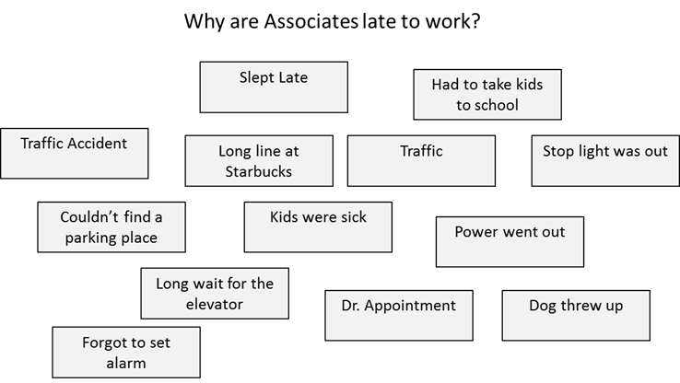
Affinity Diagram: Building a CTQ Tree
Define the question or focus
Record responses on note cards or sticky notes
Display all note cards or sticky notes on a wall if necessary.
Notes:
In this example, the focus question is “Why are associates late to work?”
You can see all of the responses randomly distributed across the page.

Slide 85
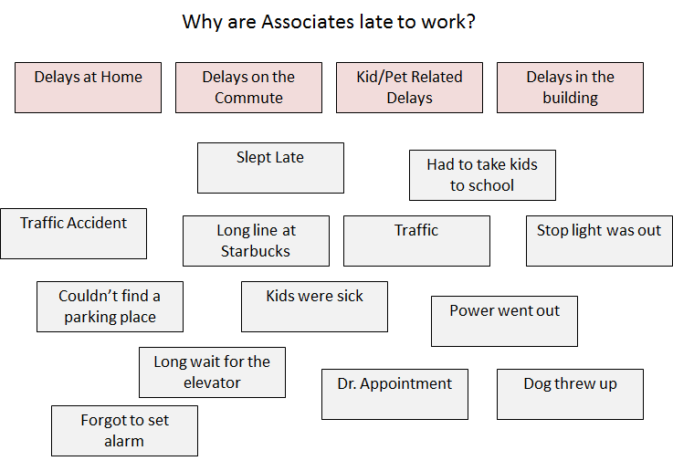
Affinity Diagram: Building a CTQ Tree
Look for and identify common themes within the responses.
Notes:
Now you see that some common themes are identified (delays at home, delays on the commute, kids/pet related delays, or delays in the building).

Slide 86
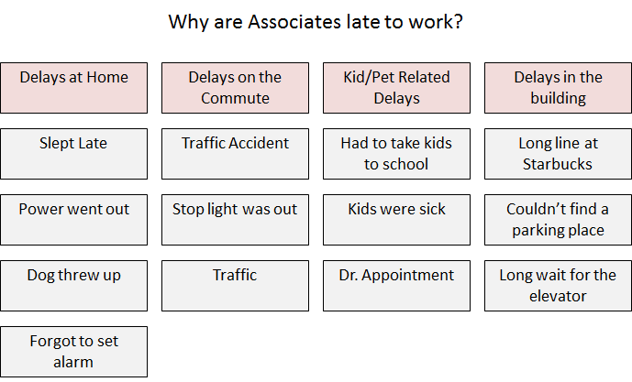
Affinity Diagram: Building a CTQ Tree
Group note cards or sticky notes into themes until all responses are allocated.
Re-evaluate and make final adjustments.
Notes:
Now you can see that the individual responses are lined up under each theme. See any that might be misplaced? How about “dog threw up?”
Perhaps “Delays at Home” and “Kid/Pet-Related Delays” do not need to be broken down separately.
These are the kinds of things to consider when evaluating and adjusting.

Slide 87
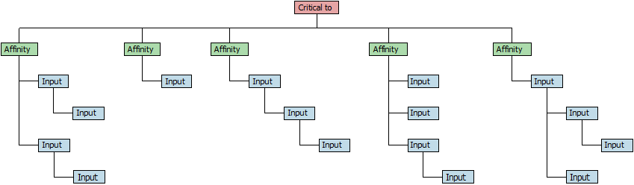
CTQ Tree
Example of a generic CTQ tree transposed from a white board to a software package.
Notes:
This slide illustrates how the CTQ tree might translate to a software package that would allow one to capture and display it electronically.

Slide 88
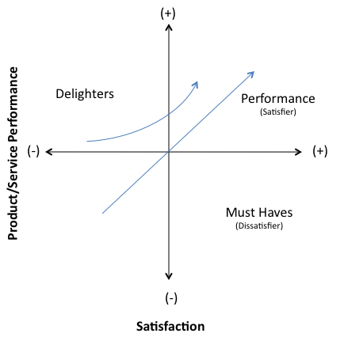
Kano
Another VOC categorization technique is the Kano.
The Kano model was developed by Noriaki Kano in the 1980s.
The Kano model is a graphic tool that further categorizes VOC and CTQs into 3
distinct groups:
  Must Haves
  Performance Attributes
  Delighters.
The Kano helps to identify CTQs that add incremental value vs. those that are simply requirements and having more is not necessarily better.
Notes:
In the 1980s, Noriaki Kano developed a VOC categorization technique.
It classifies the VOC/CTQs into three groups: must haves, performance attributes, and delighters.
It is important to understand what CTQs are non-negotiable (must haves). These attributes are taken for granted when they are fulfilled, but result in dissatisfaction when they are not fulfilled. The curve for a must have will drop in satisfaction as you move to left where the need is not fulfilled, but flattens out at a neutral satisfaction level as you move to the right.
A delighter is the opposite of the must have – if it is not fulfilled, the customer will not be dissatisfied, but as it is fulfilled, the customer’s satisfaction increases. These are things the customer did not realize they want or need, until they have experienced them. Eventually, delighters will become expected, turning them into performance attributes or must haves.
Examples:
How would you classify the steering wheel in a car?
Low prices at a discount store?
What about the touch screen on an iPhone (think back to when it came out)?
A performance attribute (or one-dimensional attribute) will increase satisfaction level as the need is fulfilled, and will decrease satisfaction when it is not fulfilled.

Slide 89

Validating VOC and CTQs
After determining all CTQs,
confirm them with the customer.
Confirming can be accomplished
by conducting surveys through one
or more of the following methods:
  Group sessions
  One-on-one meetings
  Phone interviews
  Electronic means (chat, email, social media etc.)
  Physical mail.
Consider your confirming audience and try to avoid factors that may influence or bias responses such as inconvenience or overly burdensome time commitments.
Notes:
Once the process of collecting VOC is complete, and CTQs have been determined, the next step is to validate what has been developed.
Many of the methods through which VOC is collected also serve well for confirming the VOC, such as through group sessions, one-on-one interviews in person or over the phone.
It is important that thought is put into what audience is used to confirm the VOC, ensuring that there is not a potential to bias the results. For example, an overly extensive customer survey might end up getting a rushed response and therefore may not represent the true views of an audience.

Slide 90
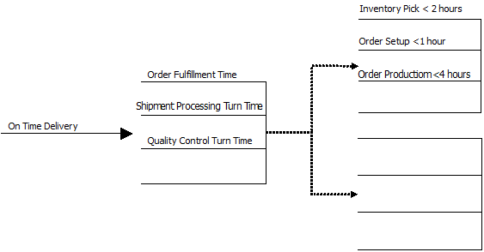
Translating CTQs to Requirements
Lastly, CTQs must be transformed into specifics that can be built upon in a process.
A requirements tree translates CTQs to meaningful and measureable requirements for production processes and products.
Notes:
To be able to incorporate a CTQ into the design of a process, the next step is to translate CTQs to process requirements.
In this example, the VOC is probably something like, “Deliver my product when you say you’re going to deliver it,” which obviously can be measured by “on-time delivery.”
One must then consider what aspects of the process contribute to the time that elapses between when the customer places an order and when it is delivered.
The order has to be fulfilled, and the shipment processed and inspected by quality control.
The process then can be assigned specifications for what maximum turn time is required to ensure the process is completed and the order is delivered on time.

Slide 91
1.2.3 Quality Function Deployment

Slide 92
History of QFD
Developed by Shigeru Mizuno (1910–1989) and Yoji Akao (b. 1928) in Japan. Quality Function Deployment (QFD) aims to design products that assure customer satisfaction and value – the first time and every time.
The QFD framework can be used for translating actual customer statements and needs (“The voice of the customer”) into actions and designs to build and deliver a quality product.
Notes:
QFD (Quality Function Deployment) is a concept that was derived in 1972 from the TQM practices of a Japanese company, Mitsubishi Heavy Industries Ltd. QFD is considered a valuable tool fundamental to a business’ success, hence it is widely applied.

Slide 93
What is QFD?
Quality Function Deployment (QFD) is a construction methodology and quantification tool used to identify and measure customer’s requirements and transform them into meaningful and measureable parameters.
QFD helps to prioritize actions to advance process or product to meet customer’s anticipations.
QFD is an excellent tool for contact between cross-functional groups.
Notes:
Quality Function Deployment is a design planning process driven by customer requirements. QFD uses planning matrices – it is also called “The House of Quality.”

Slide 94
Purpose of QFD
The quality function deployment has many purposes. Among the most important are:
  Market analysis to establish needs and expectations
  Examination of competitors’ abilities
  Identification of key factors for success
  Translation of key factors into product and process characteristics.
Notes:
QFD focuses on customer requirements, prioritizes resources, and uses competitive information effectively.

Slide 95
Phases of QFD
Four Key Phases of QFD
  Phase I: Product Planning Including the “House of Quality” (Requirements Engineering Life Cycle)
  Phase II: Product Design (Design Life Cycles)
  Phase III: Process Planning (Implementation Life Cycle)
  Phase IV: Process Control (Testing Life Cycle)

Slide 96
How to build a House of Quality
Determine Customer Requirements (What’s from VOC/CTQ)
Technical Specifications/Design Requirements (How’s)
Develop Relationship Matrix (What’s and How’s)
Prioritize Customer Requirements
Conduct Competitive Assessments
Develop Interrelationship (How’s)
Prioritize Design Requirements

Slide 97
House of Quality
Correlation Matrix [How’s vs. How’s]
Technical Specifications
[How’s]
Why’s
Customer Requirements
[What’s]
Relationship Matrix
[What’s vs. How’s]
Customer Importance Rating
Customer Market Evaluation
[What’s vs. Why’s]
How Much’s
Degree of Technical Difficulty
Overall Importance Ratings
Technical Competitive Evaluations
Target Goals
Notes:
This is the structure of a House of Quality. You can see that is contains the following elements (sometimes referred to a rooms):
Customer Requirements or the “What’s” derived from VOC and CTQs
Technical specifications or Design Requirements (the “How’s”)
Relationship Matrix (the Roof or “What’s” and “How’s”)
Prioritized Customer Requirements
Competitive Assessment
Interrelationships or Correlation Matrix (the “How’s”)
Prioritized Design Requirements

Slide 98
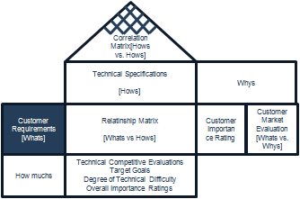
Step 1: Determine Customer Requirements
Identify the important customer requirements. These are the “What’s” and are typically determined through the VOC/CTQ process.
Use the results from your requirements tree diagram as inputs for the customer requirements in your HOQ.
On-Time Delivery
Increase Product Quality
Alternative Solutions
Customer Requirements
Reduce Turn-Around Time
Optimize Resource
Reduce COPQ
High Productivity
Notes:
Customers drive the development of the product, not the designers. Hence is it necessary to determine what are the important customer requirements.
Customers will provide the requirements in their own language; you will need to categorize the requirements based on importance. General customer requirements are:
human factors
physical requirements
reliability
life-cycle concerns
manufacturing requirements.

Slide 99
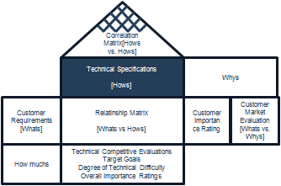
Step 2: Technical Specification
Potential choices for product features
Voice of Designers or Engineers
Each “What” item must be refined to “How’s”
Technical Specification
Resource
Development
Design and Development
Asset Management
Supply and Distribution
Material Management
Research and
Development
Customer Support
Notes:
The goal is to develop a set of technical specifications from the customer’s requirements.
Designers and engineers then take the customer requirements and determine technical parameters that need to be designed into the product or process.

Slide 100
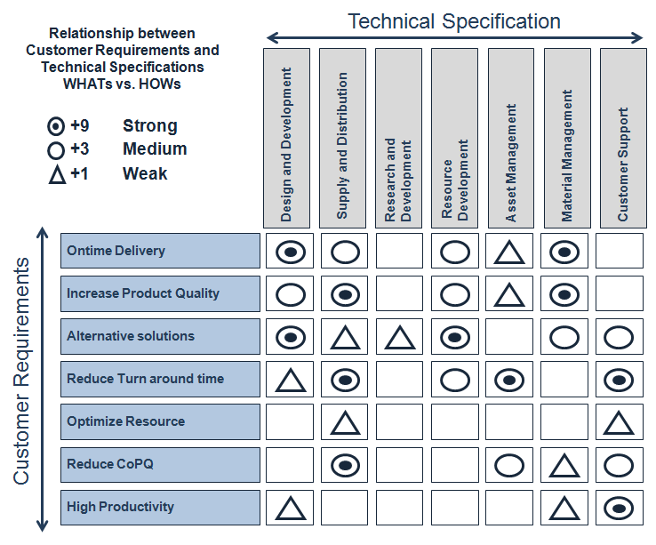
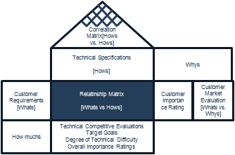
Step 3: Develop Relationship Matrix (What’s & How’s)
This is the center portion of the house. Each cell represents how each technical specification relates to each customer requirement.
Notes:
The relationship matrix represents the strength of the relationship between each technical specification and each customer requirement.
Use symbolic notations for depicting strong, medium, and weak relationships. A weight of 1-3-9 can be used.

Slide 101
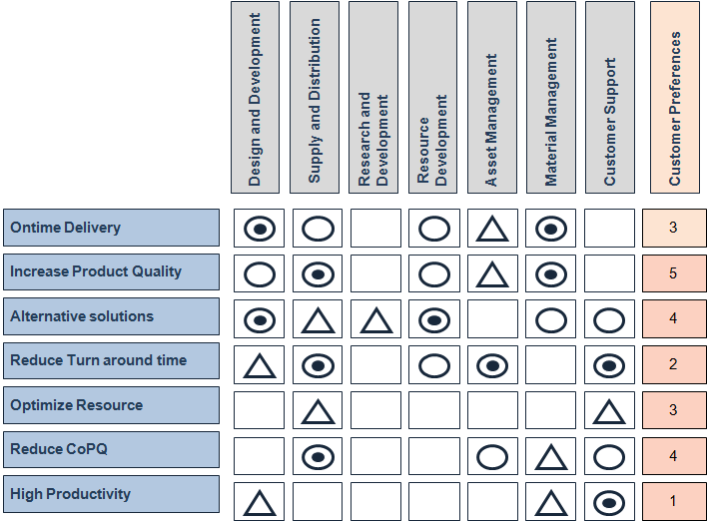
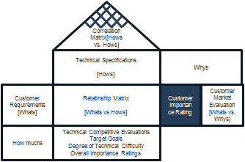
Step 4: Prioritize Customer Requirements
This is the right portion of the house. Each cell represents customer requirements based on relative importance to customers and perceptions of competitive performance.
Notes:
Prioritize the customer requirements based on importance rating, target value, scale-up factor, sales point.

Slide 102
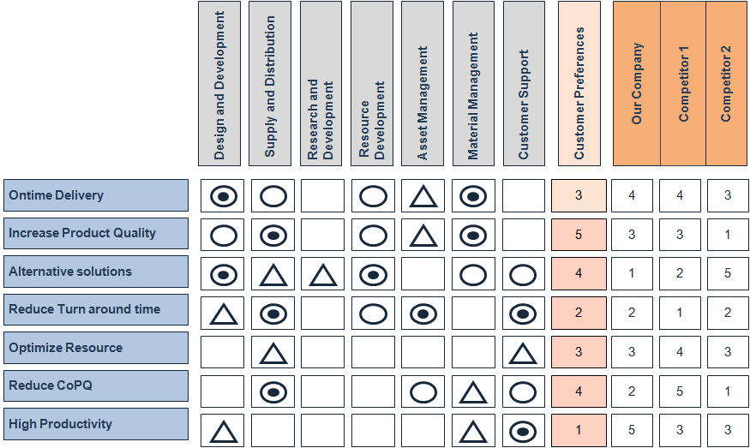
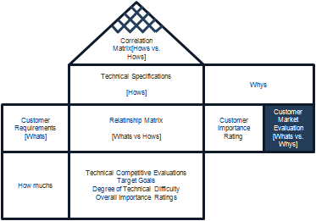
Step 5: Competitive Assessments
This is the extreme right portion of the house. Comparison of the organization’s product to competitors’ products.
Notes:
Use the competitive assessment as an opportunity to compare your product/process requirements and specifications with your competitors’ products/process.
The customer can be used to estimate 1–5 ratings on all products/processes.

Slide 103
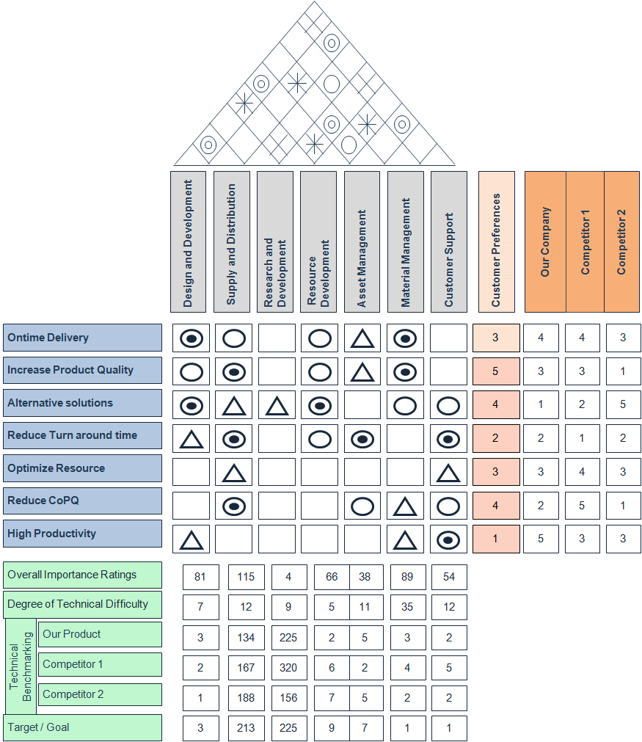
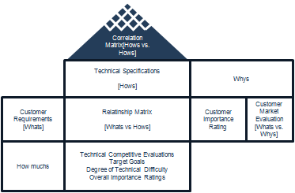
Step 6: Correlation Matrix
This is the top portion of the house. It identifies the way “how” items either support (positive) or conflict (negative) with one another.
+9
Strong Positive
+3
Positive
-3
Negative
-9
Strong Negative
Notes:
The purpose of the correlation matrix is to identify any inconsistency within the design or technical specifications.

Slide 104
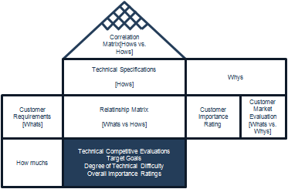
Step 7: Prioritize Design Requirements
Overall Importance Ratings
Function of relationship ratings and customer prioritization ratings
Technical Difficulty Assessment
Similar to customer market competitive evaluations but conducted by the technical team

Slide 105
Step 7: Prioritize Design Requirements
Technical Specification Competitive Evaluation
Helps to establish the feasibility and realization of each “how” item
Target Goals
How much is good enough to satisfy the customer
Notes:
Technical specification competitive evaluation will be done by technical teams.
Generally, 1 to 5 ratings will be used. They should be clearly stated in a measurable way.

Slide 106
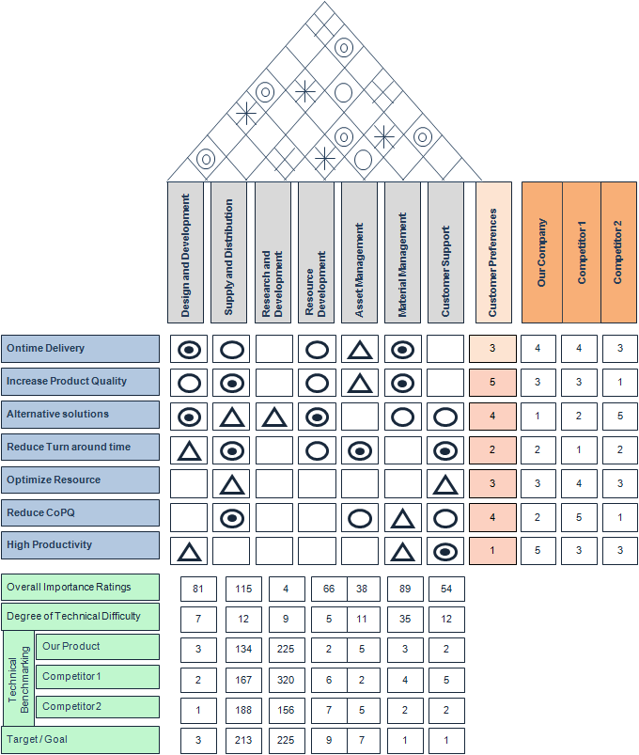
House of Quality
6
2
1
3
4
5
7
Notes:
Let us review:
Customer Requirements
Technical Specifications
Relationship Matrix
Prioritized Customer Requirements
Competitive Assessment
Correlation Matrix
Prioritized Design Requirements

Slide 107
Pros of QFD
Focuses the design of the product or process on satisfying customer’s needs and wants.
Improves the contact channels between customers, advertising, research and improvement, quality and production departments, which sustains better decision making.
Reduces the new product development project period and cost.

Slide 108
Cons of QFD
The relationship matrix can be too obscure with many process inputs and/or many customer constraints.
It can be very complicated and difficult to implement without experience.
If throughout the process new ideas, specifications, or requirements are not discovered, you run the risk of losing team members’ trust in the process.

Slide 109
QFD Summary
When used properly, the quality function deployment is an extremely valuable approach to product/process design.
There are many benefits of QFD that can only be realized when each step of the process is completed thoroughly:
  Logical way of obtaining information and presenting it
  Smallest product development cycle
  Considerably condensed start-up costs
  Fewer engineering alterations
  Reduced chance of supervision during design process
  Collaborating environment
  Preserving everything in characters.

Slide 110
1.2.4 Cost of Poor Quality

Slide 111

Cost of Poor Quality
        Cost of Poor Quality (COPQ) is the expense incurred due to waste, inefficiencies, and defects.
The COPQ has been proven to range from 5% to 30% of gross sales for most companies.
The COPQ can be staggering when considering process inefficiencies, hidden factories, defective products, rework, scrap, etc.
Understanding COPQ and where to look for it will help uncover process inefficiencies, defects, and hidden factories within your business.
Notes:
Cost of Poor Quality (or COPQ) is exactly what it sounds like. It is the cost absorbed when a process operates at anything less than optimal: the cost of waste, resource inefficiency, and defects (e.g., repairs, rework, service calls, scrap, warranty claims, and write-offs).
Experts have estimated COPQ to be 5%–30% of gross sales for most companies. Consider a company that does ~$100 million in sales per week, and has a COPQ of 20%. That means that 1 day out of a 5-day work week is completely devoted to producing scrap!
A thorough understanding of this concept can help uncover lots of opportunities. Consider for instance the hidden factories – do you have procedures for rework, or work-arounds? They might seem “hidden” at first, because they have come to be accepted as the normal process for doing things.
There are many different types of non-value added activities that can drive waste. (Discussed on the next slide.)

Slide 112
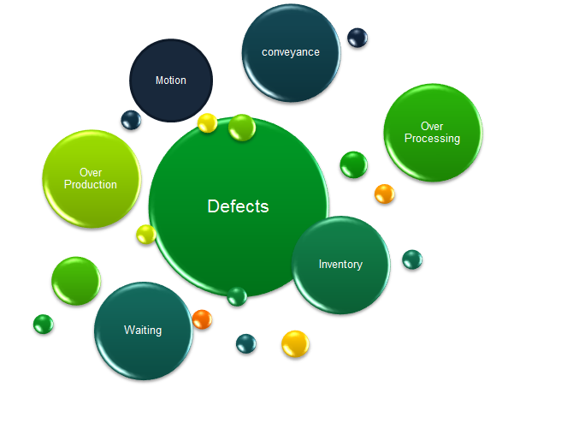
Cost of Poor Quality
There are 7 common forms of waste that are often referred to as the “7 deadly muda.”
Technically, there are more than 7 forms of waste but if you can remember these you will capture over 90% of your waste.
  Defects
  Overproduction
  Over-Processing
  Inventory
  Motion
  Transportation
  Waiting
Notes:
Muda is a Japanese word meaning “futility, uselessness, idleness, superfluity, waste, wastage, wastefulness.”
The “7 deadly muda,” as defined by Taiicho Ohno (the Toyota Production System), are:
Defects
Overproduction – producing more than what your customers are demanding.
Over-processing – unnecessary time spent (e.g., relying on inspections instead of designing a process to eliminate problems)
Inventory – things awaiting further processing or consumption
Motion – extra, unnecessary movement of employees
Transportation – unnecessary movement of goods
Waiting – for an upstream process to delivery, for a machine to finish processing, or for an interrupted worker to get back to work.

Slide 113
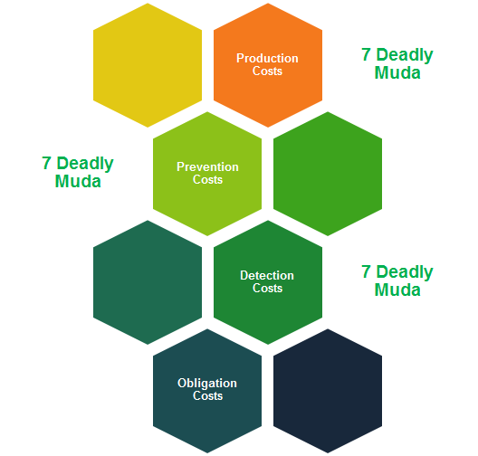
Cost of Poor Quality
The “7 deadly muda” are very important to understand. They are the best way to identify the COPQ.
The presence of any muda causes many other forms of inefficiencies and hidden factories to manifest themselves.
There are four key categories of costs related to muda:
    Costs Related to Production
    Costs Related to Prevention
    Costs Related to Detection
    Costs Related to Obligation
Notes:
As mentioned previously, the seven wastes (or “deadly muda”) are important to understand because they help identify where costs of poor quality exist.
The next few slides will lay how to determine the cost of poor quality related to the seven muda.

Slide 114
COPQ: Costs Related to Production
Costs related to production are the direct costs of the presence of muda. These forms of COPQ are usually understood and easily observable. They are in fact the “7 deadly muda” themselves.
    Defects
    Overproduction
    Over-Processing
    Inventory
    Motion
    Transportation
    Waiting
Notes:
The costs related to production are most evident in a process and are most easily understood and estimated.
Consider:
The cost of a defect itself (i.e., the lost labor and materials)
The cost of overproduction (resources spent producing more of something than what is needed, along with the material cost). This is producing “just-in-case” instead of “just-in-time.” This creates excessive lead times, results in high storage costs, and makes it difficult to detect defects. Over-producing hides problems in production and takes a lot of courage to produce only what is needed (which will uncover where the issues are)
The cost of over-processing (resources spent inspecting and fixing instead of getting right the first time)
The cost of inventory (work in process on the floor is a symptom of over-processing and waiting)
The cost of motion (unnecessary time spent by employees to perform the process; consider motion like bending, stretching, walking, lifting, and reaching)
The cost of transportation (adds no value to the product and even increases risk of damage). This can be a hard cost to overcome if facilities are built in a way that requires transportation from one process to another.
The cost of waiting (usually because material flow is poor, production runs are too long, and distances between work centers are too long).

Slide 115
COPQ: Costs Related to Prevention
Costs related to the prevention of muda are those associated with trying to reduce or eliminate any of the “7 deadly muda.”
  Costs for error proofing methods or devices
  Costs for process improvement and quality programs
  Costs for training and certifications
  etc.
Any costs directly associated with the prevention of waste and defects should be included in the COPQ calculation.
Notes:
The costs related to prevention are those incurred trying to reduce or eliminate any of the 7 deadly muda before they occur.
Consider the cost of any action taken to reduce defects, make process improvements, error-proof processes or devices, implement a quality program, conduct training, and obtain certifications.

Slide 116
COPQ: Costs Related to Detection
Costs related to the detection of muda are those associated with trying to find or observe any of the “7 deadly muda.”
  Costs for sampling
  Costs for quality control check points
  Costs for inspection costs
  Costs for cycle counts or inventory accuracy inspections
  etc.
Any costs directly associated with the detection of waste and defects should be included in the COPQ calculation.
Notes:
The costs of detection are those spent trying to find or observe any of the 7 deadly muda after they occur.
Detection is not as effective as prevention, but sometimes is the only option. It can keep additional costs from being incurred, like continuing to process a defective unit.
Examples include costs of sampling and monitoring, costs of inspecting, costs of inventory checks.

Slide 117
COPQ: Costs Related to Obligation
Costs related to obligation are those associated with addressing the muda that reaches a customer.
  Repair costs
  Warranty costs
  Replacement costs
  Customer returns and customer service overhead
  etc.
Any costs directly associated with customer obligations should be included in the COPQ calculation.
Notes:
The costs related to obligation are those things associated with addressing the muda that reach the customer.
The cost of repair or replacement, the cost of returns, and the cost of handling customer service calls are examples.

Slide 118
COPQ: Types of Cost
There are two types of costs to be considered when determining COPQ
  Hard Costs
    Tangible costs that can be traced to the income statement
  Soft Costs
    Intangible costs: avoidance, opportunity costs, lost revenue etc.
Calculating the COPQ
  Determine the types of waste that are present in your process
  Estimate the frequency of waste that occurs
  Estimate the cost per event, item, or time frame
  Do the math.
Notes:
When determining the costs of poor quality, one must consider both hard costs and soft costs.
Hard costs – costs of resources or materials are good examples
Soft costs
cost avoidance (the difference between what is actually spent and what could have been spent had no action been taken; think of this as slowing the rate of cost increases)
opportunity cost (value of lost time that could have been used producing something of value
To estimate the cost of poor quality, there are a few basics steps:
Find the waste
Estimate how often the waste occurs
Estimate the cost per event, per item, or per time frame (whichever is appropriate)
Multiply the costs.

Slide 119
1.2.5 Pareto Charts and Analysis

Slide 120
Pareto Principle
The Pareto principle is commonly known as the “law of the vital few” or “80:20 rule.”
It means that the majority (approximately 80%) of effects come from a few (approximately 20%) of the causes.
This principle was first introduced in early 1900s and has been applied as a rule of thumb in various areas.
Example of applying the Pareto principle:
  80% of the defects of a process come from 20% of the causes.
  80% of sales come from 20% of customers.
Notes:
The Pareto principle is known as the “law of the vital few” or sometimes referred to as the “80:20 rule.”
It is a very powerful tool for scoping process improvement efforts because it tells us what the “few” causes are that drive the majority of the effects (or in many cases defects).
The “few” meaning approximately 20% of the causes, and the majority meaning 80% of the “effects.”
Business-management consultant Joseph M. Juran suggested the principle and named it after Italian economist Vilfredo Pareto, who observed in 1906 that 80% of the land in Italy was owned by 20% of the population; he developed the principle by observing that 20% of the pea pods in his garden contained 80% of the peas.

Slide 121
Pareto Principle
The Pareto principle helps us to focus on the vital few items that have the most significant impact.
In concept, it also helps us to prioritize potential improvement efforts.
Since this 80:20 rule was originally based upon the works of Wilfried Fritz Pareto (or Vilfredo Pareto), the Pareto principle and references to it should be capitalized because Pareto refers to a person (proper noun).
  Mr. Pareto is also credited for many works associated with the 80:20, some more loosely than others:
    Pareto’s Law
    Pareto efficiency
    Pareto distribution etc.
Notes:
Again, the Pareto principle is a powerful tool for narrowing focus, scoping a project, and prioritizing our efforts. It tells us what the vital few items are that have the most significant impact.
Because the rule was named after Wilfried Pareto, we always refer to it as a proper noun, and capitalize the term Pareto.
There are other references to Pareto’s works, so you may hear of people refer to it as Pareto’s Law, Pareto’s efficiency, and Pareto distribution.

Slide 122
Pareto Charts
A Pareto chart is a chart of descending bars with an ascending cumulative line on the top.
  Sum or Count:
The descending bars on a Pareto chart may be set on a scale that represents the total of all bars or relative to the biggest bucket, depending on the software you are using.
  Percent to Total: A Pareto chart shows the percentage to the total for individual bars.
  Cumulative Percentage: A Pareto chart also shows the cumulative percentage of each additional bar. The data points of all cumulative percentages are connected into an ascending line on the top of all bars.
Notes:
So what is a Pareto chart:
It is a chart of descending bars that typically represent a count of effects grouped by the cause.
It also includes a line that represents a cumulative percentage of the total effects for each cause.
Not all software packages display Pareto charts the same way. Some show the percent of total for each individual bar, and others show the cumulative percentage as mentioned previously.

Slide 123
Pareto Charts
Case study time!
  Next we will use Minitab to run Pareto charts on exactly the same data set.
  Open the Minitab data file labeled Pareto and follow the instructions over the next few pages to run Pareto charts in Minitab.
Notes:
Now we will use a sample data set to create a Pareto chart using your software program.
The first step is to input this data set into your program, and follow instructions over the next few pages.

Slide 124
Create a Pareto Chart in Minitab
Steps to generate a Pareto chart using Minitab:
    Open the spreadsheet with the count data for individual categories.
    Click on Stat → Quality Tools → Pareto Chart.
    A new window with the title “Pareto Chart” pops up.
    Select “Category” into the box “Defects or attribute data in” and “Count” into the box “Frequency in.”
    Click “OK.”
    The Pareto chart is created in a newly-generated window.
Notes:
To create in Minitab, follow the steps listed on this page.

Slide 125
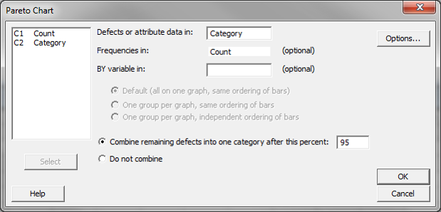
Create a Pareto Chart in Minitab
Notes:
Here is a pictorial version of the instructions on the previous page.

Slide 126
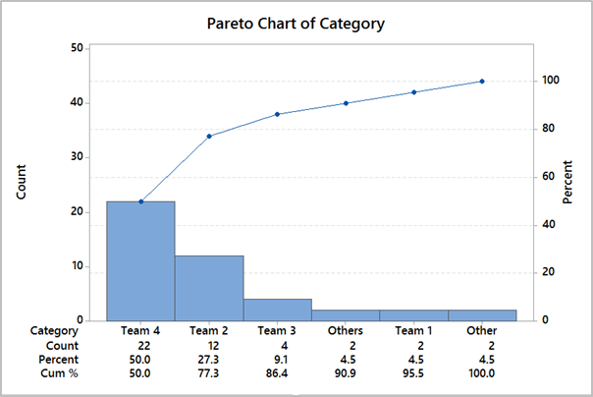
Create a Pareto Chart in Minitab
The above Pareto chart generated in Minitab presents the count of defective products by team.
The bars are descending on a scale with the peak at 50, which is approximately the total count of all defective products for all teams.
The table below the chart contains counts, individual percentages, and cumulative percentages.
The cumulative percentages are the red data points driving the red line that spans across the graphic.
Notes:
In this example, we were looking to determine how many defective products (effects) were created by each team (cause).
As you can see, Minitab sorted the data in decreasing order, the team with the most defective products on the left.
The total number of defects is 44, and you can see that the cumulative percentage (red line) shows what each team, cumulatively, is contributing as a percentage of the total number of defects.

Slide 127
Pareto Analysis
The Pareto analysis is used to identify the root causes by using multiple Pareto charts.
In Pareto analysis, we drill down into the bigger buckets of defects and identify the root causes of defects that contribute heavily to total defects.
This "drill down" approach effectively solves a significant portion of the problem.
Next you will see an example of three-level Pareto analysis.
  The second-level Pareto is a Pareto chart that is a subset of the tallest bar on the first Pareto.
  The third-level Pareto is a subset of the tallest bar of the second-level Pareto.
Notes:
The Pareto analysis is the process of using multiple Pareto charts to identify root causes of defects.
In this analysis we drill down by creating secondary or second-level Pareto charts for the tallest bars on the primary or first-level Pareto chart.
The following example will illustrate Pareto analysis taken to three levels.

Slide 128
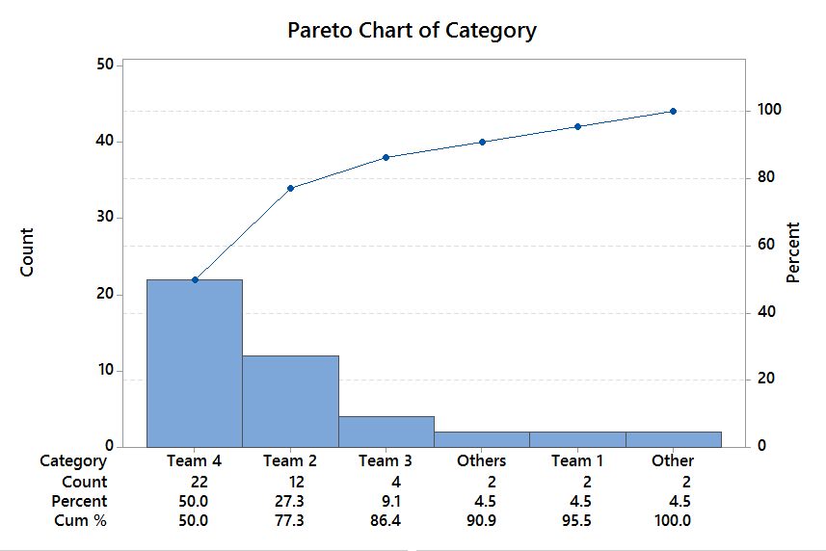
Pareto Analysis: First Level
First-level Pareto
Shows the count of defective items by team
Next level will only show the defective items of team 4
Notes:
In this first level Pareto, you can see that Team 4 accounts for 50% of the total number of defects.
In the second level Pareto, you will see how Team 4 defects are accounted for.

Slide 129
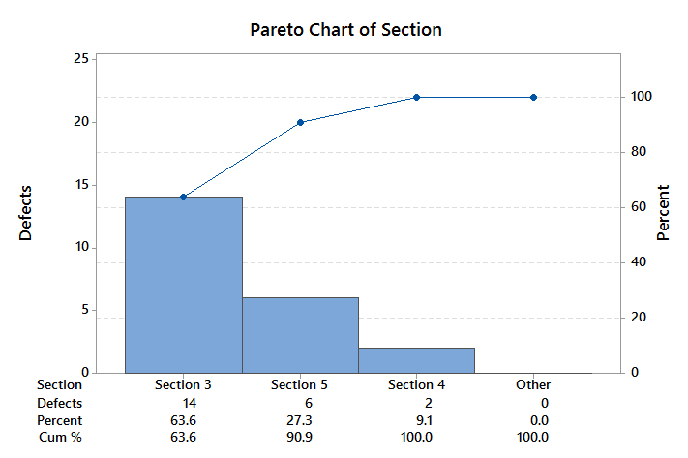
Pareto Analysis: Second Level
Second-level Pareto
Shows the count of the defective items by section for only team 4
Next level will only show the defective items of section 3
Notes:
This Pareto breaks down by sections only the 22 defects of Team 4.
Section 3 of Team 4 is accounting for 14 (or 64%) of all Team 4’s defects.
In the third level Pareto you will see the breakdown of those 14 defects.

Slide 130
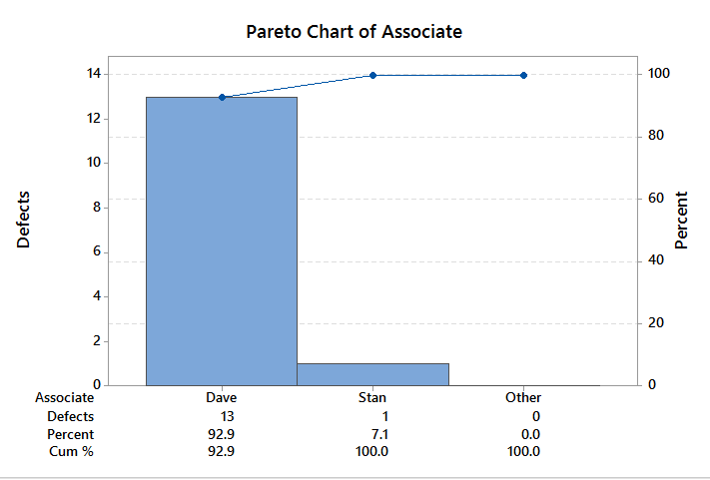
Pareto Analysis: Third Level
Third-level Pareto
Shows the count of defective items by associate for only section 3 of team 4
Next level will only show the defective items of Dave
Notes:
13 of the 14 defects in Section 3 of Team 4 are accounted for by 1 person – Dave.
Now instead of focusing on all teams to reduce the number of defects, we can focus on a single individual who is contributing with 13 defects out of a total of 44 (30%).

Slide 131
Pareto Analysis: Conclusion
After drilling down three levels we find that most of the defective products are from Dave who is in Section 3 of Team 4.
Determining what Dave might be doing differently and solving that problem can potentially fix about 30% of the entire defective products (13/44).
Notes:
In conclusion, this type of analysis significantly narrowed the focus for reducing defective products.
By focusing on what Dave is doing (or not doing), the defect rate could be improved by as much as 30%.

Slide 132
1.3 Six Sigma Projects

Slide 133
Yellow Belt Training: Define Phase
1.1 Six Sigma Overview
1.1.1 What is Six Sigma
1.1.2 Six Sigma History
1.1.3 Six Sigma Approach Y = f(x)
1.1.4 Six Sigma Methodology
1.1.5 Roles and Responsibilities
1.2 Six Sigma Fundamentals
1.2.1 Defining a Process
1.2.2 VOC and CTQs
1.2.3 QFD
1.2.4 Cost of Poor Quality (COPQ)
1.2.5 Pareto Analysis (80:20 rule)
1.3 Lean Six Sigma Projects
1.3.1 Six Sigma Metrics
1.3.2 Business Case and Charter
1.3.3 Project Team Selection
1.3.4 Project Risk Management
1.3.5 Project Planning
1.4 Lean Fundamentals
1.4.1 Lean and Six Sigma
1.4.2 History of Lean
1.4.3 The Seven Deadly Muda
1.4.4 Five-S (5S)

Slide 134
1.3.1 Six Sigma Metrics

Slide 135
Six Sigma Metrics
There are many Six Sigma metrics and/or measures of performance used by Six Sigma practitioners.
In addition to the ones we will cover here, several others (Sigma level, Cp, Cpk, Pp, Ppk, takt time, cycle time, utilization etc.) will be covered in other modules throughout this training.
The Six Sigma metrics of interest here in the define phase are:
    Defects per Unit (DPU)
    Defects per Million Opportunities (DPMO)
    Yield (Y)
    Rolled Throughput Yield (RTY).
Notes:
In this module, we will seek to cover many performance metrics that are commonly used by Six Sigma practitioners.
It is important to identify the right Six Sigma metric that is appropriate for a business situation, so that it helps tell a good story about the problem faced.

Slide 136
Defects per Unit: DPU
DPU stands for “Defects per Unit“
DPU is the basis for calculating DPMO and RTY, which we will cover in the next few pages.
DPU is found by dividing total defects by total units.
    DPU = D/U
For example, if you have a process step that produces an average of 65 defects for every 598 units, then your DPU = 65/598 = 0.109.
Notes:
The calculation is simple: the defects per unit are the total number of defects divided by the total number of units.

Slide 137
DPMO: Defects per Million Opportunities
DPMO is one of the few important Six Sigma metrics that you should get comfortable with if you are associated with Six Sigma.
In order to understand DPMO it is best if you first understand both the nomenclature and the nuances such as the difference between defect and defective.
Nomenclature
    Defects = D
    Unit = U
    Opportunity to have a defect = O
Notes:
DPMO (Defects per Million Opportunities) is one of the most important Six Sigma metrics. It is commonly referred to in context of a Six Sigma process. Remember 3.4 defects per million opportunities?
Take note of the following abbreviations: D = defect, U = unit, O = opportunity.

Slide 138
DPMO: Defects per Million Opportunities
In order to properly discuss DPMO, we must first explore the differences between "defects" and "defective."
  Defective
    Defective suggests that the value or function of the entire unit or product has been compromised.
    Defective items will always have at least one defect. Typically, however, it takes multiple defects and/or critical defects to cause an item to be defective.
  Defect
    A defect is an error, mistake, flaw, fault, or some type of imperfection that reduces the value of a product or unit.
    A single defect may or may not render the product or unit "defective" depending on the specifications of the customer.
  Summary
    Defect means that part of a unit is bad.
    Defective means that the whole unit is bad.
Notes:
To correctly leverage the DPMO metric, it is important to understand the difference between a “defect” and something that is “defective.”
Defective suggests that a unit has been compromised in some way. It has at least 1 defect, but typically has multiple defects or critical defects to cause an item to be defective.
A defect is a single error, mistake, flaw, or any other type of imperfection that reduces the value of a product or unit. A single defect may not render the product or unit defective, depending on how it impacts the functionality for the customer (or customer specifications).
So to differentiate between terms, a defect means that part of a unit is bad, and defective means the whole unit is bad.

Slide 139
DPMO: Defects per Million Opportunities
Now let us turn our attention to defining "opportunities" so that we can fully understand Defects per Million Opportunities (DPMO).
  Opportunities
    Opportunities are the total number of possible defects.
    Therefore, if a unit has 6 possible defects, then each unit produced is equal to 6 defect opportunities.
    If we produce 100 units, then there are 600 defect opportunities.
Notes:
Every possible defect is considered an “opportunity.” If a unit has 6 possible defects, then it has 6 opportunities. 100 units have 600 opportunities (100 units × 6 opportunities/unit).

Slide 140
DPMO: Defects per Million Opportunities
Calculating Defects per Million Opportunities
The equation is DPMO = (D/(U × O)) × 1,000,000
Example: Let us assume:
    There are 6 defect opportunities per unit
    There are an average of 4 defects every 100 units.
  Opportunities = 6 × 100 = 600
  Defect rate = 4/600
  DPMO = 4/600 × 1,000,000 = 6,667
Notes:
This is how to calculate DPMO.
Using the given information (6 opportunities per unit, and an average of 4 defects per 100 unites)
Total opportunities = 6 defect opportunities per unit × 100 units = 600 defect opportunities
Defect rate = 4 defects/600 defect opportunities
DPMO = 6,667 defects per million opportunities

Slide 141
DPMO: Defects per Million Opportunities
What is the reason or significance of 1,000,000?
Converting defect rates to a per million value becomes necessary when the performance of your process approaches Six Sigma.
When this happens, the number of defects shrinks to virtually nothing. In fact, if you recall from the “What is Six Sigma” module, sigma is 3.4 defects per million opportunities.
By using 1,000,000 opportunities as the barometer we have the resolution in the measurement to count defects all the way up to Six Sigma.
Notes:
So why is the “million” in “defects per million” opportunities significant?
Because when a process approaches Six Sigma performance, the number of defects becomes immeasurable across smaller populations. At Six Sigma it is only 3.4 defects per million.
We need the million to have enough resolution to count the defects.

Slide 142
RTY: Rolled Throughput Yield
Rolled Throughput Yield (RTY) is a process performance measure that provides insight into the cumulative effects of an entire process.
RTY measures the yield for each of several process steps and provides the probability that a unit will come through that process defect-free.
RTY allows us to expose the "hidden factory" by providing visibility into the yield of each process step.
This helps us identify the poorest performing process steps and gives us clues into where to look to find the most impactful process improvement opportunities.
Notes:
Rolled Throughput Yield is a measure for the cumulative quality across an entire process.
It measures the yield for each step in a process to determine the probability that a unit will make it through the entire process without a defect.
It can help uncover where we have waste in a process, helping to scope process improvement efforts.

Slide 143

RTY: Rolled Throughput Yield
Calculating RTY:
RTY is found by multiplying the yields of each process step.
Let us take the 5-step process below and calculate the RTY using the multiplication method mentioned above.
The calculation is: RTY = 0.90 × 0.91 × 0.99 × 0.98 × 0.97 = 0.77
Therefore, RTY = 77%.
Notes:
In this example you can see how RTY is calculated.
The yield (or percent of units that get through without a defect) is shown for each step in this 5-step process.
To calculate the RTY, multiply the yield for all 5 steps. In this example 77% of units get through all 5 process steps without a defect.

Slide 144
RTY: Rolled Throughput Yield
You may have noticed that in order to calculate RTY we must determine the yield for each process step.
Before we get into calculating yield, there are a few abbreviations that need to be declared.
  Abbreviations
    Defects = D
    Unit = U
    Defects per Unit = DPU
    Yield = Y
    e = 2.71828 (mathematical constant)
Notes:
In the previous example, the yield for each step was provided. Obviously, one must be able to calculate yield to get to RTY.
Here are a few key terms/abbreviations that are important when calculating yield.

Slide 145

RTY: Rolled Throughput Yield
Calculating Yield
The Yield of a process step is the success rate of that step or the probability that the process step produces no defects.
In order to calculate the yield, we need to know the DPU and then we can apply it to the yield equation below.
Example
  Let us assume a process step has a DPU of 0.109 (65/598)
  Yield = 2.718 ^ -0.109 = 0.8967. Rounded, Yield = 90%.
$$Yield=e^{−dpu}$$
Notes:
Yield is the success rate for a process step, or probability that it will not produce a defect.
To calculate the yield, use the equation on this slide.
In this example, the DPU (defects per unit) is 0.109 (65 defects/598 units).
Plugging the DPU, and using the mathematical constant for e (2.718), the result is 0.8967, or 90% when rounded.

Slide 146

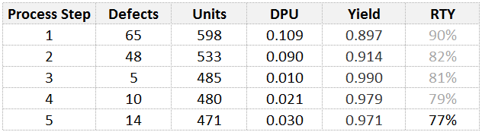
RTY: Rolled Throughput Yield
Below is a table using the above process yield data that we used in the earlier RTY calculation.
This table allows us to see the DPU and yield of each step as well as the RTY for the whole process.
Notes:
This slide allows us to see a visual, in tabular form, that shows the inputs when calculating DPU and yield for each process step.
On the right of the table you can see the RTY variation through the process steps.
Which steps seem to be opportunities? Notice the yield in steps 1 and 2.

Slide 147
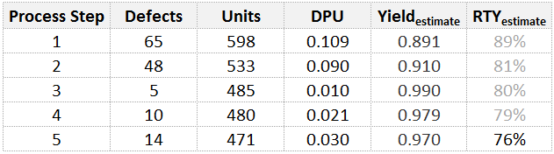
RTY: Using an Estimate of Yield
Calculating RTY using Yield estimation
  It is possible to “estimate” yield by taking the inverse of DPU or simply subtracting DPU from 1.
  Yield Estimation = 1 − DPU
    Example Yield Estimate for process step 1: 1 − 0.10870 = 0.90
  RTY using the Yield Estimation Method
    RTY = 0.891 × 0.91 × 0.99 × 0.979 × 0.97 = 0.76 = 76%
NOTE: This method assumes max DPU is 1. Although this is not technically true, in practice its extremely rare to find processes with DPU greater than 1. If it is the case this method will not work.
Notes:
Instead of using the equation provided earlier, there is a quick and easy way to estimate yield.
Assuming maximum DPU is 1*, so to get a yield percent just subtract DPU from 1.
As you can see, by calculating the yield this way we get nearly the same result for the RTY (76%) calculated earlier (which was 77%).

Slide 148
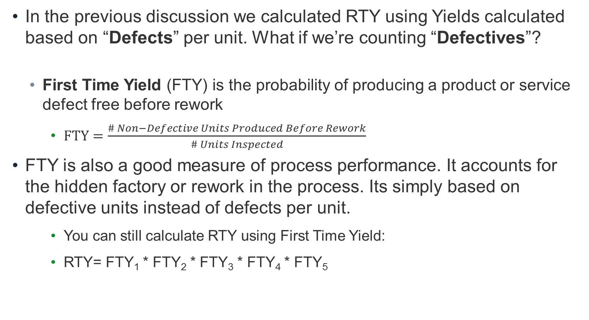
RTY: Using First Time Yield (FTY)
In the previous discussion we calculated RTY using Yields calculated based on “Defects” per unit. What if we’re counting “Defectives”?
  First Time Yield (FTY) is the probability of producing a product or service defect free before rework
    $FTY=\frac{\# Non−Defective Units Produced Before Rework}{\# Units Inspected}$
FTY is also a good measure of process performance. It accounts for the hidden factory or rework in the process. Its simply based on defective units instead of defects per unit.
    You can still calculate RTY using First Time Yield:
    RTY= FTY₁ * FTY₂ * FTY₃ * FTY₄ * FTY₅
Notes:
In the case that you’re counting defectives rather than defects, we can use First Time Yield (FTY) as our yield value in our RTY calculation. FTY is the count of “non-defective” (e.g. good units) produced by the process divided by the total number of units going into the process (assuming no rework). So if your process step had 100 units go in and 87 good units come out then your FTY for that step is 87/100 or 87%.

Slide 149
1.3.2 Business Case and Charter

Slide 150
Business Case and Project Charter
Earlier we stated that DMAIC is a structured and rigorous methodology designed to be repeatedly applied to any process in order to achieve Six Sigma.
We also stated that DMAIC was a methodology that refers to 5 phases of a project.
  Define, Measure, Analyze, Improve, and Control
Given that the premise of the DMAIC methodology is project-based, we must take the necessary steps to define and initiate a project, hence the need for. . .
  Project Charters
Notes:
A recap from our overview of Six Sigma. DMAIC is a structured, rigorous methodology that can be applied to any process to achieve Six Sigma.
DMAIC consists of 5 phases: Define, Measure, Analyze, Improve, Control.
The first step in any DMAIC project, beginning in the define phase of course, is to create a project charter. It is what sets direction for a project.

Slide 151
Project Charter
The purpose of a project charter is to provide vital information about a project in a quick and easy-to-comprehend manner.
Project charters are used to get approval and buy-in for projects and initiatives as well as declaring:
  The scope of work
  Project teams
  Decision authorities
  Project lead
  Success measures
Notes:
A project charter is important because it provides information that is core to a project. It is a contract of sorts between project champions, sponsors, stakeholders, and the project team. It is a quick reference to tell the story of what, why, who, when, etc.
To set the right direction for a project, it is critical to define certain guardrails to ensure the project stays on track and is successful. Examples are:
The scope of work, or boundaries within which the project will operate
The team that will execute the project and who will lead them
Who the decision makers are
What are the measures of success.

Slide 152
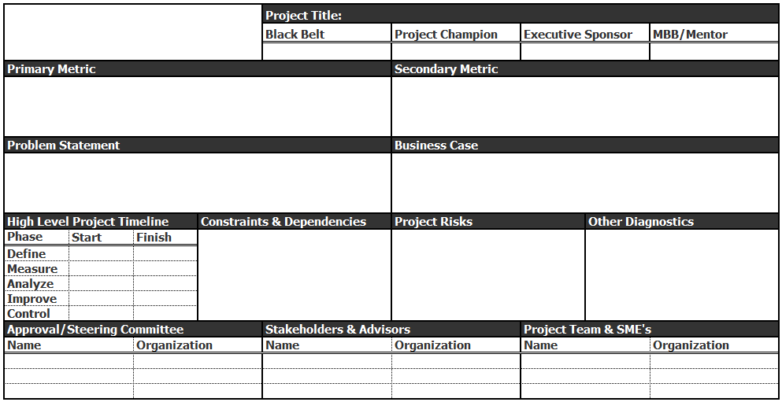
Project Charter Template
Notes:
Here you can see a blank canvas of a project charter template. Next we explore the key components.

Slide 153
Project Charter Key Elements
Project title, leader and sponsor are critical components. Identifying a lead helps keep order and accountability. Without a sponsor and approval there is no project
The primary metric is vital to understanding how you are measuring project success as well as being able to establish a baseline and goal.
The secondary metric is a measure that help keep a project honest. Sometimes you’ll find improvement of a metric to the detriment of another. The secondary metrics helps bring visibility to this.
The problem statement is a concrete factual statement declaring the projects baseline, goal, gap to goal and gap closure. It should also be explicit about timing.
The business case describes why this project is important to the business.
Be clear about the project timeline.
Identify constraints and project dependencies.
Identify project risks that the sponsor should be aware of.
Identify any other relevant project measures.
All formal project require approvals.
Identify people who have a vested interest in the project’s success.
Declare project team members and subject matter experts.
Notes:
Here you can see an example of a project charter in the background and discussion points that highlight all the key elements of a project charter. A good project charter is very clear, definitive, concise. It’s best to keep it in a one-page layout. It will be easy to share, easy to read, and is useful for quickly communicating to people who may not be familiar with the project.

Slide 154
Project Charter: Key Elements
Title
  Projects should have a name, title, or some reference that identifies them.
  Branding can be an important ingredient in the success of a project so be sure your project has a reference name or title.
Leader
  Any projects needs a declared leader or someone who is responsible for project’s execution and success.
  You may hear references to RACI throughout in your Six Sigma journey.
  RACI stands for Responsible, Accountable, Consulted, Informed and identifies the people that play those roles.
  Every project must have declared leaders indicating who is responsible and who is accountable.
Notes:
A title may seem like an insignificant piece of the charter, but do not underestimate the power of branding. This is how your project will be known to others, and keeping it top of mind is obviously part of ensuring its success.
The project leader is responsible, and ultimately accountable, for the execution and success of the project.

Slide 155
Project Charter: Key Elements
Business Case
  A business case is the quantifiable reason why the project is important.
  Business cases help shed light on problems. They explain why a business should care.
  Business cases must be quantified and stated succinctly.
  COPQ is a key method of quantification for any business case.
Notes:
A business case clearly articulates why it is necessary to do the project and what is the benefit to the customer, to employees, or to the shareholders.
A problem by itself is not enough to articulate why a project needs to be done. The business case turns the problem into the reason a business should care: what is the cost of the problem, what is the impact to customers, or what is the lost revenue opportunity?
It is important for the business case to be quantifiable. Stakeholders have to know what success looks like.
Cost of poor quality, as described earlier, is a great approach to quantifying the business case.

Slide 156
Project Charter: Key Elements
Problem Statement and Objective
  A properly written problem statement has an objective statement woven into it.
  There should be no question as to the current state or the goal.
  A gap should be declared, the gap being the difference between the present state and the goal state.
  The project objective should be to close the gap or reduce the gap by some reasonable amount.
  Valuation or COPQ is the monetary value assigned to the gap.
  Lastly, a well-written problem statement refers to a timeline expected to be met.
Notes:
A well-written problem statement includes all of the following:
Declaration of the current state of a problem in terms of a given measure
A goal for the measure, which establishes a gap from the current state
An objective that states how much of the gap the project aims to close
The monetary value of the objective (cost of poor quality)
Finally, a timeline that the project will meet.

Slide 157
Project Charter: Problem Statement Examples
Currently, process defect rates are 17% with a goal of 2%. This represents a gap of 15%, costing the business $7.4 million dollars. The goal of this project is to reduce this gap by 50% before Nov 2010 putting process defect rates at 9.5% and saving $3.7MM.
Process cycle time has averaged 64 minutes since Q1 2009. However, production requirements put the cycle time goals at 48 min. This 16-min gap is estimated to cost the business $296,000. The goal of this project is reduce cycle time by 16 min. by Q4 2010 and capture all $296,000 cost savings.
Notes:
Here are a couple of example problem statements.
Can you identify the key elements of a problem statement?

Slide 158
Project Charter: Key Elements
Metrics
  A measure of success is an absolute for any project.
  Metrics give clarity to the purpose of the work.
  Metrics establish how the initiative will be judged.
  Metrics establish a baseline or “starting point.”
  For Six Sigma projects…metrics are mandatory!
Notes:
How does one know if a project does what it sets out to do?
It is critical that every project chooses the right metrics to determine success.
The metrics are the center point for the work to ensure that the direction and decisions made through the course of the project are based on data.
The metrics are what stakeholders will judge the success of the project on.

Slide 159
Project Charter: Key Elements
Primary Metric
  The primary metric is a generic term for a Six Sigma project's most important measure of success. The primary metric is defined by the Black Belt, GB, MBB, or Champion.
  A primary metric is an absolute MUST for any project and it should not be taken lightly. Here are a few characteristics of good primary metrics.
  Primary metrics should be:
    tied to the problem statement
    measureable
    expressed with an equation
    aligned to business objectives
    tracked at the proper frequency (hourly, daily, weekly, monthly etc.)
    expressed pictorially over time with a run chart, time series, or control chart
    validated with an MSA.
Notes:
A project can have many metrics, but the primary metric is the most important.
Choosing the primary metric should not be taken lightly. A Six Sigma expert should play a significant role in determining the primary metric to ensure it meets the characteristics of a good one.
The primary metric should be tied to the problem to ensure that what is being measured is a direct indication of whether the problem is being solved or not.
Obviously, the primary metric should be measureable, otherwise it is of no use.
It should be expressible as an equation, meaning that the primary metric, Y, can be expressed as a function of the x’s.
The Y’s should be aligned to business objectives, meaning that the primary metric should be correlated to business results.
The primary metrics should be tracked at the proper frequency; in other words, they should be something that can be tracked frequently enough so that action can be taken quickly when the metric changes.
The primary metrics should always be expressed pictorially over time with a line chart (a run chart, time series, or control chart for example)
And, of course, it is important to validate that the measurement system is reliable.

Slide 160
Project Charter: Key Elements
The primary metric is the reason for your work.
It is the success indicator.
It is your beacon.
The primary metric is of utmost importance and should be improved, but not at the expense of your secondary metric.
Notes:
Do not trade one problem for another. Solutions need to be balanced. Be sure that you do not create an issue somewhere else when you implement a solution to improve your primary metric. That is why secondary metrics are important.

Slide 161
Project Charter: Key Elements
Secondary Metric
  The secondary metric is the thing you do not want sacrificed on behalf of a primary improvement.
  A secondary metric is one that makes sure problems are not just "changing forms" or "moving around."
  The secondary metric keeps us honest and ensures we are not sacrificing too much for our primary metric.
  If your primary metric is a cost or speed metric, then your secondary metric should probably be some quality measure.
    Example: If you were accountable for saving energy in an office building and your primary metric was energy consumption then you could shut off all the lights and the HVAC system and save tons of energy. . .except that your secondary metrics are probably comfort and functionality of the work environment.
Notes:
When you think about your primary metric, think about the really easy and obvious ways to improve the primary metric. Chances are that you can easily improve it by sacrificing something else.

Slide 162
Project Charter: Key Elements
Elements of a Good Project Charters (continued)
  Scope Statement – defined by high-level process map
  Stakeholders Identified – who is affected by the project
  Approval Authorities Identified – who makes the final call
  Review Committees Defined – who is on the review team
  Risks and Dependencies Highlighted – identify risks and critical path items
  Project Team Declared – declare team members
  Project Timeline Estimated – set high-level timeline expectations.

Slide 163
1.3.3 Project Team Selection

Slide 164
Project Team Selection
Six Sigma project team selection is the cornerstone of a successful Six Sigma project.
Teams and Team Success
  A team is a group of people who share complementary skills and experience.
  A team will be dedicated to consistent objectives.
  Winning teams share similar and coordinated goals.
  Teams often execute common methods or approaches.
  Team members hold each other accountable for achieving shared goals.
Notes:
Team selection is obviously not something that is unique to a Six Sigma project. Team selection is important in any kind of project. You want to choose a group of people that complement each other, share similar goals and objectives, and are not afraid to hold each other accountable for achieving the project’s objectives.

Slide 165

Project Team Selection
What makes a team successful?
  Shared goals
  Commitment
  Leadership
  Respect
  Effective communication
  Autonomy
  Diversity (capabilities, knowledge, skills, experience etc.)
  Adequate resources.
Notes:
There should not be any surprises about what makes a team successful. These characteristics are all important for a team to be successful.

Slide 166
Project Team Selection
Keys to Team Success
  Agreed focus on the goal or the problem at hand
    Focus on problems that have meaning to the business
    Focus on solvable problems within the scope of influence; a successful team does not seek unattainable solutions.
  Team Selection
    Selected teammates have proper skills and knowledge
    Adequately engaged management
    Appropriate support and guidance from their direct leader
  Successful teams use reliable methods
    Follow the prescribed DMAIC methodology
    Manage data, information, and statistical evidence
  Successful teams always have exceeds players
    Winning teams typically
      Have unusually high standards.
      Have greater expectations of themselves and each other.
      Do not settle for average or even above average results.
Notes:
Teams should be able to agree on what the focus is. The team members all need to understand how the problem translates to something meaningful for the business. They also should be realistic about what they can and should seek to accomplish.
The people that are selected need to have “skin in the game.” Not only do they need to be knowledgeable and have the needed skills, but they (and their management) need to be motivated to seek the solution.
The team should use the facts and data to lead the way. Be disciplined to follow the DMAIC approach and be aware of when a gut feeling or emotion is driving their behavior.
Of course teams should be built from the top performers whenever possible.

Slide 167
Project Team Selection
Principles of Team Selection:
  Select team members based on
    Skills required to achieve the objective
    Experience (Subject Matter Expertise)
    Availability and willingness to participate
    Team size (usually 4–8 members)
        Don’t go at it alone!
        Don’t get too many cooks in the kitchen!
    Members’ ability to navigate
      The process
      The company
      The political landscape
  Be sure to consider the inputs of others
    Heed advice
    Seek guidance
Notes:
A team member should be selected based on the skills and subject matter expertise. For example, if you are focusing on a process improvement, find a top performing employee that performs the process on a regular basis.
A team member needs to have capacity to participate on a project. This is why it is important to pick people with shared goals. If they have a shared goal, it is likely that they can find the time.
The team size needs to be optimal. Include enough people to generate consensus, but not too many people because they can never reach consensus, and this can paralyze a project.
Be open minded, listen to others, be inclusive

Slide 168
Project Team Development
All teams experience the following four stages of development. It is helpful to understand these phases so that you can anticipate what your team is going to experience.
The four stages of team development process:
  Forming
  Storming
  Norming
  Performing
Teammates seek something different at each stage:
  In the forming stage they seek inclusion
  In the storming stage they seek direction and guidance
  In the norming stage they seek agreement
  In the performing stage they seek results.
Notes:
Teams do not generally develop “chemistry” overnight.
There are typically four stages to team development, which will be discussed over the following pages.

Slide 169
Project Team Development
Patterns of a team in the Forming stage:
  Roles and responsibilities are unclear
  Process and procedures are ignored
  Scope and parameter setting is loosely attempted
  Discussions are vague and frustrating
  There is a high dependence on leadership for guidance
Patterns of a team in the Storming stage:
  Attempts to skip the research and jump to solutions
  Impatience for some team members regarding lack of progress
  Arguments about decisions and actions of the team
  Team members establish their position
  Subgroups or small teams form
  Power struggles exist and resistance is present
Notes:
In the Forming stage:
People are trying to figure out where they fit in.
The team is trying to figure out where the social boundaries are with each other.
They are all trying to “get to know” each other.
In the Storming stage
After the delay of the forming stage, urgency can set in and they start to seek progress.
Team members even seek progress by sacrificing the discipline.

Slide 170
Project Team Development
Patterns of a team in the Norming stage:
  Agreement and consensus start to form
  Roles and responsibilities are accepted
  Team members’ engagement increases
  Social relationships begin to form
  The leader becomes more enabling and shares authority
Patterns of a team in the Performing stage:
  Team is directionally aware and agrees on objectives
  Team is autonomous
  Disagreements are resolved within the team
  Team forms above average expectations of performance
Notes:
In the Norming stage:
The team is settling into place and into roles with responsibilities.
Once roles are clear, engagement increases with comfort level, and the team starts to form relationships with each other.
In the Performing stage:
The team is aligned and directed.
The are autonomous in that they can resolve issues within and stay on the path to progress.
The team is united to exceed expectations of performance.

Slide 171
Project Team Development
Well-structured and energized project teams are the essential components of any successful Six Sigma project.
To have better chances of executing the project successfully, you will need to understand and effectively manage the team development process.
Notes:
Even with the most perfectly defined project, a well-structured team can be the difference between success and failure.

Slide 172
1.3.4 Project Risk Management

Slide 173

Risk
Risk is defined as a future event that can impact the task/project if it occurs.

Slide 174
What is Project Risk Management?
The main purpose of risk management is to foresee potential risks that may inhibit the project deliverables from being delivered on time, within budget, and at the appropriate level of quality, and then to mitigate these risks by creating, implementing, and monitoring contingency plans.
Risk management is concerned with identifying, assessing, and monitoring project risks before they develop into issues and impact the project.
Risk analysis helps to identify and manage potential problems that could impact key business initiatives or project goals.
Notes:
The project risk management process supports the project team in proactively managing events that could potentially impact the project.
A broad definition of project risk is an uncertainty that can have a negative or positive effect on meeting project objectives.
Positive risks are risks that result in good things happening – sometimes called opportunities.

Slide 175
Three Basic Parameters of Risk Analysis
Risk Assessment:
  The process of identifying and evaluating risks, whether in absolute or relative terms.
Risk Management:
  Project risk management is the effort of responding to risks throughout the life of a project and in the interest of meeting project goals and objectives.
Risk Communication:
  Communication plays a vital role in the risk analysis process because it leads to a good understanding of risk assessment and management decisions.
Notes:
Risk management is often overlooked in projects, but it can help improve project success by helping select good projects, determining project scope, and developing realistic estimates.
The quality of risk communication underpins the quality of the entire risk analysis process.

Slide 176

Why is Risk Analysis Necessary?
What can happen if you omit the risk analysis?
  Vulnerabilities cannot be detected
  Mitigation plans are introduced without proper justification
  Customer dissatisfaction
  Not meeting project goals
  Remake the whole system
  Huge cost and time loss

Slide 177
Project Risk Analysis Steps
The project risk analysis process consists of the following steps that evolve through the life cycle of a project.
Risk Identification:
  Identify risks and risk categories, group risks, and define ownership.
Risk Assessment:
  Evaluate and estimate the possible impacts and interactions of risks.
Response Planning:
  Define mitigation and reaction plans.
Mitigation Actions:
  Implement action plans and integrate them into the project.
Tracking and Reporting:
  Provide visibility to all risks.
Closing:
  Close the identified risk.

Slide 178

Risk Identification
The first action of risk management is the identification
of individual events that the project may encounter
during its lifecycle.
The identification step comprises:
Identify the risks
Categorize the risks
Match the identified risks to categories
Define ownership for managing the risks.
Notes:
The process of identification, matching, and assigning ownership may involve the full project team in a brainstorming exercise or a workshop. The team should be encouraged to participate in risk identification by actively reporting risks as they arise, and to make suggestions as to the controls needed to rectify the situation.

Slide 179
Risk Identification
Source of Risk:
Identification of risk sources provides a basis for systematically examining changing situations over time to uncover circumstances that impact the ability of the project to meet its objectives.
Notes:
Establishing categories for risks provides a mechanism for collecting and organizing risks as well as ensuring appropriate scrutiny and management attention for those risks that can have more serious consequences on meeting project objectives.

Slide 180
Risk Identification
Source of Risk | Description
Human Resources | The risks originated from human resources (e.g., availability, skill etc.)
Physical Resources | The risks originated from physical resources (e.g., hardware or software, availability of the required number at the right time etc.)
Technology | The risks originated from technology (e.g., development environment, new or complex technologies, performance requirements, tools etc.)
Suppliers | The risks are associated with a supplier (e.g., delays in supplies, capability of suppliers etc.)
Customer | The risks derived from the customer (e.g., unclear requirements, requirement volatility, change in project scope, delays in response etc.)
Security | The risks are associated with information security, security of personnel, security of assets, and security of intellectual property
Legal | The risks are associated with legal issues that may impact the project
Project management | The risks are associated with project management processes, organizational maturity, and ability
Notes:
These are some examples of source of risks, from those associated with human resources to those related to project management.

Slide 181
Risk Identification
Risk Parameters:
Parameters for evaluating, categorizing, and prioritizing
risks include the following:
Risk likelihood (i.e., probability of risk occurrence)
Risk consequence (i.e., impact and severity of risk occurrence)
Thresholds to trigger management activities.
Notes:
Risk parameters are used to provide common and consistent criteria for comparing the various risks to be managed and to prioritize the necessary actions required for risk mitigation planning.

Slide 182
Risk Assessment
The risk assessment consists of evaluating the range of possible impacts should the risk occur.
  Follow these steps when assessing risks:
  Define the various impacts of each risk
  Rate each impact based on a logical severity level
  Sort and evaluate risks by severity level
  Determine if any controls already exist
  Define potential mitigation actions.
Notes:
We must prioritize and act on risks in order of priority. In reality, we may be able to fix simple project risks immediately, so we must also use our common sense when prioritizing.
Prioritizing is good practice when we need to allocate resources and keep records of the process.
The project core team must review all risks to ensure the full impact of risk on a project has been identified and estimated.

Slide 183
Risk Mitigation Planning
The risk owners are responsible for planning and implementing mitigation actions with support from the project team.
All team members, inclusive of partners and suppliers, may be requested to identify and develop mitigation measures for identified risks.
The project core team members are responsible for identifying an appropriate action owner for each identified risk.
After mitigation actions are defined, the project core team will review the actions.
The risk owner must track all mitigation actions and expected completion dates.
The risk owner and the project core team members must hold all action owners accountable for the risk mitigation planning.
Notes:
Documenting the process allows us to systematically address the risk that exists in the project.
Once the process is documented, action plans can be formulated and responsibilities allocated for controls that need to be implemented to eliminate or reduce the risk of those hazards.
An action plan for each identified risk can include multiple actions involving the team members.
In case of risk occurrence, or risk triggers, the risk owner reports to the project manager and implements the response plans.

Slide 184
Risk Mitigation Action Implementation
The action implementation is the responsibility of the risk owner.
The action owners are responsible for the execution of the tasks or activities necessary to complete the mitigation action and eliminate or minimize the risk.
The risk owner or the project manager will monitor completion dates of the mitigation action implementation.

Slide 185
Risk Occurrence and Contingency Plans
Whenever any risk occurs, the project team should implement contingency plans to ensure that project deliverables can be met.
The details of each occurrence should be recorded in the risk register or other tracking tool.
The risk register or risk management plan (see next slide) will be maintained by the project manager and reviewed on a regular basis.
Notes:
The risk register is a document that contains the results of various risk management processes.
It is often displayed in a table or spreadsheet format.

Slide 186
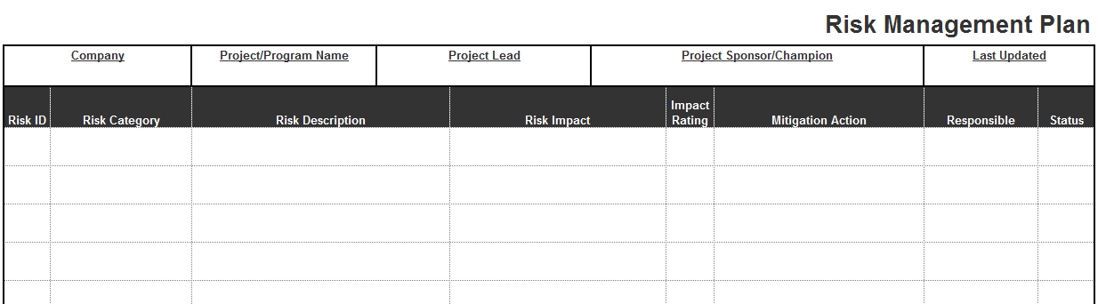
Risk Tracking and Reporting
Risk tracking and reporting provides critical visibility to all risks.
Risk owners must report on the status of their mitigation actions.
Depending on the risk severity, project managers need to report the risk status of each category of risk to senior management.
Notes:
The most efficient method to track and report risk is to do it as an integral part of project team meetings through all stages in the project lifecycle.
Risks will be reported to the senior management in the form of dashboards or through weekly status reports.

Slide 187
Risk Closure
The risk owners are responsible for recommending the risk closure to the project manager.
A risk is closed only when the item is not considered a risk to the project anymore.
When a risk is closed, the project manager needs to update the risk status in the lessons learned document.

Slide 188
Risk Analysis Features
The risk analysis should be:
Systematic
Comprehensive
Data driven
Adherent to evidence
Logically sound
Practically acceptable
Open to critique
Easy to understand.

Slide 189
Project Risk Analysis Advantages
Helps strategic and business planning
Meets customer requirements
Reduces schedule slips and cost overruns
Promotes an effective usage of resources
Promotes continuous improvement
Helps to achieve project goals
Minimizes surprises from customers and stakeholders
Allows a quick grasp of new opportunities
Enhances communication
Reassures stakeholders that the project stays on track.

Slide 190
1.3.5 Project Planning

Slide 191
What is Project Management?
Project management is the process of defining, planning, organizing, managing, leading, securing, and optimizing the resources to achieve a set of planned goals and objectives.
It is the application of knowledge, skills, tools, and techniques to project activities in order to meet project requirements.
Notes:
Project management involves understanding project needs, planning those needs, and properly allocating resources to achieve the desired results.
The basic steps of project management as we will cover in greater detail later are: initiating the project, planning the project, executing the project, and closing the project.

Slide 192
What is a Project Plan?
A project plan is a crucial step in project management for achieving a project’s goals.
A project plan is a formal approved document used to guide and execute project tasks.
It provides an overall framework for managing project tasks, schedules, and costs.
A project plan is a coordinating tool and communication device that helps teams, contractors, customers, and organizations define the crucial aspects of a project or program.
Notes:
Project planning involves defining clear, distinct tasks and deliverables, and the work needed to complete each task and phase of the project.

Slide 193
Project Planning Stages
Determine project scope and objectives: Explore opportunities, identify and prioritize needs, consider project solutions.
Plan the project: Identify input and resources requirements such as human resources, materials, software, hardware, and budgets.
Prepare the project proposal: Based on stakeholder feedback, plan the necessary resources, timeline, budget etc.
Implement the project: Implement the project by engaging responsible resources and parties. Ensure execution and compliance of the defined plans.
Evaluate the project: Regularly review progress and results. Measure the project’s effectiveness against quantifiable requirements.
Notes:
The 5 key stages of project planning are:
Determining project scope and objectives
Project planning
Project proposal and approval
Project implementation
Project evaluation.

Slide 194
Planning and Scheduling Objectives
To optimize the use of resources (both human and other resources).
To increase productivity.
To achieve desired schedules and deliverables.
To establish an approach to minimize long-term maintenance costs.
To minimize the chaos and productivity losses resulting from planned production schedules, priority changes, and non-availability of resources.
To assess current needs and future challenges.
Notes:
Proper project planning is necessary to coordinate all resources and tasks.

Slide 195
Project Planning Activities
Statement of work (SOW)
Work breakdown structure (WBS)
Resource estimation plan
Project schedule
Budget or financial plan
Communication plan
Risk management plan
Notes:
The essential high-level project activities that apply to all projects are:
statement of work, work breakdown structure, resource estimation, scheduling, budgeting, communication, and risk management.

Slide 196
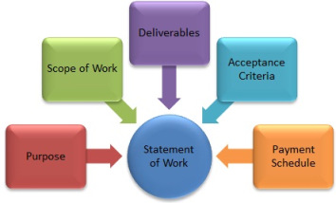
Project Planning Activities: SOW
Statement of Work (SOW) is a formal document often accompanying a contract that outlines specific expectations, limitations, resources and work guidelines intended to define the work or project.
SOW’s:
Define the scope of the project.
Establish expectations and parameters of the project.
Identify technical requirements for the project.
Provide guidance on materials to be used.
Establish timeline expectations.
Etc.
Notes:
SOWs or statements of work are important “contracts” which outline many critical elements of a project or body of work. SOWs clarify expectations, deliverables, timelines, budgets, and responsibilities.

Slide 197
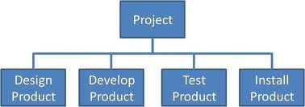
Project Planning Activities: WBS
Work Breakdown Structure (WBS) is a decomposition of project components into small and logical bodies of work or tasks.
Work Breakdown Structures:
Identify all required components of a project.
Cascades components into sub-components and tasks.
WBS’s are not by themselves project plans or schedules but they are a necessary step to help establish project plans and timelines.
WBS’s also enable logical reporting and summarizations of project progress
Notes:
A Work Breakdown Structure (WBS) is an important parameter in project planning because projects must inevitably be divided into smaller, more manageable tasks and subtasks.
These breakdowns must be aligned in a logical manner to meet customer defined target dates.
The WBS is required to prepare a project schedule and/or Gantt chart as well as to identify project milestones.

Slide 198
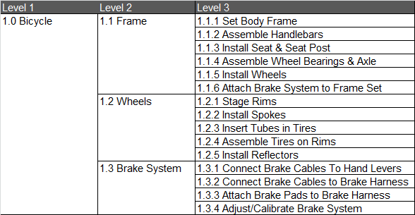
Project Planning Activities: WBS
Work Breakdown Structure Example: below is an example of a WBS for the assembly of a bicycle.
Notes:
A Work Breakdown Structure (WBS) is an important parameter in project planning because projects must inevitably be divided into smaller, more manageable tasks and subtasks.
These breakdowns must be aligned in a logical manner to meet customer defined target dates.
The WBS is required to prepare a project schedule and/or Gantt chart as well as to identify project milestones.

Slide 199
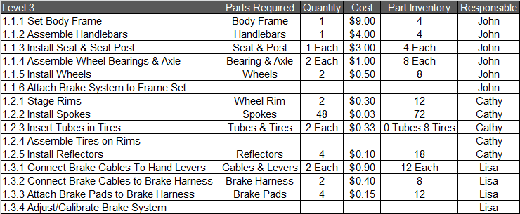
Project Planning Activities: Resource Planning
Resource Estimation Plan
Estimate Resource Requirements (Use Your WBS)
  Parts, Hardware, Software, Human Resources etc.
Plan resources
  Establish who is responsible for what and when.
  Determine quantity requirements and delivery dates etc.
Notes:
The estimation of resource requirements (human, software, hardware, materials etc.) is necessary for each task and is useful for the creation of a project plan. Use your work breakdown structure to boil it down to tasks so that you can determine specific resource requirements, dependencies etc.

Slide 200
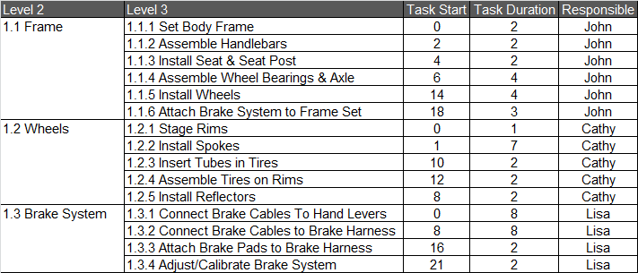
Project Planning Activities: Project Scheduling
Project Scheduling:
Assign beginning times to each activity in the WBS
(days are used for start and durations times in example below).
Assign duration times to each activity in the WBS.
Identify People Responsible and set completion dates.
Represent schedules as Gantt charts or network diagrams.
Identify critical dependencies between tasks.
Notes:
Scheduling is critical because without it you will miss deadlines and poorly organize dependent tasks and activities. The result of the lack of scheduling, or of poor scheduling, can be catastrophic to a project.

Slide 201
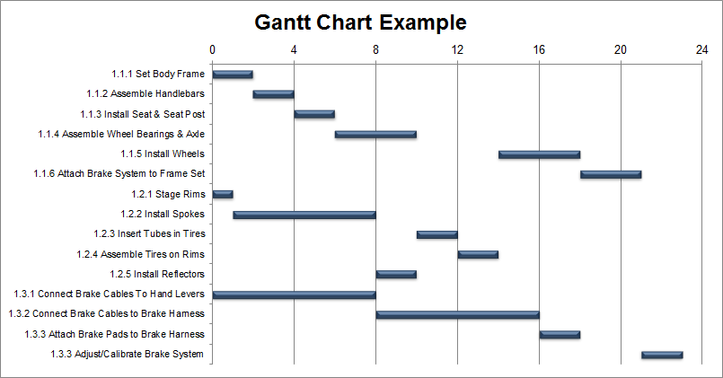
Project Planning Activities: Project Scheduling
Project Schedule – Gantt Chart:
The advantage of a Gantt chart is its ability to display the status of each task/activity at a glance.
Because it is a graphic representation, it is easy to demonstrate the schedule of tasks and timelines to all the stakeholders.
Notes:
A Gantt chart offers visibility to a project plan. It displays the tasks of the project plan in a simple and well organized manner.

Slide 202
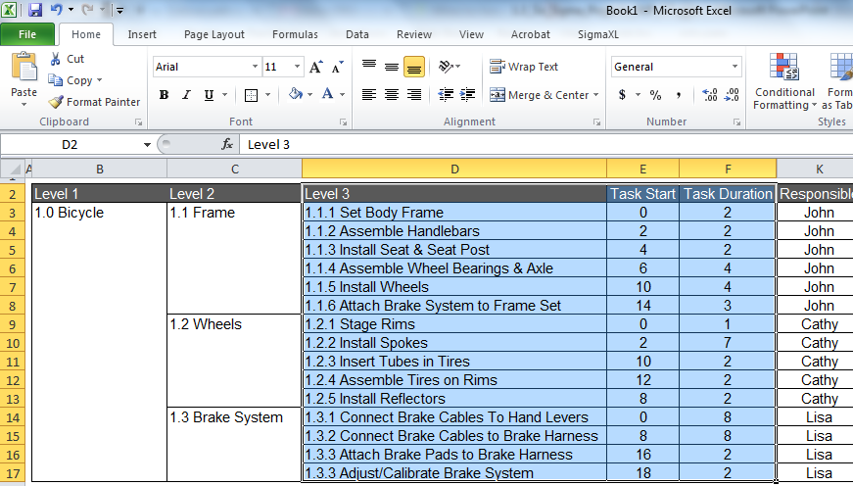
Project Scheduling: Preparing a Gantt Chart in Excel
There are many tools available to create Gantt charts. Some of the most common and compatible for businesses are: Microsoft Project, Visio and Excel. In Microsoft Excel we use the bicycle example:
  Select rows & columns of your tasks, start times and durations.
Notes:
Gantt charts can be created with many different authoring tools. The example covered in the next few slides uses one of if not the most widely used business tools for project managers, consultants and contractors. Microsoft Excel.

Slide 203
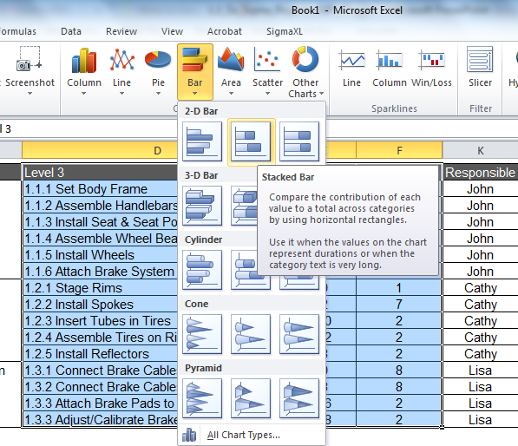
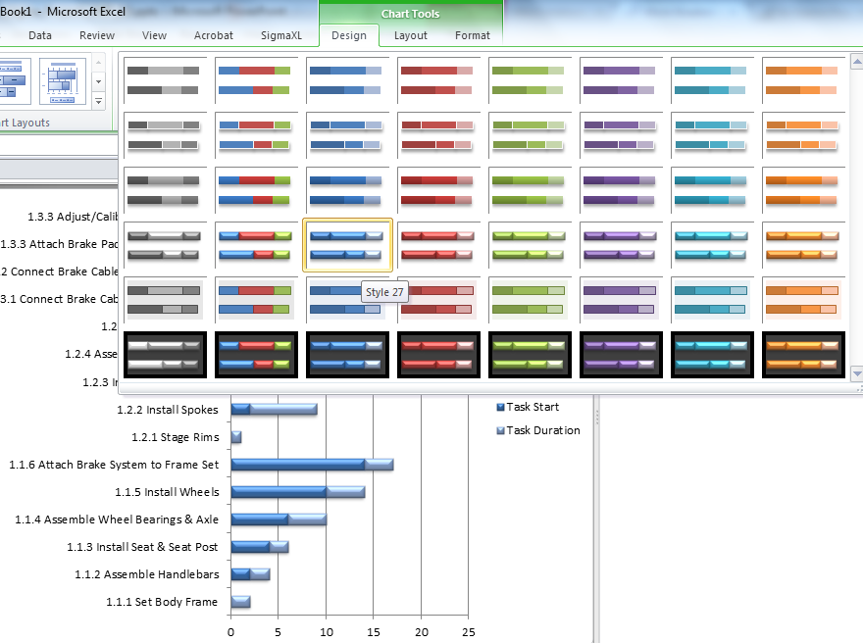
Project Scheduling: Preparing a Gantt Chart in Excel
  On the Insert tab select Bar > Stacked Bar.
  On the Design tab choose a design style from the style dropdown.
2
3
Notes:
Excel does not have a built in Gantt chart function but manipulating a stacked bar chart allows us to create a visually appealing and generally effective Gantt chart.

Slide 204
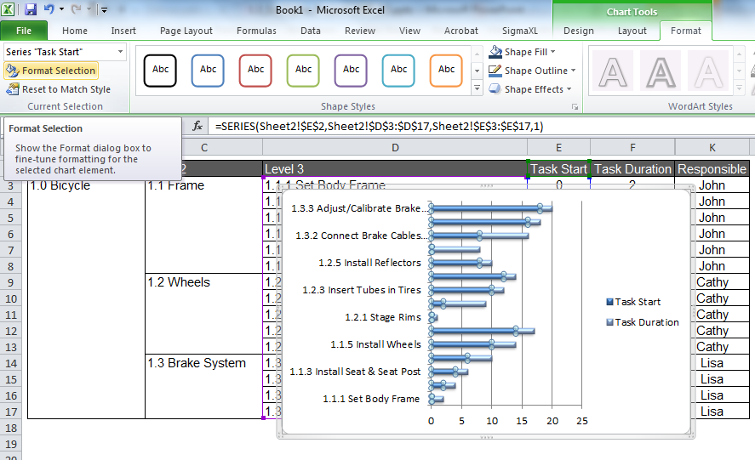
Project Scheduling: Preparing a Gantt Chart in Excel
  Activate the “start tasks” on your graph.
  From the format tab select “format selection”.
5
4

Slide 205
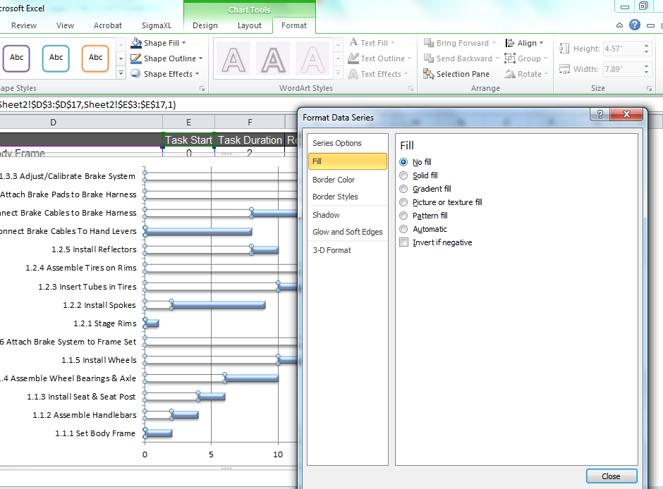

Project Scheduling: Preparing a Gantt Chart in Excel
  Select Fill > No Fill.
  Select Shadow > Presets > No Shadow > Close.
7
6

Slide 206
Project Scheduling: Preparing a Gantt Chart in Excel
  Format your new Gantt chart to your own preferences.
Notes:
After initially creating your Gantt chart you can use Excel’s design and formatting functions to style your Gantt chart to meet your organizations needs.

Slide 207
Project Scheduling: Critical Path Method
Critical Path Method (CPM) is a project modeling technique used to identify the set of activities that are most influential to a projects completion timeline.
  Critical Path tasks are those that others are dependent upon.
  Project timelines cannot be shortened without shortening the tasks or activities that are identified as critical path items.
Steps To Using The Critical Path Method
  List all activities necessary to complete the project.
  Determine the time or duration of each activity.
  Identify the dependencies between the activities.
  Use Your Work Breakdown Structure (WBS).
Notes:
CPM is fundamental to project management. You must understand all required project tasks, their durations and dependencies. The critical path method can help you organize and understand how each task behaves relative to others and how the collection of all tasks fit in the grand scheme of a project.

Slide 208
Project Scheduling: Critical Path Method
Critical Path Method Example: Let’s continue with our bicycle example. Note that the tasks in the WBS are already set to start based on their dependencies.
  For example, Installing the wheels in step 1.1.5 requires the whole set of steps in 1.2 to be completed so 1.1.5 starts on day 14 when the wheels are ready.
Notes:
By using your WBS you can efficiently evaluate task durations and dependencies to find the critical tasks that will affect the final timeline of your project.

Slide 209
Project Scheduling: Critical Path Method
Continuing this example; the last task, 1.3.4 Adjusting the Brake System, completes on day 23 and can’t begin until day 21 because the brake system must be attached to the bike frame before being calibrated.
1.1.6
Completes on day 21
1.3.4
Starts on day 21

Slide 210

Project Scheduling: Critical Path Method
Earlier if you noticed when we conducted our resource plan that we were out of tire tubes then you might have managed your resources differently.
Let’s assume the tubes take 21 days to receive from the supplier. Below is the adjustment to our Gantt chart. Notice that the project timeline is pushed out by 8 days, finishing on day 31 instead of day 23.
Notes:
By coordinating the use of all project planning tools and methods covered this far (WBS, Resource Planning, Gantt Chart, CPM) you can not only depict the project tasks and timelines but you can also better manage resources as a result. The example on screen demonstrates that there is nearly a full FTE resource wasted in “waiting” time. By knowing this you might be able to re-organize your projects tasks and resources to save on the cost of labor.

Slide 211
Project Scheduling: PERT
Program Evaluation & Review Technique (PERT): is a method of evaluation that can be applied to time or cost.
PERT provides a weighted assessment of time or cost
PERT uses 3 parameters for estimation:
  Optimistic or Best Case Scenario represented by ‘O’.
  Pessimistic or Worst Case Scenario represented by ‘P’.
  Most Likely Scenario represented by ‘ML’.
PERT Equation:
  The PERT equation provides for heavier weighting of the most likely scenario but also considers the best and worst cases. In the event that a best or worst case scenario is an extreme situation, the PERT will account for it in a weighted manner.
(O + (4*ML) + P) / 6
Notes:
Using the PERT formula, it is the sum of the estimates of the best case, the worst case, and four times the most likely case, all divided by six.

Slide 212
Project Scheduling: PERT
Let’s apply the PERT formula to our estimates of receiving our needed tire tubes from the supplier and then change our schedule based on the result.
Your experience with this supplier tells you that they typically over estimate the time required to deliver. Therefore, their 21 day lead time on the tubes should be considered a “worst case scenario”.
Procurement has indicated that tubes have arrived in as few as 6 days from this supplier. So, your best case scenario is 6 days.
The most likely scenario you decide will be the median of this suppliers delivery time which is 10 days.
Therefore:
(O + (4*ML) + P) / 6
(6 + (4*10) + 21) / 6
(6 + 40 + 21) / 6
67 / 6 = 11
Notes:
Using the PERT formula in this example: the sum of best case (6), four times most likely (4*10) and worst case (21) is sixty seven. We then divide 67 by 6 which yields 11 (rounded). 11 days is your adjusted estimate of delivery for the tire tubes.

Slide 213


Project Scheduling: PERT
Using 11 days in your project plan instead of 21 gives you a more confident estimate of time and actually removes tire tubes as the primary detracting critical path item.

Slide 214

Project Planning Activities
Budget or Financial Plan
Planned expenses
Planned revenues
Budget forecast
Notes:
Create a preliminary project budget that outlines the planned expenses and revenues pertaining to the project.
Preliminary budgets are commonly used for project justification and future business forecasts.
Most organizations expect to see some financial analysis regarding the payback of a project. IRR (Internal Rate of Return) and NPV (Net Present Value) are two very common and acceptable financial measures that can be used to justify a project.

Slide 215

Project Planning Activities
Communication Plan
Establish communication procedures among management, team members, and relevant stakeholders.
Determine the communication schedule.
Define the acceptable modes of communication.
Notes:
Effective communication and frequency of communication are vital to any project. Keeping participants, stakeholders, and customers updated with progress and forecasts helps ensure good communication.

Slide 216

Project Planning Activities
Risk Management Plan
Identify the sources of project risks and estimate the effects of those risks.
Risks might arise from new technology, availability of resources, lack of inputs from customers, business risks etc.
Assess the impact of risk to the customers/stakeholders.
Calculate the probability of risk occurrence based on previous similar projects or industry benchmarks
Initiate mitigation and contingency plans
Review risks on a periodic basis
Notes:
Most projects that fail are due to the lack of, or improper, risk management.
Identify sources of risk as early as possible in the project.
Determine the severity and frequency of possible risk occurrences and establish controls or mitigation plans.
Prioritize your energy and resources based on risk severity.

Slide 217
Project Planning Tools Advantages
    Project planning tools are very useful to organize and communicate project plans, status, and projections.
    They help link tasks and sub-tasks or other work elements to get a whole view of what needs to be accomplished.
    They allow a more objective comparison of alternative solutions and provide consistent coverage of responsibilities.
    They allow for effective scope control and change management.
    They facilitate effective communication with all project participants and stakeholders.
    They help define management reviews.
    They act as an effective monitoring mechanism for the project.
    They establish project baselines for progress reviews and control points.

Slide 218
1.4 Lean Fundamentals

Slide 219
Yellow Belt Training: Define Phase
1.1 Six Sigma Overview
1.1.1 What is Six Sigma
1.1.2 Six Sigma History
1.1.3 Six Sigma Approach Y = f(x)
1.1.4 Six Sigma Methodology
1.1.5 Roles and Responsibilities
1.2 Six Sigma Fundamentals
1.2.1 Defining a Process
1.2.2 VOC and CTQs
1.2.3 QFD
1.2.4 Cost of Poor Quality (COPQ)
1.2.5 Pareto Analysis (80:20 rule)
1.3 Lean Six Sigma Projects
1.3.1 Six Sigma Metrics
1.3.2 Business Case and Charter
1.3.3 Project Team Selection
1.3.4 Project Risk Management
1.3.5 Project Planning
1.4 Lean Fundamentals
1.4.1 Lean and Six Sigma
1.4.2 History of Lean
1.4.3 The Seven Deadly Muda
1.4.4 Five-S (5S)

Slide 220
1.4.1 Lean and Six Sigma

Slide 221

What is Lean?
A lean enterprise intends to eliminate waste and allow only value to be pulled through its system.
Lean manufacturing is characterized by:
  Identifying and driving value
  Establishing flow and pull systems
  Creating production availability and flexibility
  Zero waste
Waste Elimination
  Waste identification and elimination
  is critical to any successful lean
  enterprise.
  Elimination of waste enables flow,
  drives value, cuts cost, and provides
  flexible and available production.
Notes:
A Lean Enterprise seeks to purge the waste and to only focus on value-adding activity in its system.
A Lean Manufacturing system drives value, flows smoothly, maximizes production, and minimizes the waste.
A Lean Enterprise can be achieved by identifying and effectively eliminating all waste (which will result in a flowing, cost-effective system).

Slide 222

The 5 Lean Principles
The following 5 principles of lean are taken from the book Lean Thinking (1996) by James P. Womack and Daniel T. Jones.
  Specify value desired by customers.
  Identify the value stream.
  Make the product flow continuous.
  Introduce pull systems where continuous flow is possible.
  Manage toward perfection so that the number of steps and the amount of time and information needed to serve the customer continually falls.
Notes:
Identify customers and specify value – Only a small fraction of the total time and effort spent in an organization actually adds value for the end customer. With a clear definition of value (from the customer’s perspective), it is much easier to identify where the waste is.
Identify and map the value stream – The value stream is the entire set of activities across all parts of the organization involved in jointly delivering the product or service. It is the end-to-end process that delivers the value to the customer. As stated above, once you understand what determines value to the customer, it is easier to determine where the waste is.
Create flow through eliminating waste – Typically you will find that only 5% of activities add value, but the percentage can be as high as 45% in a service environment. Eliminating this waste ensures that your product or service flows better to the customer without interruption or waiting.
Customer pull – When possible, understand the customer demand on your product or service, then create a process to respond to it. In other words, only produce what the customer wants when they want it.
Pursue perfection – At first reorganizing the process steps will create flow, and as this is done, the layers of waste become exposed and exploited. Continuing the process of eliminating, reorganizing, and exploiting the waste will continue to drive down the number of steps and time needed to serve the customer.

Slide 223
Lean & Six Sigma
Lean and Six Sigma both have the objectives of producing high value (quality) at lower costs (efficiency).
They approach these objectives in somewhat different manners but in the end, both Lean and Six Sigma drive out waste, reduce defects, improve processes, and stabilize the production environment.
Lean and Six Sigma are a perfect combination of tools for improving quality and efficiency.
Lean
Eliminate Waste
Process Flow
Six Sigma
Eliminate Defects
Process Yield
Pull Systems
Capable Systems
Easy Visual Approach
Rigorous Analytical Approach
Quality & Value for the Customer
Efficiency for the Business
Notes:
Both Lean and Six Sigma have similar goals: to produce high value at lower cost.
Both have similar objectives: to make companies more efficient, to drive out waste through optimization.
The two methodologies complement each other to improve quality, efficiency, and ultimately profitability and customer satisfaction.

Slide 224
1.4.2 History of Lean

Slide 225
History of Lean
Polaroid
Notes:
Recall this timeline we saw at the beginning of this training?
The concepts and principles of Lean have been applied since the early 1900s, but the term was introduced only in 1990.

Slide 226
History of Lean
Lean thinking originated, as far as is known, the 1400s.
Henry Ford established the first mass production system in 1913 by combining standard parts, conveyors, and work flow.
Decades later, Kiichiro Toyoda and Taiichi Ohno at Toyota improved and implemented various new concepts and tools (e.g., value stream, takt time, kanban etc.) based on Ford’s effort.
Toyota developed what is known today as the Toyota Production System (TPS) based on lean principles.
Notes:
The first person to truly apply the principles in a production process was Henry Ford.
In 1913, he brought together the concepts of consistently interchangeable parts, standard work, and moving conveyance to create what he called flow production. The problem with Ford’s system was its inability to provide variety (remember the Model T?).
Between 1948 and 1975, Taiichi Ohno, Shigeo Shingo, and Eiji Toyoda developed the Toyota Production System. It advanced the concepts of Ford’s system through a series of innovations that provided the continuity of flow and a variety of product offerings.

Slide 227
History of Lean
Starting in the mid 1990s, Lean became extensively recognized and implemented when more and more Fortune 100 companies began to adopt Lean and Six Sigma.
The term “Lean manufacturing” was introduced by James Womack in the 1990s.
Lean and Six Sigma share similar objectives, work hand in hand, and have benefited from one another in the past 30 years.
Notes:
In the 1990s, the principles of Lean became widely recognized and applied across Fortune 100 companies.
The term “Lean” was coined in the 1990s. The term came from John Krafcik, who was a graduate student at MIT, working on a research for the book The Machine That Changed the World for Lean Enterprise Institute founder, Jim Womack.

Slide 228
1.4.3 Seven Deadly Muda

Slide 229
The 7 Deadly Muda
The Japanese word for waste is “muda.”
There are 7 commonly recognized forms of waste, often referred to as the “7 deadly muda.”
  Defects
  Overproduction
  Over-Processing
  Inventory
  Motion
  Transportation
  Waiting
Notes:
Muda is a Japanese word meaning “futility, uselessness, idleness, superfluity, waste, wastage, wastefulness.”
The “Seven Deadly Muda,” as defined by Taiicho Ohno (the Toyota Production System), are:
Defects
Overproduction – producing more than what your customers are demanding
Over-processing – unnecessary time spent (e.g., relying on inspections instead of designing a process to eliminate problems)
Inventory – things awaiting further processing or consumption
Motion – extra, unnecessary movement of employees
Transportation – unnecessary movement of goods
Waiting – for an upstream process to delivery, for a machine to finish processing, or for an interrupted worker to get back to work.

Slide 230

The 7 Deadly Muda: Defects
Defects or defectives are an obvious waste for any working environment or production system.
Defects require rework during production and/or after the product is returned from an unhappy customer.
Some defects are difficult to solve and they create “workarounds” and hidden factories.
Eliminating defects is a sure way to improve product quality, customer satisfaction, and production costs.
Notes:
Nobody likes defects. They are an obvious form of waste – wasted time, wasted materials, and wasted money.
Defects take time and resources to be fixed, and can be especially costly if they get into the hands of a customer.
Sometimes when defects are hard to fix, processes are redesigned around the issue, creating unwanted hidden factories.

Slide 231

The 7 Deadly Muda: Overproduction
Overproduction is wasteful because your system expends energy and resources to produce more materials than the customer or next function requires.
Overproduction is one of the most detrimental of the seven deadly muda because it leads to many others:
Inventory
Transportation
Waiting etc.
Notes:
What is the matter with producing more of something than what you need?
It takes valuable time, energy, and money to produce more and, once extra production is made, it must be transported and stored for some period of time.

Slide 232

The 7 Deadly Muda: Over-processing
Over-processing occurs any time more work is done than is required by the next process step, operation, or consumer.
Over-processing also includes being over capacity (scheduling more workers than required or having more machines than necessary).
Another form of over processing can be buying tools or software that are overkill (more precise, complex, or expensive than required).
Notes:
Over-processing is the unnecessary time spent (e.g., relying on inspections instead of designing a process to eliminate problems).
You might think of this as over-engineering a process or just doing more than is required at a specific step of the process (having more labor available than necessary, having more machines than are needed, or having tools that are not adding incremental value because they do more than the product requires).

Slide 233

The 7 Deadly Muda: Inventory
Inventory is an often overlooked waste. Look at the picture above and imagine all the time, materials, and logistics that went into establishing such an abundance of inventory.
If this were your personal business, and inventory velocity was not matched with production, how upset would you be?
Notes:
Inventory are things awaiting further process or consumption.
Everything in this picture represents investment by the company that makes or sells a product.
How would you feel about this inventory if you were the owner of this business?

Slide 234

The 7 Deadly Muda: Motion
Motion is another form of waste often occurring as a result of poor setup, configuration, or operating procedures.
Wasted motion can be experienced by machines or humans.
Wasted motion is very common with workers who are unaware of the impact of small unnecessary movements in repetitive tasks.
Wasted motion is exaggerated by repetition or recurring tasks.
Notes:
Motion is extra, unnecessary movement of employees.
It can result from an improperly planned setup, work area configuration, and operating procedure.
Small movements of an employee probably do not seem very wasteful. But when you consider repetitive motion that occurs over a long period of time, your perspective may change.

Slide 235

The 7 Deadly Muda: Transportation
Transportation is considered wasteful because it does nothing to add value or transform the product.
Imagine for a moment driving to and from work twice before getting out of your car to go into work. . .
That is waste in the form of transportation.
The less driving you have to do, the better.
In a similar way, the less transportation a product has to endure, the better. There would be fewer opportunities for delay, destruction, loss, damage etc.
Notes:
Transportation is the unnecessary movement of goods.
Can you think of a way that moving a product from point A to point B adds value for a customer?
Why is transportation wasteful? It takes energy to move something, it may take tools to move, and it introduces the risk of something getting damaged. Unless something is being transported into the hands of the customer, it probably means it is going somewhere to be stored (which is also wasteful).

Slide 236

The 7 Deadly Muda: Waiting
Waiting is an obvious form of waste and is typically a symptom of an upstream problem.
Waiting is usually caused by inefficiency, bottlenecks, or poorly-designed work flows within the value stream.
Waiting can also be caused by inefficient administration.
Reduction in waiting time will require thoughtful applications of lean and process improvement.
Notes:
Waiting is when a downstream process is being starved because there is something wrong upstream in the process (like a machine having to finish processing or a worker that has stepped away from his or her station). In other words, there is a “bottleneck” that inhibits the flow of the process.

Slide 237
1.4.4 Five-S (5S)

Slide 238
What is 5S?
5S is systematic method to organize, order, clean, and standardize a workplace…and to keep it that way!
  5S is a methodology of organizing and improving the work environment.
5S is summarized in five Japanese words all starting with the letter S:
  Seiri (sorting)
  Seiton (straightening)
  Seiso (shining)
  Seiketsu (standardizing)
  Shisuke (sustaining)
5S was originally developed in Japan and is widely used to optimize the workplace to increase productivity and efficiency.
Notes:
5S is a methodology that is applied in a Lean workplace. Its intent is to bring organization and order, and keep it that way.
The five Japanese words beginning with the letter S also have English meanings that start with the letter S: Sorting, Straightening, Shining, Standardizing, and Sustaining.

Slide 239
Five-S (5S)
Sort
Set in Order
Shine
Standardize
Sustain
Notes:
Sort – to separate the needed from the unnecessary and prioritize what is needed
Set in order (or straighten) – to establish a place for everything
Shine – to clean the work area
Standardize – to ensure that work practices are done consistently and everyone knows their responsibilities
Sustain – to maintain and review the standards

Slide 240
Goals of 5S
Reduced waste
Reduced cost
Establish a work environment that is:
  self-explaining
  self-ordering
  self-regulating
  self-improving.
  Where there is/are no more:
    Wandering and/or searching
    Waiting or delaying
    Secret hiding spots for tools
    Obstacles or detours
    Extra pieces, parts, materials etc.
    Injuries
    Waste.
Notes:
Can you think of reasons why 5S might be beneficial?
Eliminates wasted time searching for tools or materials.
Reduces the time necessary to perform a job.
Reduces cost of tools and materials (lost, damaged).
Creates a safer work environment.

Slide 241
Benefits of 5S Systems
Reduced changeovers
Reduced defects
Reduced waste
Reduced delays
Reduced injuries
Reduced breakdowns
Reduced complaints
Reduced red ink
Higher quality
Lower costs
Safer work environment
Greater associate and equipment capacity.
Notes:
By meeting the goals of 5-S, the following benefits are realized.

Slide 242
Reported Results of 5S Systems
Cut in floor space: 60%
Cut in flow distance: 80%
Cut in accidents: 70%
Cut in rack storage: 68%
Cut in number of forklifts: 45%
Cut in machine changeover time: 62%
Cut in annual physical inventory time: 50%
Cut in classroom training requirements: 55%
Cut in nonconformance in assembly: 96%
Increase in test yields: 50%
Late deliveries: 0%
Increase in throughput: 15%
Notes:
Organizations that have implemented 5S systems have reported very impressive results – reduction in waste, improved safety, reduced costs, improved performance.

Slide 243

Sorting (Seiri)
Go through all the tools, parts, equipment, supply, and material in the workplace.
Categorize them into two major groups: needed and unneeded.
Eliminate the unneeded items from the workplace. Dispose of or recycle those items.
Keep the needed items and sort them in the order of priority. When in doubt…throw it out!
Notes:
How do you Sort?
As you go through the workplace, separate tools, parts, equipment, materials, and supplies into two groups – needed and unneeded.
Eliminate the unneeded items from the workplace. (If you are unsure, store them away for some period of time until you are satisfied that you clearly do not need them.)
Sort the needed items in order of priority.

Slide 244

Straightening (Seiton)
Straightening in 5S is also called setting in order.
Label each needed item.
Store items at their best locations so that the workers can find them easily whenever they needed any item.
Reduce the motion and time required to locate and obtain any item whenever it is needed.
Promote an efficient work flow path.
Use visual aids like the tool board image on this page.
Notes:
Straightening (or Set in Order)
Label each item and store it in an appropriate location.
Try to reduce Motion by storing the most frequently used items in the most convenient locations.
Promote an efficient work flow path by working to minimize movement around the workplace.
Use visual aids to remind employees where things belong so the order is sustained.

Slide 245

Shining (Seiso)
Shining in 5S is also called sweeping.
Clean the workplace thoroughly.
Maintain the tidiness of the workplace.
Make sure every item is located at the specific location where it should be.
Create the ownership in the team to keep the work area clean and organized.
Notes:
Shining means:
Clean and maintain a tidy workplace.
Ensure that all items are in their proper location.
Get the team to own and take pride in keeping the workplace clean and organized.

Slide 246
Standardizing (Seiketsu)
Standardize the workstation and the layout of tools, equipment and parts.
Create identical workstations with a consistent way of storing the items at their specific locations so that workers can be moved around to any workstation any time and perform the same task.
Notes:
Standardization – removing the variation across workstations.
Replicate the workstation setting across all workstations, so they are interchangeable and workers can move amongst them and easily perform their duties.

Slide 247
Sustaining (Shisuke)
Sustaining in 5S is also called self-discipline.
Create the culture in the team to follow the first four S’s consistently.
Avoid falling back to the old ways of cluttered and unorganized work environment.
Keep the momentum of optimizing the workplace.
Promote innovations of workplace improvement.
Sustain the first fours S’s using:
  5S Maps
  5S Schedules
  5S Job cycle charts
  Integration of regular work duties
  5S Blitz schedules
  Daily workplace scans.
Notes:
Sustaining
It takes discipline to maintain 5S. Obviously, it takes time for new habits to form, and there needs to be a culture within the team to follow this methodology. It is critical not to fall back into the old ways.
Keep the momentum by identifying improvements and optimizing. Look for better ways to set the workplace in order and reduce waste.

Slide 248
Simplified Summary of 5S
Sort – “when in doubt, move it out.”
Set in Order – Organize all necessary tools, parts, and components of production. Use visual ordering techniques wherever possible.
Shine – Clean machines and/or work areas. Set regular cleaning schedules and responsibilities.
Standardize – Solidify previous three steps, make 5S a regular part of the work environment and everyday life.
Sustain – Audit, manage, and comply with established 5S guidelines for your business or facility.
Notes:
Here is a quick summary of how to apply the 5S.

Slide 249
Five-S (5S)
A few words about 5S and the Lean Enterprise
  As a method, 5S generates immediate improvements.
  5S is one of many effective lean methods that create observable results.
  It is tempting to implement 5S alone without considering the entire value stream.
  However, it is advisable to consider a well-planned lean manufacturing approach to the entire production system.
Notes:
5S is a quick and effective way to improve results, and it is tempting to stop at that.
Keep it going beyond 5S and consider Lean for the entire system.

Slide 250
2.0 Measure Phase

Slide 251
Yellow Belt Training: Measure Phase
2.1 Process Definition
2.1.1 Cause and Effect Diagrams
2.1.2 Cause and Effects Matrix
2.1.3 Process Mapping
2.1.4 FMEA: Failure Modes & Effects Analysis
2.1.5 Theory of Constraints
2.2 Six Sigma Statistics
2.2.1 Basic Statistics
2.2.2 Descriptive Statistics
2.2.3 Distributions and Normality
2.2.4 Graphical Analysis
2.3 Measurement System Analysis
2.3.1 Precision and Accuracy
2.3.2 Bias, Linearity, and Stability
2.3.3 Gage R&R
2.3.4 Variable and Attribute MSA
2.4 Process Capability
2.4.1 Capability Analysis
2.4.2 Concept of Stability
2.4.3 Attribute and Discrete Capability
2.4.4 Monitoring Techniques

Slide 252
2.1 Process Definition

Slide 253
Yellow Belt Training: Measure Phase
2.1 Process Definition
2.1.1 Cause and Effect Diagrams
2.1.2 Cause and Effects Matrix
2.1.3 Process Mapping
2.1.4 FMEA: Failure Modes & Effects Analysis
2.1.5 Theory of Constraints
2.2 Six Sigma Statistics
2.2.1 Basic Statistics
2.2.2 Descriptive Statistics
2.2.3 Distributions and Normality
2.2.4 Graphical Analysis
2.3 Measurement System Analysis
2.3.1 Precision and Accuracy
2.3.2 Bias, Linearity, and Stability
2.3.3 Gage R&R
2.3.4 Variable and Attribute MSA
2.4 Process Capability
2.4.1 Capability Analysis
2.4.2 Concept of Stability
2.4.3 Attribute and Discrete Capability
2.4.4 Monitoring Techniques

Slide 254
2.1.1 Cause and Effect Diagram

Slide 255
What is a Cause and Effect Diagram?
A cause and effect diagram is also called a Fishbone Diagram or Ishikawa Diagram. It was created by Kaoru Ishikawa and is used to identify, organize, and display the potential causes of a specific effect or event in a graphical way similar to a fishbone.
It illustrates the relationship between one specified event (output) and its categorized potential causes (inputs) in a visual and systematic way.
Notes:
A cause and effect diagram is a powerful brainstorming tool that is used to identify and organize possible causes of a specific effect or event.
It is sometimes referred to as a fishbone diagram or Ishikawa diagram.
It shows the relationship between the effect and potential causes or inputs.

Slide 256
Major Categories of Potential Causes
P4ME
  People: People who are involved in the process
  Methods: How the process is completed (e.g., procedures, policies, regulations, laws)
  Machines: Equipment or tools needed to perform the process
  Materials: Raw materials or information needed to do the job
  Measurements: Data collected from the process for inspection or evaluation
  Environment: Surroundings of the process (e.g., location, time, culture).
Notes:
Typically, the possible causes fall into six major categories (or branches in the diagram).
Remembering this acronym (P4ME) is a helpful way to remember these categories: People, Methods, Machines, Materials, Measurements, Environment.

Slide 257
How to Plot a Cause and Effect Diagram
Step 1: Identify and define the effect/event being analyzed.
  Clearly state the operational definition of the effect/event of interest.
  The event can be the positive outcome desired or negative problem targeted to solve.
  Enter the effect/event in the end box of the Fishbone diagram and draw a spine pointed to it.
Notes:
Plotting a cause and effect diagram is a simple 4-step process. Step 1 is to identify and define the effect being analyzed.
The effect/event should be clearly stated and defined. It can be a positive or negative outcome.
Enter the effect/event at the head of the diagram. See next page for an illustration.

Slide 258
How to Plot a Cause and Effect Diagram
Step 1

Slide 259
How to Plot a Cause and Effect Diagram
Step 2: Brainstorm the potential causes or factors of the effect/event occurring.
  Identify any factors with a potential impact on the effect/event and include them in this step.
  Put all the identified potential causes aside for use later.
Notes:
Step 2 is to brainstorm the potential causes for the event or effect being analyzed.
It is brainstorming, so you should include anything with a potential impact on the event or effect analyzed.
This can be done through a whiteboard exercise, using sticky notes, or even electronically on a spreadsheet or other drawing tools.

Slide 260
How to Plot a Cause and Effect Diagram
Step 2
Notes:
This is an illustration of step 2.

Slide 261
How to Plot a Cause and Effect Diagram
Step 3: Identify the main categories of causes and group the potential causes accordingly.
  Besides P4ME (i.e., people, methods, machines, materials, measurements, and environment), you can group potential causes into other customized categories.
  Below each major category, you can define sub-categories and then classify them to help you visualize the potential causes.
  Enter each cause category in a box and connect the box to the spine. Link each potential cause to its corresponding cause category.
Notes:
Step 3 is to identify the main categories for the causes and group the brainstormed items.
You can use P4ME, or you can use customized main categories to group the potential causes.
Under each main category, you can define sub-categories if additional levels of detail are needed.

Slide 262
How to Plot a Cause and Effect Diagram
Step 3
Notes:
This is the graphic representation of Step 3.

Slide 263
How to Plot a Cause and Effect Diagram
Step 4: Analyze the cause and effect diagram.
  A cause and effect diagram includes all the possible factors of the effect/event being analyzed.
  Use a Pareto chart to filter causes the project team needs to focus on.
  Identify causes with high impact that the team can take action upon.
  Determine how to measure causes and effects quantitatively. Prepare for further statistical analysis.
Notes:
In the fourth and final step, analyze the diagram.
Have all factors been represented?
Use any data that you have to prioritize the causes – perhaps with a Pareto chart.
Identify which high-impact items are actionable, and determine how to measure causes and effects quantitatively.

Slide 264
Benefits to Using Cause and Effect Diagram
Helps to quickly identify and sort the potential causes of an effect.
Provides a systematic way to brainstorm potential causes effectively and efficiently.
Identifies areas requiring data collection for further quantitative analysis.
Locates “low-hanging fruit.”
Notes:
The benefits to using a cause and effect diagram to analyze an effect or event are:
It is helpful in systemically brainstorming and sorting potential causes of an effect and identifying which areas will require further analysis. Often this is where some quick wins (or the so called “low-hanging fruit”) can be uncovered.

Slide 265
Limitation of Cause and Effect Diagrams
A cause and effect diagram only provides qualitative analysis of correlation between each cause and the effect.
One cause and effect diagram can only focus on one effect or event at a time.
Further statistical analysis is required to quantify the relationship between various factors and the effect and identify the root causes.
Notes:
The tool does have limitations:
Is qualitative only, so it does not leverage data to find true relationships. More analysis is needed to quantify relationships between causes and effects.
It only focuses on one effect at a time. Effects can have different causes.

Slide 266
Cause and Effect Diagram Example
Case study:
  A real estate company is interested to find the root causes of high energy costs of its properties.
  The cause and effect diagram is used to identify, organize, and analyze the potential root causes.
Notes:
Let us follow an example through the process of using a cause and effect diagram. What is the effect to be analyzed? (High energy cost)

Slide 267
Cause and Effect Diagram Example
Step 1: Identify and define the effect/event being analyzed: high energy costs of buildings.
Notes:
As you can see, in step 1 the effect is noted at the head of the diagram.

Slide 268
Cause and Effect Diagram Example
Step 2: Brainstorm the potential causes or factors of the high energy costs.
Bad energy consuming habits
Aged HVAC units
Poor maintenance of HVAC units
Most lights are still on during non-business hours
Inaccurate metering
Building materials
Building air leakage
Temperature set point is too high in winter
Temperature set point is too low in summer
Fuel prices increasing
Notes:
In step 2, you can see the multiple potential causes that can be driving the effect of high energy cost of buildings.

Slide 269
Cause and Effect Diagram Example
Step 3: Identify the main categories of causes and group the potential causes accordingly.
Notes:
In step 3, see how the possible causes were grouped into the main categories (P4ME in this example)?

Slide 270
Cause and Effect Diagram Example
Step 4: Analyze the cause and effect (C&E) diagram.
  After completing the C&E diagram, the real estate company conducts further research on each potential root cause.
  It is discovered that:
    The utility metering is accurate
    The building materials are fine and there is not significant amount of air leakage from the building
    The fuel prices increased recently but were negligible
    Most lights are off during the non-business hours except that some lights have to be on for security purposes
    The temperature set points in the summer and winter are both adequate and reasonable
    The high energy costs are probably caused by the poor HVAC maintenance on aged units and the wasteful energy consuming habits.
Next, the real estate company needs to collect and analyze the data to check whether root causes identified in the C&E diagram are statistically the causes of the high energy costs.
Notes:
Finally, in analyzing the diagram and the potential root causes, additional information or data is uncovered to validate or invalidate the potential causes. It is determined that poor HVAC maintenance on aged units and wasteful energy consuming habits are at the root.
The real estate company needs to collect and analyze additional data to determine statistical relationships between causes and high energy costs.

Slide 271
2.1.2 Cause and Effects Matrix

Slide 272
What is a Cause and Effect Matrix?
The cause and effect matrix (XY Matrix) is a tool to help subjectively quantify the relationship of several X's to several Y's.
Among the Y's under consideration, two important ones should be the primary and secondary metrics of your Six Sigma project.
The X's should be derived from your cause and effect diagram. Let us take a peek as what it looks like on the next page.
Notes:
A cause and effect matrix is a powerful yet easy tool to transition from brainstorming (which you did using the cause and effect diagram) to estimating, ranking, and quantifying the relationship between those things you found during brainstorming and the Y’s that are important to the project.

Slide 273

Cause and Effects Matrix
Notes:
This is a clean cause and effect matrix where you can translate all of the potential X's brainstormed during the creation of your cause and effect diagram session.
Once you have that information entered into the matrix you can add 1 or more Y's to the top of the matrix. The Y's should be weighted relative to each other based on their importance to the project.
Once this is complete, you begin rating each X against each Y on a scale of 0, 3, 5, 7 (0 means no impact; 3 means weak impact; 5 is moderate impact; and 7 is strong impact). Try to use the whole spectrum of your scale during this process because you will need the resolution to help differentiate the X's from one another.

Slide 274
How to Use a Cause and Effect Matrix
Across the top enter your output measures. These are the Y’s that are important to your project.
Next, give each Y a weight. Use a 1–10 scale, 1 being least important and 10 most important.
Below, in the leftmost column, enter all the variables you identified with your cause and effect diagram.
Within the matrix itself, rate the strength of the relationship between the X in the row and the corresponding Y in that column. Use a scale of 0, 3, 5, and 7.
Lastly, sort the “Score” column to order the most important X’s first.

Slide 275

Cause and Effect Matrix Notes
Notes:
When complete, sort the X's based on their scores and graph them (use a Pareto chart).
What the results will tell you should not be "taken to the bank" as this entire process from brainstorming X's to rating them against Y's is a subjective exercise. However, if you have chosen your team wisely, it is very common that someone or several SMEs on your project team know the real solutions and/or the best way to narrow down to find them.
Therefore, it is also important not to dismiss the results of your cause and effect matrix. Look at the image with comments embedded to summarize what you have just read.

Slide 276
After You Have Completed the C&E Matrix
After you have completed your cause and effects matrix, build a strategy for validating and/or eliminating the x’s as significant variables to the Y=f(x) equation.
  Build a data collection plan
  Prepare and execute planned studies
  Perform analytics
  Review results with SMEs
  etc.
Notes:
The combination of the C&E diagram and the C&E matrix is powerful. This is where some of the best ideas and theories about the Y=f(x) equation begin.
Now, it is time to start eliminating and/or validating these variables.
Put a plan together to do so. Use the resources and tools you have already learned as well as those that you are about to learn throughout this course.

Slide 277
2.1.3 Process Mapping

Slide 278
What is a Process Map?
Process mapping is an important aspect to begin understanding a process. It provides a visual display of the steps required to produce a good or service.
There are various forms of process mapping techniques that are used in the DMAIC methodology. We have already covered three common and useful maps in our “Process Definition” section of the Define phase:
    High Level Process Map
    Detailed Process Map
    Functional Process Map
Now we will explore a few other value process mapping techniques:
    SIPOC
    Value Stream
    Spaghetti Diagram
    Thought Process Map
Notes:
Obviously, a process map is necessary to document a process. It helps us understand and drive discussion around a process.
It is a graphical representation for how a process flows, a step-by-step visual for how a process works.
It can help us understand how material or information flows.
It can help us understand who is responsible for each step in the process.
During the Measure phase of a project, the process map is used as the representation of the current state process.

Slide 279
What is SIPOC?
A SIPOC (Suppliers-Input-Process-Output-Customers) is a high-level visualization tool to help identify and link the different components in a process.
It is usually applied in the Measure phase in order to better understand the current state of the process and define the scope of the project.
Notes:
A SIPOC is a tool that summarizes the inputs and outputs of a process. At the outset of a process improvement effort it is very helpful to provide an overview to people who are unfamiliar or need to become reacquainted with a process.

Slide 280
Key Components of a SIPOC
Suppliers: vendors who provide the raw material, services, and information. Customers can also be suppliers sometimes.
Input: the raw materials, information, equipment, services, people, environment involved in the process.
Process: the high-level sequence of actions and decisions that results in the services or products delivered to the customers.
Output: the services or products delivered to the customers and any other outcomes of the process.
Customers: the end users or recipients of the services or products.
Notes:
Suppliers (external or internal to an organization) are those who provide raw material, services, or information for a process.
Inputs are the materials, information, equipment, services, people, and environment that are involved in the process.
The process is the sequence of activities or decisions that result in an output.
Output is a service or product that will be delivered to a customer.
Customers, of course, are the end users or recipients of the service or product, which again can be external or internal to an organization.

Slide 281
How to Plot a SIPOC Diagram
The first method:
  Step 1: Create a template that can contain the information of the five key components in a clear way.
  Step 2: Plot a high-level process map that covers five steps at maximum.
  Step 3: Identify the outputs of the process.
  Step 4: Identify the receipt of the process.
  Step 5: Brainstorm the inputs required to run each process step.
  Step 6: Identify the suppliers who provide the inputs.
Notes:
In the first method of creating a SIPOC:
Begin with the process steps (five steps at most)
Determine the outputs
Identify who the recipients of the process
Then work to the left, identifying the inputs and then the suppliers for those inputs.

Slide 282
How to Plot a SIPOC Diagram
The second method:
  Step 1: Create a template that can contain the information of the five key components in a clear way.
  Step 2: Identify the receipt of the process.
  Step 3: Identify the outputs of the process.
  Step 4: Plot a high-level process map that covers five steps at maximum.
  Step 5: Brainstorm the inputs required to run each process step.
  Step 6: Identify the suppliers who provide the inputs.
Notes:
In the second method:
Start with the customer (or the recipient of the process)
Work your way back by identifying the process outputs, then the high-level process map (five steps maximum)
Brainstorm the inputs to the process, then identify the suppliers for those inputs.

Slide 283
Benefits of SIPOC Diagrams
A SIPOC diagram provides more detailed information than process maps and it demonstrates how each component gets involved in the process.
It helps visualize and narrow the project scope.
It serves as a great communication tool to help different process owners understand the entire process, their specific roles and responsibilities.
Notes:
A SIPOC has more detail than a simple high-level process map, and it uncovers additional components about the process that are just as important as the process itself, like the inputs and outputs for each step.
It is very useful to help us visualize the process and help narrow the scope for an improvement project.
It is a great tool to help people who may not be as familiar with the process to understand it.

Slide 284

SIPOC Diagram Example
Example of plotting a SIPOC diagram for Mom cooking scrambled eggs for two kids
Notes:
This slide shows you an example of a SIPOC used to convey a very simple process of cooking scrambled eggs for two children.

Slide 285

Creating a SIPOC
Step 1: Vertically List High-Level Process
  If you followed the general rules for a high-level process map, then you should have no more than 4–6 steps for your process.
  List those steps in a vertical manner as depicted below.
Notes:
Here is a walk-through for completing a SIPOC via the first method described, starting with the process steps.
Remember, a high-level process should not have more than four to six steps; list them vertically.

Slide 286

Creating a SIPOC
Step 2: List Process Outputs
Notes:
Next, list the outputs for each step of the process.

Slide 287

Creating a SIPOC
Step 3: List Output Customers
Notes:
Then indicate the customers.

Slide 288

Creating a SIPOC
Step 4: List Process Inputs
Notes:
Next, move to the left of the process, indicating what inputs are needed for each process step.

Slide 289

Creating a SIPOC
Step 5: List Suppliers of Inputs
Notes:
Finally, enter the suppliers for the inputs.

Slide 290
SIPOC Benefits
Visually communicate project scope
Identify key inputs and outputs of a process
Identify key suppliers and customers of a process
Verify:
  Inputs match outputs for upstream processes
  Outputs match inputs for downstream processes.
This type of mapping is effective for identifying opportunities for improvement of your process.
If you have completed your high-level process map, follow the outlined steps to create a process map of Suppliers, Inputs, Process, Outputs, and Customer.
Notes:
As mentioned earlier, a SIPOC is a visual for communicating a process and the scope of a project.
It is more powerful than a simple high-level process map because it conveys the inputs and outputs of a process, as well as the suppliers and customers.
The outputs from one process step should match the inputs for the next step (and vice-versa).
This type of map is even more effective at indentifying opportunities in that the inputs and outputs could represent improvement opportunities too.

Slide 291

What is Value Stream Mapping?
Value stream mapping is a method to visualize and analyze the path of how information and raw materials are transformed into products or services customers receive.
It is used to identify, measure, and decrease the non-value-adding steps in the current process.
Notes:
Value stream mapping is just that – creating a visual for where value is added to a product or service by transforming raw materials and information.
It helps us determine where the non-value added activity takes place in a process, which we can then focus on minimizing.

Slide 292
Non-Value-Added Activities
Non-value-adding activities are activities in a process that do not add any other value to the products or services customers demand.
Example of non-value-adding activities:
  Rework
  Overproduction
  Excess transportation
  Excess stock
  Waiting
  Unnecessary motion.
Not all non-value-adding activities are unnecessary.
Notes:
A non-value added activity is an activity that occurs during the process, but from the customer’s perspective does not add any value to the product or service.
Here are some activities that can take place in a process before a product reaches a customer, but do not add value:
Rework – it should have been done right the first time, so a second time certainly does not add value
Overproduction – work that is done before it is needed, and could change, leading to rework
Excess transportation – moving the product around does not add value
Excess stock – similar to overproduction
Waiting – wasted time
Unnecessary motion – wasted energy
Sometimes, non-value added activities are required. For example, an inspection that is done for regulatory compliance purposes is necessary but does not add value to the product or service the customer receives.

Slide 293
How to Plot a Value Stream Map
Plot the entire high-level process flow from when the customer places the order to when the customer receives the products or services in the end.
A value stream map requires more detailed information for each step than the standard process map.
  Cycle time
  Preparation time
  Actual working time
  Available time
  Scrap rate
  Rework rate
  Number of operators
Assess the value stream map of current process, identity and eliminate the waste.
Notes:
To plot a value stream map, start by mapping the high-level process from when the customer places an order to when the customer receives the product or service at the end.
There are several pieces of information that can and should be provided with each step of the process to help illustrate where waste is occurring and value is added.
Finally, assess the map to identify the waste that should be eliminated.

Slide 294
Spaghetti Chart
A spaghetti chart is a graphical tool to map out the physical flow of materials, information, and people involved in a process. It can also reflect the distances between multiple workstations the physical flow has been through.
A process that has not been streamlined has messy and wasteful movements of materials, information, and people, resembling a bowl of cooked spaghetti.
Notes:
This tool is used to map the physical flow of material, information, or people that are involved in a process.
A non-optimized process typically has a lot of wasteful transportation, information flow, and people movement. When you have mapped it out, it will look like a jumbled mess…like spaghetti.

Slide 295
How to Plot a Spaghetti Chart
Step 1: Create a map of the work area layout.
Step 2: Observe the current work flow and draw the actual work path from the very beginning of work to the end when products exit the work area.
Step 3: Analyze the spaghetti chart and identify improvement opportunities.
Notes:
Start by mapping out the work area (the floor plan).
Observe the work flow and trace the path of the work from beginning to end.
Analyze the spaghetti chart and identify the areas where the work flow can be streamlined (look for waste like transportation, motion, etc.).

Slide 296

Spaghetti Chart Example
Notes:
This is an example of a spaghetti chart of work paths and flow of production.

Slide 297
Thought Process Mapping
A thought process map is a graphical tool to help brainstorm, organize, and visualize the information, ideas, questions, or thoughts regarding reaching the project goal.
It’s a popular tool often used at the beginning of a project in order to:
  identify knowns and unknowns
  communicate assumptions and risks
  discover potential problems and solutions
  identify resources, information, and actions required to meet the goal
  present relationship of thoughts.
Notes:
This is a simple yet powerful tool that creates a visual for the thought process used to solve a problem or reach a project goal. It helps a project team map to understand where they have been, where they still need to go, what questions have been answered, how were they answered, and what is yet to be answered.
It helps document what is known and unknown; communicate assumptions and risks; discover problems and solutions; determine what information, actions, or resources are needed to achieve the goal; and, of course, present the relationship of all of the thoughts.

Slide 298
How to Plot a Thought Process Map
Step 1: Define the project goal.
Step 2: Brainstorm knowns and unknowns about the project.
Step 3: Brainstorm questions and group the unknowns and questions into five phases (Define, Measure, Analyze, Improve, and Control).
Step 4: Sequence the questions below the project goal and link the related questions.
Step 5: Identify tools or methods that would be used to answer the questions.
Step 6: Repeat steps 3 to 5 as the project continues.
Notes:
Start with the goal of the project.
Through brainstorming, document the knowns and unknowns.
Group the unknowns and questions into five phases (DMAIC).
Sequence the questions under the project goal and link any related questions.
Continue to leverage steps 3, 4, and 5 throughout the project until the goal is met.

Slide 299
Thought Process Map Example
Scheduling
Car Battery
Process Map
How often?
Routing
Process
Traffic
Which area?
Deliver the pizza to clients in time
What time?
Staff
Transportation
Too few?
Training
Online ordering system
System
Phone ordering system
Notes:
This is an example of a thought process map. In this case, the goal is on-time pizza delivery.

Slide 300
2.1.4 FMEA

Slide 301

What is FMEA?
The FMEA (Failure Modes and Effects Analysis) is an analysis technique to identify, evaluate, and prioritize a potential deficiency in a process so that the project team can design action plans to reduce the probability of the failure/deficiency occurring.
FMEA is completed in cross-functional brainstorming sessions in which attendees have a good understanding of the entire process or of a segment of it.
Notes:
The failure mode and effects analysis is a very useful tool to identify, analyze, and prioritize any potential weaknesses in a process. The point is to prioritize the greatest deficiencies so that the project team can design action plans to reduce the probability of a failure occurring.
The activity of performing an FMEA follows the process mapping exercise. A process map is used during the FMEA to determine where potential process breakdowns can occur. At each step, the team must ask, “what can go wrong?”
A Pareto analysis may follow to quantitatively validate or invalidate the results of the FMEA.
To be effective, the FMEA should be done with a cross-functional group that has a thorough understanding of the process.

Slide 302
Basic FMEA Terms
Process Functions
  Process steps depicted in the process map. FMEA is based on a process map and one step/function is analyzed at a time.
Failure Modes
  Potential and actual failure in the process function/step. It usually describes the way in which failure occurs. There might be more than one failure mode for one process function.
Failure Effects
  Impact of failure modes on the process or product. One failure mode might trigger multiple failure effects.
Failure Causes
  Potential defect of the design that might result in the failure modes occurring. One failure mode might have multiple potential failure causes.
Current Controls
  Procedures currently conducted to prevent failure modes from happening or to detect the failure mode occurring.
Notes:
There are several basic terms that anyone participating in an FMEA should know:
Process Function – is a step in the process.
Failure Mode – is a description of how a failure can occur during a process step. There can be multiple failure modes for a single process step.
Failure Effect – is the impact that the failure has. There can be multiple effects for a failure.
Failure Cause – describes the flaw (or defect) in the process that results in a failure mode occurring.
A control is a anything established within the process to prevent or detect the failure mode occurring.
Toaster Example
Process Function: engage toaster handle to heat toaster
Failure Mode: handle sticks in engaged position
Failure Effect: toaster catches fire
Failure Cause: debris in handle mechanism
Current Control: thermostatic safety release incorporated into design

Slide 303
Basic FMEA Terms
Severity Score
  The seriousness of the consequences of a failure mode occurring.
  Ranges from 1 to 10, with 10 indicating the most severe consequence.
Occurrence Score
  The frequency of the failure mode occurring.
  Ranges from 1 to 10, with 10 indicating the highest frequency.
Detection Score
  How easily failure modes can be detected.
  Ranges from 1 to 10, with 10 indicating the most difficult detection.
Notes:
Here are some additional FMEA terms:
The Severity Score – is a quantification for how serious the effect of the failure mode is (10 is the most severe).
The Occurrence Score – is a rating for how frequently the failure mode occurs (10 is the most frequent).
The Detection Score – is a rating for how effective any controls are in the process. A score of 1 means there are excellent controls to prevent or detect a failure mode, and a 10 would mean there are very weak to no controls.

Slide 304
Basic FMEA Terms
RPN (Risk Prioritization Number)
  The product of the severity, occurrence, and detection scores.
  Ranges from 1 to 1000.
  The higher RPN is, the more focus the particular step/function needs.
Recommended Actions
  The action plan recommended to reduce the probability of failure modes occurring.
Notes:
The RPN (or Risk Prioritization Number) is a calculated value that ultimately is used to prioritize the FMEA.
It is calculated by multiplying the severity, occurrence, and detection scores. It has a minimum value of 1 and a maximum of 1000.
The higher the RPN, the more attention is needed on the process step.
The recommended action plan is built by the team to reduce the probability of a failure mode or at least enable better controls to detect it when it occurs.

Slide 305
How to Conduct an FMEA
Step 1: List the critical functions of the process based on the process map created.
Step 2: List all potential failure modes that might occur in each function. One function may have multiple potential failures.
Step 3: List all potential failure effects that might affect the process or product.
Step 4: List all possible causes that may lead to the failure mode happening.
Step 5: List the current control procedures for each failure mode.
Notes:
Conducting an FMEA is not a difficult process, but can be time consuming when done correctly, particularly the first time it is performed on a process.
Start by listing the process steps, then identify all potential failure modes for a function.
List all failure effects that can effect the process or product. This means you should not focus on effects that are inconsequential.
List possible causes for the failure mode, then identify the current control procedures for each.

Slide 306
How to Conduct an FMEA
Step 6: Determine the severity rating for each potential failure mode.
Step 7: Determine the occurrence rating for each potential failure cause.
Step 8: Determine the detection rating for each current control procedure.
Step 9: Calculate RPN (Risk Prioritization Number).
Step 10: Rank the failures using RPN and determine the precedence of problems or critical inputs of the process. A Pareto chart might help to focus on the failure modes with high RPNs. The higher the RPN, the higher the priority the correction action plan.
Notes:
Next, you want to establish a severity, occurrence, and detection rating for each failure mode, cause, and control procedure, respectively.
Calculate the RPN for each, then rank the failures using the RPN.
Those with the highest RPN are where you want to put the highest priority with a corrective action plan.

Slide 307
How to Conduct an FMEA
Step 11: Brainstorm and create recommended action plans for each failure mode.
Step 12: Determine and assign the task owner and projected completion date to take actions.
Step 13: Determine the new severity rating if the actions are taken.
Step 14: Determine the new occurrence rating if the actions are taken.
Step 15: Determine the new detection rating if the actions are taken.
Step 16: Update the RPN based on new severity, occurrence, and detection ratings.
Notes:
Make sure the corrective action plan is robust. Make sure it is clear what action is to be taken, who owns the task, and what the completion date is for the task.
Re-assess the severity, occurrence, and detection ratings if the corrective action plan is carried out, and update the RPN.

Slide 308
FMEA Example
Case study:
Joe is trying to identify, analyze, and eliminate the failure modes he experienced in the past when preparing his work bag before heading to the office every morning. He decides to run an FMEA for his process of work bag preparation.
There are only two steps involved in the process.
  Putting the work files in the bag
  Putting a water bottle in the bag.
Notes:
Here is a very straightforward example of an FMEA.
Joe is analyzing his process for preparing his workbag each morning before going to work.
There are only two steps in the process.

Slide 309



FMEA Example
Step 1: List the critical functions of the process based on the process map created.
Step 2: List all the potential failure modes for each function.
Step 3: List potential failure effects that might affect the process.
Notes:
Here you see that the process steps are listed under the “Process Function” heading.
Next you can see that Joe has identified one failure mode for each step:
The incorrect files are put in the bag
The effects Identified are:
Work is delayed (because he packed the wrong files)
Files were damaged (because they got wet).

Slide 310



FMEA Example
Step 4: List all possible causes to the failure mode.
Step 5: List any control procedures for each failure mode.
Step 6: Determine the severity rating for each failure mode.
Notes:
The causes for the two failure modes are:
His files are not well organized.
Water bottle cap cannot be tightened completely.
His only control is a quality control “check”.
Severity Ratings:
Work is delayed got a ranking of 9
Files damaged got a ranking of 7.

Slide 311



FMEA Example
Step 7: Determine the occurrence rating for each failure cause.
Step 8: Determine the detection rating for each control.
Step 9: Calculate the RPN (Risk Prioritization Number).
Notes:
The occurrence probability for each was ranked low:
Files not organized well was ranked 3
Water bottle cap not tightened perfectly was ranked 5.
The detection rating for both controls was ranked equally (5).
By multiplying the severity, occurrence, and detection, an RPN was reached for each failure mode.
135 for incorrect files
175 for water leaks.

Slide 312


FMEA Example
Step 10: Rank the failures using the RPN and determine the precedence of problems or critical inputs of process.
Step 11: Brainstorm and create recommended action plans.
Step 12: Determine and assign owners with completion dates.
Notes:
The two failure modes are now sorted in order of decreasing RPN.
A recommended action is made for both failure modes:
Organize and categorize files into folders
Buy a new water bottle.
Each action is assigned to Joe, with a projected completion date.

Slide 313




FMEA Example
Steps 13-15: Determine new severity, occurrence and detection ratings if actions are taken.
Step 16: Update RPN based on new ratings.
Notes:
If the actions are taken on the failure mode, then reassess the ratings and calculate a new RPN value.

Slide 314
2.1.5 Theory of Constraints

Slide 315

What is the Theory of Constraints?
Processes, systems, and organizations are vulnerable to their weakest part.
Any manageable system is limited by constraints in its ability to produce more (and there is always at least one constraint).
Notes:
A common analogy: A chain is no stronger than its weakest link.
This concept was introduced by Eliyahu M. Goldratt in his 1984 book titled The Goal.
TOC (Theory of Constraints) is an important tool for improving process flows.
For most organizations the goal is to make money. For some organizations (e.g., non-profits) making money is a necessary condition for pursuing the goal.
Constraints come in many forms. Some examples: production capacity, material, logistics, the market (demand), employee behavior, or even management policy.
The underlying premise of TOC is that organizations can be measured and controlled through variation of three measures – throughput, operational expense, and inventory.

Slide 316

Performance Measures
Making sound financial decisions based on these three measures is a critical requirement.
Throughput – rate at which a system generates money through sales.
Operational Expense – money spent by the system to turn inventory into throughput.
Inventory – money the system has invested in purchasing things it intends to sell.
Notes:
Why is throughput defined by sales? Goods are not considered an asset until sold. This contradicts the common accounting practice of listing inventory as an asset even if it may never be sold. Units that are produced but not sold are inventory.
The objective of a firm is to increase throughput and/or decrease inventory and operating expense in such a way as to increase profit, return on investment, and cash flow.
Read more: Theory of Constraints - strategy, organization, system, style, examples, manager, model, company, business http://www.referenceforbusiness.com/management/Str-Ti/Theory-of-Constraints.html#ixzz23U8a9bi3

Slide 317

Five Focusing Steps
Objective: To ensure ongoing improvement
efforts are focused on the constraints of
a system.
Identify the system’s constraint(s).
Decide how to exploit the constraint(s).
Subordinate everything else to the decision in step 2.
Elevate the constraint(s).
If in previous steps a constraint has been broken, return to step 1, but do not allow inertia to cause a system’s constraint.
Notes:
TOC focuses on the output of an entire system versus a discrete unit of the components. The five focusing steps help to identify the constraint that towers above all others within the system.
It is an iterative process. Once the largest constraint is addressed (strengthened), then the next weakest link in the chain should be addressed, and so on. It is an ongoing system of process improvement.

Slide 318
Logical Thinking Processes
Focusing Step | Thinking Process | Tools
Identify the system’s constraint(s) | Identify the problems Find the root causes | Cause and effect diagram
Decide how to exploit the constraint(s) | Develop a solution | Future reality tree
Subordinate everything else to the decision in step 2 | Identify the conflict preventing the solution Remove the conflict | Evaporating cloud
Elevate the constraint | Construct and execute an implementation plan | Prerequisite tree Transition tree
If in previous steps a constraint has been broken, return to step 1, but do not allow inertia to cause a system’s constraint
1
2
3
4
5
Notes:
Use in conjunction with the five focusing steps. There are many logic tools to help a firm analyze and verbalize cause and effect:
E-C-E (Effect-Cause-Effect) Diagramming
Current reality tree, also known as cause and effect diagram – problem and root cause identification
Future reality tree – assess solutions
Evaporating cloud – conflict resolution tool
Prerequisite tree – implementation tool
Transition tree – implementation plan.

Slide 319
Simulation Exercise
Resources needed:
3 “production line” participants
1 timer per each “production line” participant
5 small boxes of 15 widgets each (paperclips, pens/pencils, candy, etc.)
Widget Value Chain:
Get box of widgets and empty it
Count widgets and fill box
Return box to instructor
Participant 1
Participant 2
Participant 3
Notes:
Perform the process slowly the first time. The instructor gives the boxes, one at a time, to the first participant in the production line who empties the contents and hands the box and widgets to the next participant. The second participant counts the widgets, puts them in the box, and hands it to the third person who returns the box to the instructor. The instructor varies the rates at which the five boxes of widgets are handed to the first person in the “value chain” and times are recorded for each member’s part in the process.
Considerations or Observations:
As the boxes are distributed slowly, it is clear that all participants have plenty of time to do their activities, but they are all being starved of work and the “bottleneck” is external to the process (the instructor).
As the instructor speeds up the process and hands over the boxes at a much faster rate, all three participants start to work faster, with the person in the middle always busy as the other two participants are waiting for him or her. In essence, the bottleneck has now changed to Person B, and a process constraint or bottleneck has been identified.
Have the timers provide an average time for each of the three steps. Calculate “throughput” for each step in the value chain (follow example below):
Participant 1: Time = 2 seconds (Throughput = 30 boxes/minute)
Participant 2: Time = 20 seconds (Throughput = 3 boxes/minute) <– Bottleneck
Participant 3: Time = 5 seconds (Throughput = 12 boxes/minute)
The efficiency of the process has slowed down to the slowest resource. In the example above, the output of the whole process is three boxes a minute; and Participant 1 and Participant 3 are not contributing to the overall efficiency. If they were to slow down, they would not have an adverse impact on the process, since they will always have idle time. Such resources with extra capacity are non-bottleneck resources.
Key question – so what would you do to improve the efficiency of this system? Transition to next slide (five focusing steps)

Slide 320

Simulation Exercise
Widget Value Chain:
Get box of widgets and empty it
Count widgets and fill box
Return box to instructor
Participant 1
Participant 2
Participant 3
Five focusing steps:
Identify the system’s constraint(s).
Decide how to exploit the constraint(s). Quick improvements. Use what you have.
Subordinate everything else to the decision in step 2.
Elevate the constraint(s). If more improvement is needed, what actions are required?
If in previous steps a constraint has been broken, return to step 1, but do not allow inertia to cause a system’s constraint.
Notes:
Step 1: Identifying the constraint. In this exercise, “Count widgets and fill box” is the bottleneck; however, it is not always that easy to identify the bottleneck, so brainstorming tools like cause and effect diagrams are helpful.
Step 2: How do we exploit the constraint? This is where you would brainstorm potential solutions.
More resources to perform step 2 (adds cost to the process).
Sharing the work with Participant 1 or 3 (no added cost).
Other ideas?
Step 3: What are the conflicts preventing the solution?
Perhaps there is resistance to spending more on additional resources?
Maybe resources performing other steps require additional training/certification to perform another function?
Step 4: What is the plan to implement?
Hiring new resources? Training?
What other considerations for implementing a solution?
Step 5: Now where is the bottleneck?

Slide 321
2.2 Six Sigma Statistics

Slide 322
Yellow Belt Training: Measure Phase
2.1 Process Definition
2.1.1 Cause and Effect Diagrams
2.1.2 Cause and Effects Matrix
2.1.3 Process Mapping
2.1.4 FMEA: Failure Modes & Effects Analysis
2.1.5 Theory of Constraints
2.2 Six Sigma Statistics
2.2.1 Basic Statistics
2.2.2 Descriptive Statistics
2.2.3 Distributions and Normality
2.2.4 Graphical Analysis
2.3 Measurement System Analysis
2.3.1 Precision and Accuracy
2.3.2 Bias, Linearity, and Stability
2.3.3 Gage R&R
2.3.4 Variable and Attribute MSA
2.4 Process Capability
2.4.1 Capability Analysis
2.4.2 Concept of Stability
2.4.3 Attribute and Discrete Capability
2.4.4 Monitoring Techniques

Slide 323
2.2.1 Basic Statistics

Slide 324
What is Statistics?
Statistics is the science of collection, analysis, interpretation, and presentation of data.
In Six Sigma, we apply statistical methods and principles to quantitatively measure and analyze the process performance to reach statistical conclusions and help solve business problems.
Notes:
sta·tis·tics (defined on dictionary.com)
1. the science that deals with the collection, classification, analysis, and interpretation of numerical facts or data, and that, by use of mathematical theories of probability, imposes order and regularity on aggregates of more or less disparate elements.
2. the numerical facts or data themselves.
In Six Sigma we use statistics to measure performance and reach conclusions that are based on probability.

Slide 325
Types of Statistics
Descriptive Statistics
  Describing what was going on
Inferential Statistics
  Making inferences from the data at hand to more general conditions
Notes:
Descriptive statistics is exactly what it sounds like. Descriptive statistics simply describes what is happening, while inferential statistics helps you make comparisons, draw conclusions, or make judgments about data.

Slide 326
Descriptive Statistics
Descriptive statistics is applied to describe the main characteristics of a collection of data.
Descriptive statistics summarizes the features of the data quantitatively.
Descriptive statistics is descriptive only and it does not make any generalizations beyond the data at hand.
The data used for descriptive statistics are for the purpose of representing or reporting.
Notes:
Descriptive statistics tells us about the characteristics of the data. It describes the distribution of the data. It tells us things like the average, median, standard deviation, range, maximum, minimum, and more.
It does not help us make any judgments, it only represents the data.

Slide 327
Inferential Statistics
Inferential statistics is applied to infer the characteristics or relationships of the populations from which the data are collected.
Inferential statistics draws statistical conclusions about the population by analyzing the sample data subject to random variation.
A complete data analysis includes both descriptive statistics and inferential statistics.
Notes:
Inferential statistics, on the other hand, helps us to make inferences, tells us what the population is and what it is not.
We can draw statistical conclusions that are based on variation of data and probability.

Slide 328
Statistics vs. Parameters
The word statistic refers to a numeric measurement calculated using a sample data set, for example, sample mean or sample standard deviation. Its plural is statistics (the same spelling as “statistics” which refers to the scientific discipline).
The parameter refers to a numeric metric describing the population, for example, population mean and population standard deviation. Unless you have the full data set of the population, you will not be able to know the population parameters.
Notes:
We will use this terminology later, so it is important to understand the difference between a statistic and a parameter.
A statistic is a numerical representation of a sample data set. A sample is a subset of a population.
Statistics can be the plural of statistic, but can also describe the science discipline of statistics.
A parameter is a numeric metric that describes a whole “population”. Unless you have a complete set of data for the entire population, you will not know the parameters of the population.
Almost always, you will be working with statistics, but they will allow you to make inferences about the population.

Slide 329
Continuous Variable vs. Discrete Variable
Continuous Variable
  Measured
  There is an infinite number of values possible
  Examples: temperature, height, weight, money, time
Discrete Variable
  Counted
  There is a finite number of values available
  Examples: count of people, count of countries, count of defects, count of defectives
Notes:
Data can take different forms, which is important to recognize when it is time to analyze the data.
Continuous data are measured and can be divided infinitesimally (it can take any value within a range). Examples are temperature, time, or height and weight.
Discrete data are sometimes referred to as count data. There is a finite number of values available.

Slide 330
Types of Data
Nominal
  Categorical data
  Examples: a set of colors, the social security number
Ordinal
  Rank-ordering data
  Examples: the first, second place in a race, scores of exams
Interval
  Equidistant data
  Examples: temperature with Fahrenheit or Celsius scale
Ratio
  The ratio between the magnitude of a continuous value and the unit value of the same category
  Examples: weight, length, time
Notes:
Nominal
Comes from the Latin nomen, meaning “name” and nominal data are items that are differentiated by a simple naming system.
Be careful of nominal items that have numbers assigned to them and may appear ordinal but are not – these are used to simplify capture and referencing.
Nominal items are usually categorical, in that they belong to a definable category, such as “employees”.
Ordinal
Items on an ordinal scale are set into some kind of order by their position on the scale.
The order of items is often defined by assigning numbers to them to show their relative position.
Interval
Interval data (also sometimes called integer) are measured along a scale in which each position is equidistant from one another. This allows for the distance between two pairs to be equivalent in some way.
Another example: my level of happiness, rated from 1 to 10
Ratio
In a ratio scale, numbers can be compared as multiples of one another. Thus one person can be twice as tall as another person. Important also, the number zero has meaning.
Thus the difference between a person of 35 and a person 38 is the same as the difference between people who are 12 and 15. A person can also have an age of zero.
Interval and ratio data measure quantities and hence are quantitative. Because they can be measured on a scale, they are also called scale data.

Slide 331
2.2.2 Descriptive Statistics

Slide 332
Basics of Descriptive Statistics
Descriptive statistics provides a quantitative summary for the data collected.
It summarizes the main features of the collection of data.
  Shape
  Location
  Spread
It is a presentation of data collected and it does not provide any inferences about a more general condition.
Notes:
As said previously, descriptive statistics provide a quantitative summary for data, and do not provide any inferences beyond just describing what the data “looks like.”
It describes three dimensions of the data: what the distribution is shaped like, where it is located (e.g., mean), and the spread of the data (e.g., standard deviation).

Slide 333
Shape of the Data
Distribution is used to describe the shape of the data.
Distribution (also called frequency distribution) summarizes the frequency of an individual value or a range of values of a variable (either continuous or discrete).
Distribution is depicted as a table or graph.
Notes:
When we describe the “shape” of the data, we typically refer to the distribution of the data.
It is sometimes referred to as a “frequency distribution” because it depicts how often a particular value occurs within a data set.

Slide 334
Shape of the Data
Simple example of distribution
  We are tossing a fair die. The possible value we obtain from each tossing is a value between 1 and 6.
  Each value between 1 and 6 has a 1/6 chance to be hit for each tossing.
  The distribution of this game describes the relationship between every possible value and the percentage of times the value is being hit (or count of times the value is being hit).
Notes:
In this example, there is an equal probability for each value on the die occurring.
If you were to roll the die a high number of times, what might the distribution look like?
If you rolled it 600 times, you would likely get each value nearly 100 times.

Slide 335
Shape of the Data
Examples of continuous distribution
  Normal Distribution
  T distribution
  Chi-square distribution
  F distribution
Examples of discrete distribution
  Binomial distribution
  Poisson distribution
Notes:
There are different types of distributions that are commonly found in statistics.
It is important to recognize that there are different types of data distributions because the statistics can tell you different things about the data and different inferential statistics have to be used for different situations.

Slide 336
Location of the Data
The location (i.e. central tendency) of the data describes the value where the data tend to cluster around.
There are multiple measurements to capture the location of the data:
  Mean
  Median
  Mode.
Notes:
When we describe the location of the data, we are describing the central tendency of the data. This is where the majority of the values in the data set tend to be located or clustered around.
There are a few terms that are typically used to describe central tendency: mean, median, and mode, which we will describe further on the following pages.

Slide 337
Mean
The mean is the arithmetic average of a data set.
n is the number of values in the data set
For example, we have a set of data: 2, 3, 5, 8, 5, and 9. The arithmetic mean of the data set is
Notes:
The mean is another term for the average. It is easily calculated by dividing the sum of the data points by n (the number of data points).
In the example, there are 6 data points. The sum of the 6 data points is 32, and when dividing by the number of data points, 6, the arithmetic mean is 5.33.

Slide 338
Median
The median is the middle value of the data set in numeric order.
It separates the finite set of data into two parts: one with values higher that the median and the other with values lower than the median.
For example, we have a set of data: 45, 32, 67, 12, 37, 54, and 28. The median is 37 since it is the middle value of the sorted list of values (i.e., 12, 28, 32, 37, 45, 54, and 67).
Notes:
The median is the middle value when the numbers are listed in numerical order.
In this example using 7 values, the median (or middle value) is 37. There are 3 values lower and 3 values higher than the median.

Slide 339
Mode
The mode is the value that occurs most often in the data set.
If no number is repeated, there is no mode for the data set.
For example, we have a data set: 55, 23, 45, 45, 68, 34, 45, 55. The mode is 45 since it occurs most frequently.
Notes:
The mode is the value that occurs most often within a data set.
In this example, the numbers 23, 34, and 68 occur once, 55 occurs twice, and 45 occurs 3 times.
45 occurs the most, and therefore it is the mode of the given data set.

Slide 340
Spread of the Data
The spread (i.e. variation) of the data describes the degree of data dispersing around the center value.
There are multiple measurements to capture the spread of the data:
  Range
  Variance
  Standard Deviation.
Notes:
When we talk about spread of the data, we are talking about how widely or narrowly dispersed the data points are around the center value.
We typically measure this through range, variance, or standard deviation.

Slide 341
Range
The range is the numeric difference between the greatest and smallest values in a data set.
Only two data values (i.e., the greatest and the smallest values) are accounted for calculating the range.
For example, we have a set of data: 34, 45, 23, 12, 32, 78, and 23. The range of the data is 78−12 = 66.
Notes:
Range is very straightforward: it is simply the difference between the largest and smallest value in a data set.
In the example here, the largest value is 78, and the smallest is 12. Therefore, the range is 78−12 = 66.

Slide 342
Variance
The variance measures how far on average the data points spread out from the mean.
It is the average squared deviation of each value from its mean.
It is the square of the sample standard deviation.
All the data points are accounted for calculating the variance.
where
n is the number of values in the data set
Notes:
You will notice that the variance and standard deviation are directly related to each other.
The variance measures the average distance of each point from the mean, but more specifically, it is the average squared deviation of each value from the mean.
Why is the term squared? First, because squared terms always give a positive value and we are only trying to measure the distance from the mean (positives and negatives will negate each other). Second, squaring emphasizes the larger terms (or differences) between the mean and each individual data point.

Slide 343
Standard Deviation
Standard deviation describes how far the data points spread away from the mean.
It has the same measurement units as the data itself.
It is simply the square root of the variance.
All the data points are accounted for calculating the standard deviation.
where
n is the number of values in the data set
Notes:
Similar to variance, the standard deviation describes how far the data points spread away from the mean.
It is calculated by taking the square root of the variance.

Slide 344
2.2.3 Normal Distribution & Normality

Slide 345
What is Normal Distribution?
The normal distribution is a probability distribution of a continuous random variable whose values spread symmetrically around the mean.
A normal distribution can be completely described by using its mean (μ) and variance (σ²).
When a variable x is normally distributed, we denote x ~ N(μ, σ²).
Notes:
In our world, random variation tends to conform to a certain distribution called Gaussian distribution, otherwise known as the normal distribution.
It can be described by the mean (remember centering or middle point?) and the variance (the spread of the data).
The notation to describe a normal distribution includes the two terms that describe the distribution, the mean, and the variance.

Slide 346
Z Distribution
The Z distribution is the simplest normal distribution with the mean equal to zero and the variance equal to one.
Any normal distribution can be transferred to a Z distribution by applying
where
Notes:
The Z distribution is also known as the standard normal distribution. It is the simplest form of the normal distribution.
The parameters of the standard normal distribution are equal to zero (mean) and one (variance).
The standard normal distribution is important since the probabilities and quantiles of any normal distribution can be computed from the standard normal distribution – if the mean and standard deviation are known.

Slide 347
Z Score
The Z Score is the measure of how many standard deviations an observation is above or below the mean.
Positive Z Scores indicate the observation is above the mean or “right of the mean”.
Negative Z Scores indicate the observation is below the mean of “left of the mean”
Calculate Z Score using the formula below:
where
x is the observation
μ is the mean of the population
σ is the standard deviation of the population
Notes:
The Z distribution is also known as the standard normal distribution. It is the simplest form of the normal distribution.
The parameters of the standard normal distribution are equal to zero (mean) and one (variance).
The standard normal distribution is important since the probabilities and quantiles of any normal distribution can be computed from the standard normal distribution – if the mean and standard deviation are known.

Slide 348

Shape of Normal Distribution
The probability density function curve of normal distribution is bell-shaped.
Probability density function of normal distribution
μ
Notes:
You might remember teachers from your academic days referring to the “curve” when talking about how they will grade performance.
The bell curve refers to the shape of a normal distribution.
It is a probability density function. It just means that within the population that is described by this distribution, the highest probability is for values closest to the mean, then the probability drops as you move further from the mean (in either direction).

Slide 349
Location of Normal Distribution
If a variable is normally distributed, the mean, the median, and the mode have the same value.
The probability density curve of normal distribution is symmetric around a center value which is the mean, the median, and the mode at the same time.
Notes:
There are some special characteristics of a normal distribution.
As far as the location of the distribution is concerned, the mean, median, and mode all coincide.
That is because the distribution is symmetrical around the center value.

Slide 350
Spread of Normal Distribution
The spread or variation of the normally-distributed data can be described using the variance or the standard deviation.
The smaller the variance or the standard deviation, the less variability in the data set.
Notes:
Just as described earlier, the variation (or spread) of a normal distribution can be described by the variance or the standard deviation (which is the square root of the variance).
The smaller the variance, the less variability in the data set, and the narrower the distribution.

Slide 351
Empirical Rule
The 68-95-99.7 rule or the empirical rule in statistics states that for a normal distribution:
  About 68% of the data fall within one standard deviation of the mean
  About 95% of the data fall within two standard deviations of the mean
  About 99.7% of the data fall within three standard deviations of the mean.
Notes:
One way to think about this rule is to consider the area under the normal distribution curve.
The 68-95-99.7 rule describes what percent of data fall within one, two, and three standard deviations from the mean, respectively.

Slide 352

Empirical Rule (68-95-99.7 Rule)
Image Attribution: Pearson Education Inc.
Notes:
The percentages represent the area under the normal curve. Most of the data values are grouped around the center.

Slide 353
Normality
Not all the distributions with a bell shape are normal distributions.
To check whether a group of data points are normally distributed, we need to run a normality test.
There are different normality tests available:
  Anderson-Darling test
  Sharpiro-Wilk test
  Jarque-Bera test.
More details of normality test will be introduced in the Analyze module.
Notes:
Normality – it is important to understand whether or not data being analyzed fit this distribution because there are implications for how the data are analyzed and what inferences are made from the data.
A normality test can be used to determine whether the data are normal, and there are several tests to do this: Anderson-Darling, Sharpiro-Wilk, and Jarque-Bera are some examples.

Slide 354
Normality Testing
To check whether the population of our interest is normally distributed, we need to run normality test.
  Null Hypothesis (H₀): The data points are normally distributed.
  Alternative Hypothesis (H_{a}): The data points are not normally distributed.
There are many normality tests available. For example, Anderson-Darling test, Sharpiro-Wilk test, Jarque-Bera test, and so on.
Notes:
To determine if a data set fits a normal distribution, we must apply a normality test to the data.
The following slides will explain this in more details, but take note that:
The null hypothesis is that the data ARE normally distribution.
The alternative hypothesis is that the data are NOT normally distributed.

Slide 355

Use Minitab to Run a Normality Test
      Case study: we are interested to know whether the height of basketball players is normally distributed.
        Data File: “One Sample T-Test” tab in “Sample Data.xlsx”
Null Hypothesis (H0): the height of basketball players is normally distributed.
Alternative Hypothesis (Ha): the height of basketball players is not normally distributed.
Notes:
We will use Minitab to determine if a dataset is normally distributed.
In this example we want to know about the height of basketball players.
Null: height IS normally distributed
Alternative: height is NOT normally distributed.

Slide 356
Use Minitab to Run a Normality Test
Steps to run a normality test in Minitab
    Click Stat → Basic Statistics → Normality Test.
    A new window named “Normality Test” pops up.
    Select “HtBk” as the “Variable.”
    Click “OK.”
    The normality test results appear in the new window.
Notes:
Using your Minitab software, follow these instructions to run a normality test.

Slide 357

Use Minitab to Run a Normality Test
Notes:
This slide shows you how to do this through the Minitab menus.

Slide 358

Use Minitab to Run a Normality Test
  Null Hypothesis (H₀): The data are normally distributed.
  Alternative Hypothesis (H_{a}): The data are not normally distributed.
Since the p-value of the normality is 0.275 greater than alpha level (0.05), we fail to reject the null and claim that the data are normally distributed.
Notes:
The output from Minitab is shown here. We need to know the p-value to determine if we should accept or reject the null hypothesis that the distribution is normal.
The p value 0.275 and is greater than alpha (or significance level). Since p > 0.05, we fail to reject the null hypothesis, which was that the data is normal. Therefore, the data are normal.

Slide 359
2.2.4 Graphical Analysis

Slide 360
What is Graphical Analysis?
In statistics, graphical analysis is a method to visualize the quantitative data.
Graphical analysis is used to discover the structure and patterns in the data, explaining and presenting the statistical conclusions.
A complete statistical analysis includes both quantitative analysis and graphical analysis.
Notes:
When we think of statistics, we often think of numbers. However, graphical analysis is complementary to purely quantitative statistics because it allows us to visualize structure and patterns in the data.
Often the graphical presentation of data can tell a story on its own, but the total statistical analysis is important to complete the picture. Sometimes our eyes can deceive us.

Slide 361
Graphical Analysis Example
There are various graphical analysis tools available. Here are four most commonly used examples:
  Box Plot
  Histogram
  Scatter Plot
  Run Chart.
Notes:
Over the next several pages we will look at some types of commonly used graphical analysis: box plots, histograms, scatter plots, and run charts.

Slide 362
Box Plot
A box plot is a graphical method to summarize a data set by visualizing the minimum value, 25th percentile, median, 75th percentile, the maximum value, and potential outliers.
A percentile is the value below which a certain percentage of data fall. For example, if 75% of the observations have values lower than 685 in a data set, then 685 is the 75th percentile of the data.
Notes:
The graphical technique of using the box plot summarizes a dataset by breaking it into quartiles.
At the 50th percentile, or median, 50% of the values are lower and 50% are higher than that value.

Slide 363
Box Plot
Median
(Q₂)
Minimum Value in the Data
25th Percentile (Q₁)
75th Percentile
(Q₃)
Maximum Value in the Data
Potential Outliers
Interquartile Range
(IQR)
Potential Outliers
Minimum (Minimum Value in the Data, Q₁ – I.5*IQR)
Maximum (Maximum Value in the Data, Q₃ + I.5*IQR)
Interquartile Range = 75th Percentile – 25th Percentile
Notes:
The diagram above describes how to read a box plot.
The middle part of the plot, or the “interquartile range,” represents the middle quartiles (or the 75th minus the 25th percentile).
The line near the middle of the box represents the median (or middle value of the data set).
The whiskers on either side of the IQR represent the lowest and highest quartiles of the data.
The ends of the whiskers represent the maximum and minimum of the data, and the individual dots beyond the whiskers represent outliers in the data set.

Slide 364
How to Use Minitab to Generate a Box Plot
Data File: “Box Plot” tab in “Sample Data.xlsx”
Steps to render a Box Plot in Minitab
    Click Graph → Boxplot.
    A new window named “Boxplots” pops up.
    Click “OK” in the window “Boxplots.”
    Another new window named “Boxplot – One Y, Simple” pops up.
    Select “HtBk” as the “Graph Variables.”
    Click the “Data View” button and a new window named “Boxplot – Data View” pops up.
    Check the boxes “Median symbol” and “Mean symbol.”
    Click “OK” in the window “Boxplot – Data View.”
    Click “OK” in the window “Boxplot – One Y, Simple.”
    The box plot appears automatically in the new window.
Notes:
The following steps instruct on how to create a box plot using Minitab.

Slide 365



How to Use Minitab to Generate a Box Plot

Slide 366

How to Use Minitab to Generate a Box Plot
Median (Q₂)
75th Percentile (Q₃)
25th Percentile (Q₁)
Mean

Slide 367
Histogram
A histogram is a graphical tool to present the distribution of the data.
The X axis represents the possible values of the variable and the Y axis represents the frequency of the value occurring.
A histogram consists of adjacent rectangles erected over intervals with heights equal to the frequency density of the interval.
The total area of all the rectangles in a histogram is the number of data values.
Notes:
A histogram is a graphical tool to help us visualize the distribution of a data set.
The X axis represents the possible values, and the Y axis represents the frequency of occurrence of these values.
A histogram consists of a series of rectangles, one at each value, for which the height represents the number of data points at each value.

Slide 368
Histogram
A histogram can also be normalized. In this case, the X axis still represents the possible values of the variable, but the Y axis represents the percentage of observations that fall into each interval on the X axis.
The total area of all the rectangles in a normalized histogram is 1.
With the histogram, we have a better understanding of the shape, location, and spread of the data.
Notes:
Instead of the Y-axis representing the frequency of data at each value, we can also plot a percentage of observations at each value.

Slide 369
Histogram
Histogram with frequency (count) as the Y axis
Normalized histogram with proportion (probability) as the Y axis
Notes:
This is a comparison of a regular histogram, which has frequency (or count) represented on the Y axis and a normalized histogram, which has proportion (or probability) represented on the Y axis.

Slide 370
How to Use Minitab to Generate a Histogram
Data File: “Histogram” tab in “Sample Data.xlsx”
Steps to render a histogram in Minitab
    Click Stat → Basic Statistics → Graphical Summary.
    A new window named “Graphical Summary” pops up.
    Select “HtBk” as the “Variables.”
    Click “OK.”
    The histogram appears in the new window.
Notes:
The following steps instruct on how to create a histogram using Minitab.

Slide 371

How to Use Minitab to Generate a Histogram

Slide 372

How to Use Minitab to Generate a Histogram
Notes:
This is an example of a histogram created in Minitab.

Slide 373
Scatter Plot
A scatter plot is a diagram to present the relationship between two variables of a data set.
A scatter plot consists of a set of data points.
On the scatter plot, a single observation is presented by a data point with its horizontal position equal to the value of one variable and its vertical position equal to the value of the other variable.
Notes:
A scatter plot is a great way to demonstrate a relationship between two variables.
Each data point on a scatter plot represents a coordinate. There is a data point at each observation where the coordinates represent the horizontal axis and vertical axis.

Slide 374
Scatter Plot
A scatter plot helps to understand:
  Whether the two variables are related to each other or not
  How is the strength of their relationship
  What is the shape of their relationship
  What is the direction of their relationship
  Whether outliers are present.
Notes:
A scatter plot tells us about the relationship between two variables:
If a relationship exists
The strength of the relationship
The shape (i.e., linear or non-linear)
The direction (positive or negative; the values go up/down together or they relate inversely)
If there are outliers that clearly do not follow the relationship.

Slide 375
How to Use Minitab to Generate a Scatter Plot
Data File: “Scatter Plot” tab in “Sample Data.xlsx”
Steps to render a histogram in Minitab:
    Click Graph → Scatterplot.
    A new window named “Scatterplots” pops up.
    Click “OK” in the window “Scatterplots” and another window named “Scatterplot – Simple” pops up.
    Select “MPG” as the “Y variables.”
    Select “weight” as the “X variables.”
    Click “OK.”
    The scatter plot appears in the new window.
Notes:
Here are instructions for creating a scatter plot in Minitab.

Slide 376


How to Use Minitab to Generate a Scatter Plot

Slide 377

How to Use Minitab to Generate a Scatter Plot
Notes:
This is an example of scatter plot created in Minitab.

Slide 378
Run Chart
A run chart is a chart used to present the data in time order. It captures the process performance over time.
The X axis of the run chart indicates the time and the Y axis indicates the observed values.
Run chart looks similar to control charts except that a run chart does not have control limits plotted. It is easier to produce a run chart than a control chart.
It is often used to identify the anomalies in the data and discover the pattern of data changing over time.
Notes:
A run chart is similar to a scatter plot in that it shows the relationship between X and Y, but is special because it shows how the Y variable changes with an X variable of time.
It is a great tool to see how a process performs over time. It helps to identify patterns in the data, or see if there are trends or anomalies.

Slide 379
How to Plot a Run Chart in Minitab
Steps to plot a run chart in Minitab:
    Data File: “Run Chart” tab in “Sample Data.xlsx.”
    Click Stat → Quality Tools → Run Chart.
    A new window named “Run Chart” pops up.
    Select “Measurement” as the “Single Column.”
    Enter “1” as the “Subgroup Size.”
    Click “OK.”
    The run chart appears automatically in the new window.
Notes:
Here are the instructions for creating a run chart in Minitab.

Slide 380

How to Plot a Run Chart in Minitab

Slide 381

How to Plot a Run Chart in Minitab
Run charts are used to identify the trend, cycle, seasonal pattern, or abnormality in the data.
  The time series in this chart appears stable.
  There are no extreme outliers, trending or seasonal patterns.
Notes:
In this example, the data points seem to vary randomly over time. There are no apparent cyclical (or seasonal) patterns and no extreme outliers.
Let us see some other examples that look different.

Slide 382

Run Chart Example
Following the previous “Run Chart” instructions, create a new chart using the data listed in the column “Cycle” in the “Run Chart” tab of “Sample Data.xlsx.”
Notice the repeating pattern of the data. This could suggest something cyclical or seasonal.
Notes:
In this example, the data points are clearly exhibiting a pattern. It could be something that is seasonal, or it could be something cyclical in a process.
Imagine that the data points are taken monthly and this is a process performing over a period of 2.5 years. Perhaps the data points represent the number of customers buying new homes. The home buying market tends to peak in the summer months and dies down in the winter.

Slide 383

Run Chart Example
Create another run chart using the data listed in column “Trend” in the “Run Chart” tab of “Sample Data.xlsx.”
Notice the trending pattern represented by the data points successively declining.
Notes:
In this example the process starts out randomly, but after the seventh data point almost every data point has a lower value than the one before it. This clearly illustrates a downward trend.
What might this represent? A process winding down. Product sales at the end of a product’s life cycle. Defects decreasing after introducing a process improvement.

Slide 384
2.3 MSA (Measurement System Analysis)

Slide 385
Yellow Belt Training: Measure Phase
2.1 Process Definition
2.1.1 Cause and Effect Diagrams
2.1.2 Cause and Effects Matrix
2.1.3 Process Mapping
2.1.4 FMEA: Failure Modes & Effects Analysis
2.1.5 Theory of Constraints
2.2 Six Sigma Statistics
2.2.1 Basic Statistics
2.2.2 Descriptive Statistics
2.2.3 Distributions and Normality
2.2.4 Graphical Analysis
2.3 Measurement System Analysis
2.3.1 Precision and Accuracy
2.3.2 Bias, Linearity, and Stability
2.3.3 Gage R&R
2.3.4 Variable and Attribute MSA
2.4 Process Capability
2.4.1 Capability Analysis
2.4.2 Concept of Stability
2.4.3 Attribute and Discrete Capability
2.4.4 Monitoring Techniques

Slide 386
2.3.1 Precision and Accuracy

Slide 387
What is Measurement System Analysis
Measurement System Analysis (MSA) is a systematic method to identify and analyze the variation components in the measurement.
It is a mandatory step in any Six Sigma project to ensure the data are reliable before making any data-based decisions.
The MSA is the check point of data quality before we start any further analysis and draw any conclusions from the data.
Notes:
When you use data to make decisions, it is important to have confidence in how the data are created. If your data is unreliable, then you may as well have no data at all.
Measurement system analysis is a method to determine how much variation is in a measurement system. MSA is a mandatory, but often looked-over step in a Six Sigma project.
It is critical to check the quality of the data before drawing any conclusions from the data.

Slide 388
Data-Based Analysis
Here are some examples of data-based analysis where MSA is the prerequisite:
  Correlation analysis
  Regression analysis
  Hypothesis testing
  Analysis of variance
  Design of experiments
  Multivariate analysis
  Statistical process control.
Notes:
These are just a few examples of analytical tools that require that an MSA be done. You will see where and how these tools are used later, but it is critical that the data represent variation in the process and not in the measurement system.

Slide 389
Measurement System
A measurement system is a process to obtain data.
Y (output of the measurement system)
  Observed values
X’s (inputs of the measurement system)
  True values
  Measurement errors
Measurement System
Inputs (Xs)
Output (Y)
Notes:
It is important for us to start with understanding what a measurement system is.
It is a process for us to obtain data about a process.
However, our data are the observed values for a process, but there are two inputs for a measurement system: the true values of whatever is being measured and the measurement errors introduced by the measurement system.

Slide 390
Measurement Errors
Observed Value = True Value + Measurement Error
True Value
  The actual value we are interested to measure
  It reflects the true performance of the process we are measuring
Measurement Error
  The errors brought in by measurement system
Observed Value
  The observed/measured value obtained by the measurement system
Notes:
To be clear, let us define the terms we introduced on the previous page.
As we said, the observed value is equal to the true value plus the measurement error.
The true value is what we are ultimately trying to determine through the measurement system. It tells us how the process is performing.
The measurement error is the variation introduced by the measurement system we are using.
Finally, the observed value is what the measurement system is telling us.

Slide 391
Measurement Errors
Types of Observed Values:
  Continuous measurements
    Weight
    Height
    Money
  Discrete measurements
    Red/Yellow/Green
    Yes/No
    Ratings of 1–10
A variable MSA is designed for continuous measurements and an attribute MSA is for discrete measurements.
Notes:
There are different types of measurement systems analyses used for different types of measurements.
There are two types of measurement: continuous and discrete.
When trying to understand errors with continuous measurements we use a variable MSA; and for discrete measurements we use an attribute MSA.

Slide 392
Measurement Errors
Sources of measurement errors:
  Human
  Environment
  Equipment
  Sample
  Process
  Material
  Method.
Fishbone diagrams can help to brainstorm the potential factors affecting the measurement system.
Notes:
When you look at all of these sources for measurement errors, it should be evident why it is important to do an MSA. There are so many ways to introduce error to a measurement system.
Human error – think of reading a ruler or a scale, or think about systems where a person has to make a qualitative judgment.
Environment – sometimes the temperature of the air or humidity can effect how a measurement system reads or the equipment itself may need to be calibrated from time to time.
Sampling can introduce variation based on how/where/when we choose to sample a process.
When doing a measurement system analysis, sometimes it helps to brainstorm possible sources of measurement system errors – a fishbone diagram is perfect for this.

Slide 393
Measurement Errors
The more errors the measurement system brings in, the less reliable the observed values are.
A valid measurement system brings in minimum amount of measurement errors.
The goal of MSA is to qualify the measurement system by quantitatively analyzing its characteristics.
Notes:
So why is important to understand measurement error?
The more errors that exist within a measurement system, the less reliable the measurements (or observed values) are. Nobody wants to make decisions based on unreliable data.
A good measurement system is one that minimizes the amount of error.
Ultimately, the goal of a measurement systems analysis is to understand how much error exists in the system by analyzing the characteristics of the system. Then one can make a decision as to whether the system needs to be changed or is reliable enough.

Slide 394
Characteristics of a Measurement System
Any measurement systems can be characterized by two aspects:
  Accuracy (location related)
  Precision (variation related).
A valid measurement system is both accurate and precise.
  Being accurate does not guarantee the measurement system is precise.
  Being precise does not guarantee the measurement system is accurate.
Notes:
You might ask, what are the characteristics of a measurement system?
There are two attributes that can describe any measurement system, accuracy and precision, but having one characteristic has no bearing on the other.
A valid measurement system has both attributes – it is accurate AND precise.

Slide 395
Accuracy vs. Precision
Accuracy:
  The level of closeness between the average observed value and the true value
  How well the observed value reflects the true value.
Precision:
  The spread of measurement values
  How consistent the repeated measurements deliver the same values under the same circumstances.
Notes:
Here we define what each attribute means:
Accuracy describes how close the average observed value is to the true value for what is being measured.
Precision describes how close or repeatable the measurement is.

Slide 396
Accuracy vs. Precision
Accurate and precise
  high accuracy and high precision
Notes:
In this visual, think of the center of the target as the “true value” and the black dots as “observed values.”
In this example, all six measurements are located at the center of the target and are grouped tightly together. This means that the measurements are both accurate AND precise.

Slide 397
Accuracy vs. Precision
Accurate and not precise
  high accuracy and low precision
Notes:
In this example, all the observations are located around the center of the target, but are spread much further apart than in the last example.
This measurement system would be described as accurate, but NOT precise.

Slide 398
Accuracy vs. Precision
Precise and not accurate
  high precision and low accuracy
Notes:
In this example, all the observations are grouped closely together, but are NOT located near the center of the target.
This system is precise, but NOT accurate.

Slide 399
Accuracy vs. Precision
Not accurate and not precise
  low accuracy and low precision
Notes:
This example shows a system that is neither accurate nor precise.
The observations are not located around the center AND they are spread far apart from each other.

Slide 400
MSA Conclusions
If the measurement system is considered both accurate and precise, we can start the data-based analysis or decision making.
If the measurement system is either not accurate or not precise, we need to identify the factor(s) affecting it and calibrate the measurement system until it is both accurate and precise.
Notes:
Upon completing an MSA, you will reach one of two possible conclusions.
One conclusion is that the measurement system is both accurate AND precise, meaning you can start analyzing the data for the purpose of making decisions.
Another possibility is that the measurement system is not reliable. Either it is not accurate/precise or is neither accurate nor precise.
If the system is not reliable, the next step is to identify the factors that are causing the problem and calibrate the system until it provides the accuracy and precision that are needed.

Slide 401
Stratification of Accuracy and Precision
Accuracy
  Bias
  Linearity
  Stability
Precision
  Repeatability
  Reproducibility
Notes:
In the next sections we will talk about different categories of accuracy and precision.

Slide 402
2.3.2 Bias, Linearity and Stability

Slide 403
Bias
Bias is the difference between the observed value and the true value of a parameter or metric being measured.
It is calculated by subtracting the reference value from the average value of the measurements.
Bias = Grand Mean – Reference Value
where the reference value is a standard agreed upon
Notes:
Bias is the difference between the true value (reference value) and the observed average of the measurements on the same characteristic on the same part.
Think of it as a measurement system’s absolute correctness versus a standard (or true value).
To calculate bias, take the average value of a number of measurements and subtract the reference value, which is the true value or standard, agreed-upon value.

Slide 404

Bias
Bias
Reference value
Average of the measurements
Distribution of measurements
The closer the average of all measurements is to the reference level, the smaller the bias.
The reference level is the average of measurements of the same items using the master or standard instrument.
Notes:
In this visual, you can see that the group of observations is consistently to the right of the reference value. The blue value represents the grand mean described on the last page. The goal is to reduce the distance between the blue and green lines, thereby reducing bias.

Slide 405
Bias
To determine whether the difference between the average of observed measurement and the reference value is statistically significant (we will explain more details about statistical significance in the Analyze module), we can either conduct a hypothesis testing or compare the reference value against the confidence intervals of the average measurements.
If the reference value falls into the confidence intervals, the bias is not statistically significant and can be ignored. Otherwise, the bias is statistically significant and must be fixed.
Notes:
To draw a conclusion about bias, we will need to understand if the difference between the reference value and observed values are statistically significant or not. We will learn later how to apply hypothesis tests or use confidence intervals to do this.
If the reference value is not statistically different from the observed values, then we can ignore the bias. If it is statistically significant, we will need to eliminate the bias before proceeding.

Slide 406
Bias
Potential causes of bias:
  Errors in measuring the reference value
  Lack of proper training for appraisers
  Damaged equipment or instrument
  Measurement instrument not calibrated precisely
  Appraisers read the data incorrectly.
Notes:
Some things that might cause bias are:
There could be something wrong with the standard (or reference value). For example, think about weight standards that are used to calibrate scales. If the weight is damaged in some way such that it no longer represents the standard, then obviously we will not be able to measure the correct value.
Perhaps the person doing the measuring was not trained properly and he or she consistently performs the measurement incorrectly.
The measuring equipment could be damaged, or perhaps it is not calibrated properly.
The appraisers themselves might read the instrument incorrectly.

Slide 407
Linearity
Linearity is the degree of the consistency of bias over the entire expected measurement range.
It quantifies how the bias changes over the range of measurement.
For example, a scale is off by 0.01 pounds when measuring an object of 10 pounds. However, it is off by 10 pounds when measuring an object of 100 pounds. The scale’s bias is not linear.
Notes:
Linearity measures how consistent the bias is over a range of possible measurements. For example, is the bias the same when measuring low values as it is when reading high values?
In this example, it shows a situation where the bias is not linear. The bias is relatively small at the low end when measuring a 10 lb object (0.01 pounds); however, when weighing a 100 lb object, the bias is much larger (10 lbs).

Slide 408

Linearity
Notes:
Imagine the previous example with the 10 lb and 100 lb objects as the reference values. Look at the blue average measured values in relation to the true value at the low and high end.

Slide 409

Linearity
Create a scatter plot for bias (Y-axis) and reference level (X-axis).
Find a best fit linear regression line and compute the slope of the line.
The closer the slope is to zero, the better the measurement system performs.
Notes:
Here we are showing how a scatter plot can be used to demonstrate linearity of a measurement system.
The X axis represents the reference values, and the Y axis is the bias. The best fit line will help us to determine the slope.
The ideal linearity would be for the slope of this value to be zero (no change in bias for any change in reference value). In other words, the line would be perfectly horizontal.

Slide 410
Linearity
Formula of the linearity of a measurement system:
Linearity = |Slope| × Process Variation
where
x_{i} is the reference value;
y_{i} is the bias at each reference level;
n is the sample size.
Notes:
As we saw on the previous page, we know that slope is an important computation in determining the linearity of a measurement system.
This is based on the fact that the equation of a line defines the relationship between the bias and the reference values of the parts or samples.
Remember that the bias is the value of the sample measurement minus the reference measurement.
The formula for calculating the slope is on this page, where x is the reference value, y is the bias at each reference, and n is the sample size.

Slide 411
Linearity
Potential causes of linearity:
  Errors in measuring the lower end or higher end of the reference value
  Lack of proper training for appraisers
  Damaged equipment or instrument
  Measurement instrument not calibrated correctly at the lower or higher end of the measurement scale
  Innate nature of the instrument.
Notes:
As you will notice, some of the things we discussed as causes for bias are also potential causes for linearity issues: training, damaged or improperly-calibrated equipment.
How these issues manifest themselves is the difference, because bias can become an issue at the low and high ends of a measurement range.

Slide 412
Stability
Stability is the consistency level needed to obtain the same values when measuring the same objects over an extended period of time.
A measurement system that has low bias and linearity close to zero but cannot consistently perform well would not deliver reliable data.
Stability is evaluated using control charts.
Notes:
Stability is the last attribute of accuracy. It is an attribute that describes how consistently a measurement system can return a value when measuring the same thing repeatedly over time.
A system without stability is not reliable.
To assess a measurement system’s stability we use control charts.

Slide 413
Stability
Bias
Time
Bias
Notes:
As you can see in the example, this measurement system’s bias increases over time.

Slide 414

Stability
Control charts are used to evaluate the stability of a measurement system.
When there are no data points out of control, the measurement system is considered stable.
Notes:
As mentioned earlier, control charts are the evaluation system used to evaluate the stability of a measurement system.
As long as the data points stay within the control limits, the measurement system is stable.

Slide 415
Stability
Potential causes of instability:
  Inconsistent training for appraisers
  Damaged equipment or instrument
  Worn equipment or instrument
  Measurement instrument not calibrated
  Appraisers do not follow the procedure consistently.
Notes:
There are many possible causes for a measurement system’s lack of stability.
Consider two appraisers who were trained at two different times, and they would measure differently, or consider two appraisers who do not follow the procedures in the same way.
Measurement equipment can wear out over time, lose calibration, or even break, obviously affecting its ability to measure accurately over time.

Slide 416
2.3.3 Gage R&R

Slide 417
Repeatability
Repeatability evaluates whether the same appraiser can obtain the same value multiple times when measuring the same object using the same equipment under the same environment.
It refers to the level of agreement between the repeated measurements of the same appraiser under the same condition.
Repeatability measures the inherent variation of the measurement instrument.
Notes:
Repeatability evaluates the ability of an appraiser to repeat the measurement and get the same value when observing the same object several times, using the same equipment.
The measure of repeatability is the level of agreement between those several observations. It measures the inherent variation of the measurement system.

Slide 418
Reproducibility
Reproducibility evaluates whether different appraisers can obtain the same value when measuring the same object independently.
It refers to the level of agreement between different appraisers.
It is not caused by the inherent variation of the measurement instrument. It reflects the variability caused by different appraisers, locations, gauges, environments etc.
Notes:
Reproducibility assesses the ability of different appraisers to obtain the same value when measuring the same object.
The measure of reproducibility is the level of agreement between two appraisers. So while repeatability is inherent to the measurement system, reproducibility is not; it can be caused by different people, in different places, using different instruments, in different environments.

Slide 419
Gauge R&R
Gauge R&R (i.e. Gauge Repeatability & Reproducibility) is a method to analyze the variability of a measurement system by partitioning the variation of the measurements using ANOVA (Analysis of Variance).
Gauge R&R only addresses the precision of a measurement system.
Notes:
Gauge R&R is a common method to analyze the precision of a measurement system.
The variation is analyzed using the Analysis of Variance (ANOVA).
Remember that gauge R&R measures only the precision of the measurement system.

Slide 420
Gauge R&R
Data collection of a gauge R&R study:
  let k appraisers measure n random samples independently and repeat the process p times.
Different appraisers perform the measurement independently.
The order of measurement (e.g., sequence of samples and sequence of appraisers) is randomized.
Notes:
A gauge R&R is a controlled study in which multiple appraisers are given multiple, random samples to measure, and they must repeat the process multiple times. You can see the number of each factor can be varied, as evidenced by the representative letters k, n, and p.
To conduct the study, each of the appraisers will measure each sample independently. The order in which they measure must be randomized.

Slide 421
Gauge R&R
The potential sources of variance in the measurement:
  Appraisers:
  Parts:
  Appraisers × Parts:
  Repeatability:
Variance Components
Notes:
As can be seen in this equation for total measurement variance, there are several components: the appraisers, the parts being measured, the interaction between the appraisers and parts, and the repeatability.

Slide 422
Gauge R&R
A valid measurement system has low variability in both repeatability and reproducibility so that the total variability observed can reflect the true variability in the objects (parts) being measured.
Gauge R&R variance reflects the precision level of the measurement system.
where
Notes:
As you can see here, we can also show the total variance of the measurement system is a function of the reproducibility, the repeatability, and the variance in parts. It ties back to the equation on the previous page when you substitute variance in the appraisers and the variance in interaction between appraisers and parts with reproducibility.
The goal is to minimize reproducibility variance and repeatability variance so you are only left with variance in parts – the variance in the parts is the “true” variance.
The precision of the measurement system is represented by the sum of the repeatability variance and reproducibility variance.

Slide 423
Gauge R&R
Variation Components
where
Z₀ is a sigma multiplier that assumes a specific confidence level in the spread of the data.
Notes:
The variation of each component can be represented by the standard deviation (or sigma) for each component multiplied by Z(0), which is a sigma multiplier that assumes a specific confidence level for the spread of the data.
This is important because we will use the variation to calculate each component’s contribution to the total measurement variation of the system.

Slide 424
Gauge R&R
The percentage of variation R&R contributes to the total variation in the measurement:
where
Measurement System | % Study Var. | % Contribution | Distinct Categories
Acceptable | 10% or less | 1% or Less | 5 or Greater
Marginal | 10% - 30% | 1% - 9%
Unacceptable | 30% or Greater | 9% or Greater | Less than 5
Notes:
The goal for this calculation is to determine how much variation is contributed by repeatability and reproducibility variation.
As you can imagine, the lower the contribution from these components the better, but there are some guidelines for how to assess the quality of the measurement system:
Less than 10% – R&R contribution is satisfactory.
10–30% – is a bit tougher and one must consider risks and tradeoffs before deciding if the measurement system is adequate.
Over 30% – is unacceptable.

Slide 425
2.3.4 Variable and Attribute MSA

Slide 426
Variable Gage R&R
Whenever something is measured repeatedly or by different people or processes, the results of the measurements will vary. Variation comes from two primary sources:
  Differences between the parts being measured
  The measurement system.
We can use a gage R&R to conduct a measurement system analysis to determine what portion of the variability comes from the parts and what portion comes from the measurement system.
There are key study results that help us determine the components of variation within our measurement system.
Notes:
As we have learned on the previous pages, variation in measurements comes from two main sources: from the actual objects being measured, and from the measurement system.
We can use a variable gage R&R” study to determine how much variation comes from the objects (or parts) and how much comes from the measurement system.
We will now look at the key measures from this type of study to help us understand which components are driving the variation.

Slide 427
Key Measures of a Variable Gage R&R
%Contribution: The percent of contribution for a source is 100 times the variance component for that source divided by the total variance.
%Study Var (6*SD): The percent of study variation for a source is 100 times the study variation for that source divided by the total variation.
%Tolerance (SV/Tolerance): The percent of spec range taken up by the total width of the distribution of the data based on variation from that source.
Distinct Categories: The number of distinct categories of parts that the measurement system is able to distinguish. If a measurement system is not capable of distinguishing at least five types of parts, it is probably not adequate.
Notes:
The measures described on this slide require understanding to interpret the results of a variable gage R&R study.
Contribution is the amount that each component “contributes” toward the total variation. To calculate a percentage, just divide the variance for the component by the total variance and multiply by 100.
The percent study variation is calculated by dividing the study variation for the source by the total variation and then multiply by 100.
The percent of tolerance gives us an idea how much “wiggle room” we have within spec limits. The calculation tells us what percent of the spec range is consumed by the variation from that source.
Each measurement system should be capable of distinguishing at least 5 types of parts.
This should become more clear as we walk through examples.

Slide 428
Variable Gage R&R Guidelines (AIAG)
Percent Tolerance and Percent Study Variation
  10% or less – Acceptable
  10% to 30% – Marginal
  30% or greater – Unacceptable
Percent Contribution
  1% or less – Acceptable
  1% to 9% – Marginal
  9% or greater – Unacceptable
Distinct Categories
  Look for five or more distinct categories to indicate that your measurement system is acceptable.
Notes:
The following guidelines should be used to assess a measurement system through variable gage R&R.

Slide 429
Guidelines for Distinct Categories
Distinct categories is the number of categories of parts that your measurement system can distinguish. If it is below five, it is likely not able to distinguish between parts.
Number of Categories | Conclusion
Distinct Categories = 1 | Measurement system cannot discriminate between parts
Distinct Categories = 2 | Measurement system can only distinguish between high/low or big/small
Distinct Categories = 3 or 4 | Measurement system is of little or no value
Distinct Categories = 5+ | According to AIAG, the measurement system can acceptably discriminate parts
Notes:
As we indicated earlier, a measurement system should be able to distinguish at least five different categories. The table provides a little more definition for values less than five.
A 1 means the system cannot discriminate between parts.
A 2 means the system has very coarse distinction capability; it can only tell between high/low or big/small.
A 3 or 4 still means the system does not have much value.
A 5 or better means the system has acceptable ability to discriminate between parts.

Slide 430
Use Minitab to Implement a Variable MSA
Data File: “Variable MSA” tab in “Sample Data.xlsx”
Step 1: Initiate the MSA study
    Click on Stat → Quality Tools → Gage Study → Create Gage R&R Study Worksheet.
    A new window named “Create Gage R&R Study Worksheet” pops up.
    Select 10 as the “Number of Parts.”
    Select 3 as the “Number of Operators.”
    Select 3 as the “Number of Replicates.”
    Enter the part name (e.g., Part 01, Part 02, Part 03, …).
    Enter the operator name (e.g., Operator A, Operator B, Operator C).
    Click on the “Options” button and another window named “Create Gage R&R Study Worksheet – Options” pops up.
    Select the radio button “Do not randomize.”
    Click “OK” in the window “Create Gage R&R Study Worksheet – Options.”
    Click “OK’ in the window “Create Gage R&R Study Worksheet.”
    A new data table is generated.
Notes:
We will now use Minitab to analyze a measurement using variable MSA. Follow these instructions.

Slide 431


Use Minitab to Implement a Variable MSA
Notes:
You can use these visuals to navigate through the proper windows in Minitab.

Slide 432

Use Minitab to Implement a Variable MSA
Step 2: Data collection
  In the newly-generated data table, Minitab has provided the data layout where we can add our actual measurement data when it’s collected.
  When you actually conduct a variable MSA in your work environment it would be necessary to set up your study just as we have in the previous steps and then you could collect your measurement data properly.
  However, for our purposes today, we have provided you with an MSA that is setup and data collected. We will use our “Variable MSA” tab in “Sample Data.xlsx,” for the next steps.
Your data collection plan is now setup for your variable MSA. In real life you would collect your measurement data adding it to this table.
For our purposes today, we have provided you with that data so that we can continue learning how to perform a variable MSA.

Slide 433
Use Minitab to Implement a Variable MSA
Step 4: Implement Gauge R&R (using our “Variable MSA” data in “Sample Data.xlsx)
    Click Stat → Quality Tools → Gage Study → Gage R&R Study (Crossed).
    A new window named “Gage R&R Study (Crossed)” appears.
    Select “Part” as “Part numbers.”
    Select “Operator” as “Operators.”
    Select “Measurement” as “Measurement data.”
    Click on the “Options” button and another new window named “Gage R&R Study (Crossed) – ANOVA Options” pops up.
    Enter 5.15 as the “Study variation (number of standard deviations)”.
    Click “OK” in the window “Gage R&R Study (Crossed) – ANOVA Options.”
    Click “OK” in the window “Gage R&R Study (Crossed).”
    The MSA analysis results appear in the new window and the session window.

Slide 434


Use Minitab to Implement a Variable MSA

Slide 435
Use Minitab to Implement a Variable MSA
5.15 is the recommended standard deviation multiplier by the Automotive Industry Action Group (AIAG). It corresponds to 99% of data in the normal distribution. If we use 6 as the standard deviation multiplier, it corresponds to 99.73% of the data in the normal distribution.
Confidence Level | Sigma Multiplier
90% | 3.29
95% | 3.92
99% | 5.15
99.73% | 6
Notes:
Take note of the confidence levels and the corresponding Sigma multiplier. We will use the 5.15, which is a recommended multiplier by the Automotive Industry Action Group.

Slide 436

Use Minitab to Implement a Variable MSA
Step 5: Analyze the MSA results
  The percentage of variation that R&R contributes to the total variation is 27.86% and the precision level of this measurement system is at best “marginal” bordering on unacceptable.
  Actions should be required to calibrate the measurement system.
Notes:
The result of this Gage R&R study leaves cause for concern on a couple of key measures. As noted in previous slides, the targeted percent contribution R&R should be 9 percent or less, which it is, and the percentage of study variation should be less than 30 percent, which it also is. However, because the number of distinct categories is four and should be five or more, and both the percentage contribution and percentage study variations are at best marginal and bordering a failed study, we would strongly encourage further evaluation of this measurement system.

Slide 437

Use Minitab to Implement a Variable MSA
Notes:
Visual evaluation of this measurement system alone might mislead you to a conclusion of a passing Gage study (most of the variation seems to be in Part to Part, which is what we hope to see). However, an experienced practitioner will note such things such as the Range chart being out of control. This may help provide clues regarding what to look for when trying to further diagnose the validity of this measurement system, which as you know, we questioned in the previous slide.
Whenever a Range chart is out of control, the accuracy of the X chart is automatically called into question. You will learn in future lessons that the control limits of an X chart are calculated using the mean of the R chart. If the R chart shows out-of-control conditions, then the mean is likely misrepresented and any calculation using it should be questioned.

Slide 438
Use Minitab to Implement an Attribute MSA
Data File: “Attribute MSA” tab in “Sample Data.xlsx” (an example in the AIAG MSA Reference Manual, 3rd Edition).
Steps in Minitab to run an attribute MSA
Notes:
Now we will do an example with an attribute MSA. Follow these instructions.

Slide 439
Use Minitab to Implement an Attribute MSA
  Step 1: Reorganize the original data into four new columns (i.e., Appraiser, Assessed Result, Part, and Reference).
    Click Data → Stack → Blocks of Columns.
    A new window named “Stack Blocks of Columns” pops up.
    Select “Appraiser A,” “Part,” and “Reference” as block one.
    Select “Appraiser B,” “Part,” and “Reference” as block two.
    Select “Appraiser C,” “Part,” and “Reference” as block three.
    Select the radio button of “New worksheet” and name the sheet “Data.”
    Check the box “Use variable names in subscript column.”
    Click “OK.”
    The stacked columns are created in the new worksheet named “Data.”
    Name the four columns from left to right in worksheet “Data”: Appraiser, Assessed Result, Part, and Reference.

Slide 440

Use Minitab to Implement an Attribute MSA
Notes:
Here are the Minitab windows you will see and the options you should select.

Slide 441


Use Minitab to Implement an Attribute MSA

Slide 442
Use Minitab to Implement an Attribute MSA
Step 2: Run MSA using Minitab
    Click Stat → Quality Tools → Attribute Agreement Analysis.
    A new window named “Attribute Agreement Analysis” pops up.
    Click in the blank box next to “Attribute column” and the variables appear in the list box on the left.
    Select “Assessed Result” as “Attribute column.”
    Select “Part” as “Samples.”
    Select “Appraiser” as “Appraisers.”
    Select “Reference” as “Known standard/attribute.”
    Click the “Options” button and another window named “Attribute Agreement Analysis – Options” pops up.
    Check the boxes of both “Calculate Cohen’s kappa if appropriate” and “Display disagreement table.”
    Click “OK” in the window “Attribute Agreement Analysis – Options.”
    Click “OK” in the window “Attribute Agreement Analysis.”
    The MSA results appear in the newly-generated window and the session window.

Slide 443


Use Minitab to Implement an Attribute MSA
Notes:
This is a visual to help you navigate through Minitab’s windows and menus.

Slide 444

Use Minitab to Implement an Attribute MSA
Within Appraiser Agreement Percent: the agreement percentage within each individual appraiser.
Notes:
The rater scores represent how the raters agree with themselves. Appraiser A, for instance, agreed with himself on 84% of the measurements made.

Slide 445

Use Minitab to Implement an Attribute MSA
Each Appraiser vs. Standard Agreement Percent: the agreement percentage between each appraiser and the standard. It reflects the accuracy of the measurement system.

Slide 446


Use Minitab to Implement an Attribute MSA
Between Appraiser Agreement Percent: the agreement percentage between different appraisers.
All Appraisers vs. Standard Agreement Percent: overall agreement percentage of both within and between appraisers. It reflects how precise the measurement system performs.
Notes:
The important numbers are called out here. Of the 50 total measurements performed, for 78% of those (#39) the appraisers agreed with both themselves and the other appraisers.

Slide 447
Use Minitab to Implement an Attribute MSA
Kappa statistic is a coefficient indicating the agreement percentage above the expected agreement by chance.
Kappa ranges from -1 (perfect disagreement) to 1 (perfect agreement).
When the observed agreement is less than the chance agreement, Kappa is negative.
When the observed agreement is greater than the chance agreement, Kappa is positive.
Rule of thumb: If Kappa is greater than 0.7, the measurement system is acceptable. If Kappa is greater than 0.9, the measurement system is excellent.
Notes:
On the next slide we will look at the Kappa statistic as an output of the MSA.
The goal of the Kappa statistic is to measure how likely it is that there is agreement between and within raters purely by chance.
Kappa values range from -1 to 1, where negative values mean that the observed agreement is less than the chance agreement, and positive values indicate that the observed agreement is greater than the chance agreement.
Rule of thumb is that if Kappa is greater than 0.7, then the measurement system is acceptable; if Kappa is greater than 0.9, the measurement system is excellent.

Slide 448


Use Minitab to Implement an Attribute MSA
Kappa statistic of the agreement within each appraiser
Kappa statistic of the agreement between individual appraiser and the standard
Notes:
In all cases the Kappa indicates that the measurement system is acceptable.

Slide 449

Use Minitab to Implement an Attribute MSA
Kappa statistic of the agreement between appraisers. They are greater than 0.7 and acceptable.
Kappa statistic of the overall agreement between appraisers and the standard. Again, greater than 0.7 suggests an acceptable measurement system.
Notes:
Kappa’s greater than 0.7 indicate that the measurement system is acceptable.

Slide 450
2.4 Process Capability

Slide 451
Yellow Belt Training: Measure Phase
2.1 Process Definition
2.1.1 Cause and Effect Diagrams
2.1.2 Cause and Effects Matrix
2.1.3 Process Mapping
2.1.4 FMEA: Failure Modes & Effects Analysis
2.1.5 Theory of Constraints
2.2 Six Sigma Statistics
2.2.1 Basic Statistics
2.2.2 Descriptive Statistics
2.2.3 Distributions and Normality
2.2.4 Graphical Analysis
2.3 Measurement System Analysis
2.3.1 Precision and Accuracy
2.3.2 Bias, Linearity, and Stability
2.3.3 Gage R&R
2.3.4 Variable and Attribute MSA
2.4 Process Capability
2.4.1 Capability Analysis
2.4.2 Concept of Stability
2.4.3 Attribute and Discrete Capability
2.4.4 Monitoring Techniques

Slide 452
2.4.1 Capability Analysis

Slide 453
What is Process Capability?
The process capability measures how well the process performs to meet given specified outcome.
It indicates the conformance of a process to meet given requirements or specifications.
Capability analysis helps to better understand the performance of the process with respect to meeting customer’s specifications and identify the process improvement opportunities.
Notes:
Process capability is a term used to describe how well a process can operate within specific parameters, or how it meets a given specified outcome.
For example, if a product is expected to fall within certain specification limits, capability is a measure of how often it can meet those specifications.

Slide 454
Process Capability Analysis Steps
Step 1: Determine the metric or parameter to measure and analyze.
Step 2: Collect the historical data for the parameter of interest.
Step 3: Prove the process is statistically stable (i.e., in control).
Step 4: Calculate the process capability indices.
Step 5: Monitor the process and ensure it remains in control over time. Update the process capability indices if needed.
Notes:
To analyze process capability, follow these steps:
First of all, choose the process metric that is to be analyzed.
Second, collect data for the process metric.
Third, determine if the process is stable. It must be stable to get a true read on process capability.
Fourth, calculate process capability indices.
Fifth, monitor the process over time and ensure it remains in control.
The following pages describe in more detail what all these terms mean.

Slide 455
Process Capability Indices
Process capability can be presented using various indices depending on the nature of the process and the goal of the analysis.
Popular process capability indices:
  C_{p}
  P_{p}
  C_{pk}
  P_{pk}
  C_{pm}
Notes:
There are different indices that can be used to describe process capability.

Slide 456
C_{p}
C_{p} stands for capability of the process.
where
USL and LSL are the upper and lower specification limits.
n is the sample size.
Notes:
The Cp index is process capability. It can be calculated by dividing the difference between the upper and lower spec limits by 6 times sigma (within).
It assumes the process mean is centered between the spec limits and essentially is the ratio of the distance between the spec limits to 6 process standard deviations.
Obviously, the higher this value the better, because it means you can fit the process variation between the spec limits more easily.

Slide 457
C_{p}
C_{p} measures the process’ potential capability to meet the two-sided specifications.
It does not take the process average into consideration.
High C_{p} indicates the small spread of the process with respect to the spread of the customer specifications.
C_{p} is recommended when the process is centered between the specification limits.
C_{p} works when there are both upper and lower specification limits.
Notes:
Cp measures the capability of a process to meet two-sided specifications (meaning it has upper spec and lower spec limits).
It assumes the average is centered in the process, or basically it does not take the average into account.
The higher Cp the better, meaning the spread of the process is smaller relative to the spread of the specifications.
Since it does not take the average into account, it is best to use Cp when the process is actually centered between the customer’s spec limits.

Slide 458
P_{p}
P_{p} stands for performance of the process.
where
USL and LSL are the upper and lower specification limits.
n is the sample size.
Notes:
The Pp index is the performance of the process. It can be calculated by dividing the difference between the upper and lower spec limits by 6 times sigma (overall).
Like Cp, it assumes the process mean is centered between the spec limits and essentially is the ratio of the distance between the spec limits to 6 process standard deviations.
Obviously, the higher this value the better, because it means you can fit the process variation between the spec limits more easily.

Slide 459
P_{p}
Similar to C_{p}, P_{p} measures the capability of the process to meet the two-sided specifications.
It only focuses on the spread and does not take the process centralization into consideration.
It is recommended when the process is centered between the specification limits.
C_{p} considers the within-subgroup standard deviation and P_{p} considers the total standard deviation from the sample data.
P_{p} works when there are both upper and lower specification limits.
Notes:
The assumptions for Pp are similar to Cp, with the exception of the standard deviation used to calculate it.
The difference between Pp and Cp is how they take into account process decentralization.
Cp considers within subgroup standard deviation, but Pp considers the total standard deviation from the sample data.
Pp is a more conservative method for determining capability because it considers the total variation of a process instead of a subgroup of data.

Slide 460
C_{pk}
C_{pk} stands for the capability of the process with a k factor adjustment.
where
μ is the process mean; n is the sample size.
USL and LSL are the upper and lower specification limits.
Notes:
Cpk is process capability with a “k factor adjustment.”
The m is essentially the center point between the spec limits (it is calculated like an average).
When calculating k, the numerator is the absolute value of the difference between the center point between the spec limits (m) and the process mean (μ); the denominator is half the distance between the specs.
As you can guess from the calculation of k, it takes into consideration the location of the mean between the spec limits.

Slide 461
C_{pk}
The formulas to calculate C_{pk} can also be expressed as follows:
where
USL and LSL are the upper and lower specification limits.
Notes:
The formula for Cpk can also be expressed in another way.
The expression for Cpk is indicating that the limiting factor is which spec limit the mean is closer to. This is why Cpk is the minimum of the two expressions shown on this slide.

Slide 462
C_{pk}
C_{pk} measures the process’ actual capability by taking both the variation and average of the process into consideration.
The process does not need to be centered between the specification limits to make the index meaningful.
C_{pk} is recommended when the process is not in the center between the specification limits.
When there is only a one-sided limit, C_{pk} is calculated using C_{pu} or C_{pl}.
Notes:
As we saw, Cpk considers the process average (and where it is located relative to the spec limits) when determining capability.
If the process is not centered, this index is recommended.
The one-sided method of calculating Cpk is Cpu or Cpl.

Slide 463
C_{pk}
C_{pk} for upper specification limit:
C_{pk} for lower specification limit:
USL and LSL are the upper and lower specification limits.
μ is the process mean.
Notes:
Here you can see the formulas for calculating Cpu and Cpl.

Slide 464
P_{pk}
P_{pk} stands for the performance of the process with a k factor adjustment.
where
USL and LSL are the upper and lower specification limits.
μ is the process mean.
Notes:
Ppk is to Pp as Cpk is to Cp.
The k factor is the same used earlier to calculate Cpk.

Slide 465
P_{pk}
The formulas to calculate P_{pk} can also be expressed as follows:
USL and LSL are the upper and lower specification limits.
μ is the process mean. n is the sample size.
Notes:
Ppk can also be expressed this way, like Cpk, and the difference is the use of overall process variation instead of within subgroup variation.

Slide 466
P_{pk}
Similar to C_{pk}, P_{pk} measures the process capability by taking both the variation and the average of the process into consideration.
P_{pk} solves the decentralization problem P_{p} cannot overcome.
C_{pk} considers the within-subgroup standard deviation, while P_{pk} considers the total standard deviation from the sample data.
When there is only a one-sided specification limit, P_{pk} is calculated using P_{pu} or P_{pl}.
Notes:
Just as Pp is a more conservative alternative to Cp, Ppk is a more conservative choice when it is not clear if a rational subgroup variation can be used.

Slide 467
P_{pk}
P_{pk} for upper specification limit:
P_{pk} for lower specification limit:
USL and LSL are the upper and lower specification limits.
Notes:
Variations of Ppk can be calculated when there is only an upper or a lower spec limit.

Slide 468
C_{pm}
C_{p}, P_{p}, C_{pk}, and P_{pk} all consider the variation of the process. C_{pk} and P_{pk} take both the variation and the average of the process into consideration when measuring the process capability.
It is possible that the process average fails to meet the target customers require while the process still remains between the specification limits. C_{pm} (Taguchi’s capability index) helps to capture the variation from the specified target.
Notes:
We have learned that the k factor is the difference between Cpk/Ppk and Cp/Pp. They all take into account process variation, but the k factor takes into account the average of the process.
Cpm is another type of capability index to determine how far the process average varies from the specified target.
Cpm is also referred to as “Taguchi’s capability index,” and rather than only telling us if a measurement is good (between the spec limits), it helps us understand how good it is.

Slide 469
C_{pm}
Formula to calculate C_{pm}
USL and LSL are the upper and lower specification limits.
T is the specified target.
μ is the process mean.
Note: Cpm can work only if there is a target value specified.

Slide 470
Interpreting Capability
  Interpreting the results of a capability analysis is very dependent upon the nature of the business, product and/or customer. The Automotive Industry Action Group (AIAG) suggests that:
    P_{p} and P_{pk} should be > 1.67
    C_{p} and C_{pk} should be > 1.33.
  The reality is that anything greater than 1.0 is a fairly capable process but your business needs to assess the costs vs. benefits of achieving capability greater than 1.67 or even higher. Below is a simple table for quick interpretation
  If you’re dealing with customer safety or life and death influences then obviously the product necessitates a capability greater than 2.0.
Index | Value | Interpretation | Sigma Level
C_{pk} | <1.0 | Not Very Capable | <3
C_{pk} | 1.0-1.99 | Capable | 3-6
C_{pk} | >2.0 | Very Capable | >6
Notes:
Although the AIAG suggest Pp and Ppk should be greater than 1.67 and Cp and Cpk should be greater than 1.33, your business, product and/or customer will have the greater influence on how to interpret capability. As a simple guideline, a Cpk of less than 1.0 is not very capable, between 1 and 2 is capable and greater than 2 should be considered very capable with a sigma level of better than 6.

Slide 471
Use Minitab to Run a Process Capability Analysis
Data File: “Capability Analysis” tab in “Sample Data.xlsx”
Steps in Minitab to run a process capability analysis:
    Click Stat → Basic Statistics → Normality Test.
    A new window named “Normality Test” pops up.
    Select “HtBk” as the variable and Click “OK.”
    The histogram and the normality test results appear in the new window.
    In this example, the p-value is 0.275, greater than the alpha level (0.05). We fail to reject the hypothesis and conclude that the data are normally distributed.
    Click Stat → Quality Tools → Capability Analysis → Normal.
    A new window named “Capability Analysis (Normal Distribution)” pops up.
    Select “HtBk” as the single column and enter “1” as the subgroup size.
    Enter “6” as the “Lower spec” and “7” as the “Upper spec”
    Click “Options” button and another new window named “Capability Analysis (Normal Distribution) – Options” pops up.
    Enter “6.5” as the target and click “OK.”
    Click “OK” in the “Capability Analysis (Normal Distribution)” window. The capability analysis results are displayed.
Notes:
This example will walk you through how to run a process capability analysis in Minitab.

Slide 472


Use Minitab to Run a Process Capability Analysis
Notes:
Here are the proper selections for Minitab.

Slide 473


Use Minitab to Run a Process Capability Analysis

Slide 474

Use Minitab to Run a Process Capability Analysis
Notes:
Here in the output of the analysis, you can see where the process capability indices are provided.

Slide 475
Use Minitab to Run a Process Capability Analysis
If the p-value of the normality test is smaller than the alpha level (0.05), we reject the null hypothesis and conclude that the data are not normally distributed. In this case we run a non-normal analysis.
    Click Stat → Quality Tools → Capability Analysis → Nonnormal
    A new window named “Capability Analysis (Nonnormal Distribution)” pops up.
    Select “HtBk” as the single column.
    Enter “6” as the “Lower spec” and “7” as the “Upper spec.”
    Click “Options” button and another new window named “Capability Analysis (Nonnormal Distribution) – Options” pops up.
    Enter “6.5” as the target and click “OK.”
    Click “OK” in the “Capability Analysis (Nonnormal Distribution)” window.
    The capability analysis results appear in the new window.

Slide 476


Use Minitab to Run a Process Capability Analysis

Slide 477

Use Minitab to Run a Process Capability Analysis
Notes:
This is how the output of the analysis should look like.

Slide 478
2.4.2 Concept of Stability

Slide 479
What is Process Stability?
A process is said to be stable when:
  the process is in control
  the future behavior of the process is predictable at least between some limits
  there is only random variation involved in the process.
  the causes of variation in the process are only due to chance or common causes
  there are not any trends, patterns, or outliers in the control chart of the process.
Notes:
In the previous module, it was noted that a process must be stable before determining process capability. So what is stability?
Stability means that the process is in control, meaning there are no special causes (only random variation) influencing the process outcome.
Future process outcomes are predictable within a range of values, and there are no trends, patterns, or outliers in a control chart of the process.

Slide 480
Root Causes of Variation in the Process
Common Cause:
  Chance
  Random and anticipated
  Natural noise
  Inherent in the process
  Unable to be eliminated from the process.
Special Cause:
  Assignable cause
  Unanticipated
  Unnatural pattern
  Signal of changes in the process
  Able to be eliminated from the process.
Notes:
To discuss stability, it is important that we define and differentiate common cause and special cause variation.
Common cause variation is left to chance. It is random, it is expected, and inherent to the process; therefore, it is unable to be eliminated.
Special cause, on the other hand, can be attributed to an “assignable cause.” It is NOT expected (or anticipated), and is external to the process. These causes signal changes in the process and can be eliminated.

Slide 481
Control Charts
Control charts are the graphical tools to analyze the stability of a process.
A control chart is used to identify the presence of potential special causes in the process and to determine whether the process is statistically in control.
If the samples or calculations of samples are all in control, the process is stable and the data from the process can be used to predict the future performance of the process.
Notes:
Control charts are a very powerful tool that can be used for several purposes. In this case, the tool is used to analyze the stability of the process.
The control chart helps us determine the presence of special cause variation.
If a process is “in control” per the control chart, then the process is stable and future process results can be predicted.

Slide 482
Popular Control Charts
I-MR Chart
Xbar-R Chart
Xbar-S Chart
C Chart
U Chart
P Chart
NP Chart
EWMA Chart
CUSUM Chart
Note: More details of the control charts will be introduced in the Control module.
Notes:
There are many types of control charts that you can choose from, depending on the type of data being analyzed.
I-MR (individuals and moving range)
Xbar – R (Xbar is the average and R is range)
Xbar – S (Xbar is the average and S is standard deviation)
C chart – uses count data to chart non-conformances (or defects)
U chart – U stands for units. It is the same as a C chart, but a C chart assumes subgroup side is constant, while a U chart assumes uneven subgroup sizes
P – proportions chart (shows the proportion defective)
NP – shows number defective (with equal subgroup size)
The key difference between C/U and P/NP is defects vs. defective
EWMA – exponentially weighted moving average
CUSUM – cumulative sum.

Slide 483
Process Stability vs. Process Capability
Process stability indicates how stable a process performed in the past.
When the process is stable, we can use the data from the process to predict its future behavior.
Process capability indicates how well a process performs with respect to meeting the customer’s specifications.
The process capability analysis is valid only if the process is statistically stable (i.e., in control, predictable).
Being stable does not guarantee that the process is also capable. However, being stable is the prerequisite to determine whether a process is capable.
Notes:
It is important to understand the difference between stability and capability.
Stability is only indicative of how a process performs over time. Historical results of a stable process can be used to predict future results.
Capability, on the other hand, only speaks about how a process performs against customer specifications.
As we have discussed, process capability analysis is only valid when assessed using data from a stable process. Stability does not mean a process will be capable, but it is a must to determine a process’ true capability.

Slide 484
2.4.3 Attribute & Discrete Capability

Slide 485
Process Capability Analysis for Binomial Data
If we are measuring the count of defectives in each sample set to assess the process performance of meeting the customer specifications, we use “%Defective” (percentage of items in the samples that are defective) as the process capability index.
where N_{defectives} is the total count of defectives in the samples and N_{overall} is the sum of all the sample sizes.
Notes:
Binomial data means that we have only two options, yes or no/true or false/defective or not defective.
When we are measuring the portion of defective units, we use “%Defective” as the process capability index.
%Defective is given by a very simple calculation: determine the number of defective units divided by the number of units overall.

Slide 486
Process Capability Analysis for Poisson Data
If we are measuring the count of defects in each sample set to assess the process performance of meeting the customer specifications, we use Mean DPU (defects per unit of measurement) as the process capability index.
where N_{defects} is the total count of defects in the samples and N_{overall} is the sum of all the units in the samples.
Notes:
When we are measuring the number of defects per unit (vs. the number of defective units divided by total units), we can measure capability by dividing the number of defects (which can be more than one per unit) by the number of units.

Slide 487
2.4.4 Monitoring Techniques

Slide 488
Capability and Monitoring
In the Measure phase of the project, process stability analysis and process capability analysis are used to baseline the performance of current process.
A stable process means we can expect the same process capability in the future.
In the Control phase of the project, process stability analysis and process capability analysis are combined to monitor whether the improved process is maintained consistently as expected.
Notes:
Capability and stability are important concepts to grasp in both the Measure and Control phases of a project.
In Measure, these concepts are used to understand the baseline performance of a process. This is our starting point, our basis for improvement.
In the Control phase, these concepts help us to ensure any improvements are sustained over time.

Slide 489
3.0 Control Phase
Notes:
The goal of the Control phase is to ensure that any improvements implemented throughout the project are sustained over the long term.

Slide 490
Yellow Belt Training: Control Phase
3.1 Lean Controls
3.1.1 Control Methods for 5S
3.1.2 Kanban
3.1.3 Poka-Yoke (Mistake Proofing)
3.2 Six Sigma Control Plans
3.2.1 Cost Benefit Analysis
3.2.2 Elements of the Control Plan
3.2.3 Elements of the Response Plan

Slide 491
3.1 Lean Controls

Slide 492
Yellow Belt Training: Control Phase
3.1 Lean Controls
3.1.1 Control Methods for 5S
3.1.2 Kanban
3.1.3 Poka-Yoke (Mistake Proofing)
3.2 Six Sigma Control Plans
3.2.1 Cost Benefit Analysis
3.2.2 Elements of the Control Plan
3.2.3 Elements of the Response Plan

Slide 493
3.1.1 Control Methods for 5S

Slide 494
What is 5S?
5S is a systematic method to organize, order, clean, and standardize a workplace…and keep it that way!
  5S is a methodology of organizing and improving the work environment.
5S is summarized in five Japanese words, all starting with the letter S:
  Seiri (sorting)
  Seiton (straightening)
  Seiso (shining)
  Seiketsu (standardizing)
  Shisuke (sustaining).
5S was originally developed in Japan, and is widely used to optimize the workplace to increase productivity and efficiency.
Notes:
5S is a methodology that is applied in a Lean workplace. Its intent is to bring organization and order, and keep it that way.
The five Japanese words beginning with the letter S also have English meanings that start with the letter S: Sorting, Straightening, Shining, Standardizing, and Sustaining.

Slide 495
5S Goals
Reduced waste
Reduced cost
Establish a work environment that is:
  self-explaining
  self-ordering
  self-regulating
  self improving.
  Where there is/are no more:
    Wandering and/or searching
    Waiting or delays
    Secrets hiding spots for tools
    Obstacles or detours
    Extra pieces, parts, materials, etc.
    Injuries
    Waste.
Notes:
Can you think of reasons why 5S might be beneficial?
Eliminates wasted time searching for tools or materials
Reduces the time necessary to perform a job
Reduces cost of tools and materials (lost, damaged)
Creates a safer work environment.

Slide 496
5S Benefits
Reduced changeovers
Reduced defects
Reduced waste
Reduced delays
Reduced injuries
Reduced breakdowns
Reduced complaints
Reduced red ink
Higher quality
Lower costs
Safer work environment
Greater associate and equipment capacity
Notes:
By meeting the goals of 5S, the following benefits are achieved.

Slide 497
5S Systems Reported Results
Cut in floor space: 60%
Cut in flow distance: 80%
Cut in accidents: 70%
Cut in rack storage: 68%
Cut in number of forklifts: 45%
Cut in machine changeover time: 62%
Cut in annual physical inventory time: 50%
Cut in classroom training requirements: 55%
Cut in nonconformance in assembly: 96%
Increase in test yields: 50%
Late deliveries: 0%
Increase in throughput: 15%
Notes:
Organizations that have implemented 5S systems have reported some very impressive results: reduction in waste, improved safety, reduced costs, and improved performance.

Slide 498
Sorting (Seiri)
Go through all tools, parts, equipment, supply, and materials in the workplace.
Categorize into two major groups: needed and unneeded.
Eliminate unneeded items from the workplace. Dispose of or recycle those items.
Keep need items and sort in order of priority. When in doubt…throw it out!
Notes:
So how do you Sort?
As you go through the workplace, separate tools, parts, equipment, materials, and supplies into two groups – needed and unneeded.
Eliminate the unneeded items from the workplace. (If you are unsure, store them away for some period of time until you are satisfied that you clearly do not need them.)
Sort the needed items in order of priority.

Slide 499
Straightening (Seiton)
Straightening in 5S is also called setting in order.
  Label each needed item.
  Store items at their best locations so that the workers can find them easily whenever they needed any item.
  Reduce the motion and time required to locate and obtain any item whenever it is needed.
  Promote an efficient work flow path.
  Use visual aids like the tool board image on this page.
Notes:
Straightening (or Set in Order)
Label each item and store them in an appropriate location.
Try to reduce Motion by storing the most frequently used items in the most convenient locations.
Promote an efficient work flow path by working to minimize movement around the workplace.
Use visual aids to remind employees where things belong so the order is sustained.

Slide 500
Shining (Seiso)
Shining in 5S is also called sweeping.
Clean the workplace thoroughly.
Maintain the tidiness of the workplace.
Make sure every item is located at the specific location where it should be.
Create the ownership in the team to keep the work area clean and organized.
Notes:
Clean and maintain a tidy workplace.
Ensure that all items are in their proper location.
Get the team to own and take pride in keeping the workplace clean and organized.

Slide 501
Standardizing (Seiketsu )
Standardize the workstation and the layout of tools, equipment, and parts.
Create identical workstations with a consistent way of storing the items at their specific locations so that workers can be moved around to any workstation any time and perform the same task.
Notes:
Standardization – removing the variation across workstations.
Replicate the workstation setting across all workstations, so they are interchangeable and workers can move amongst them and easily perform their duties.

Slide 502
Sustaining (Shisuke)
Sustaining in 5S is also called self-discipline.
Create the culture in the team to follow the first four S’s consistently.
Avoid falling back to the old ways of cluttered and unorganized work environment.
Keep the momentum of optimizing the workplace.
Promote innovations of workplace improvement.
Sustain the first fours S’s using:
  5S Maps
  5S Schedules
  5S Job cycle charts
  Integration of regular work duties
  5S Blitz schedules
  Daily workplace scans.
Notes:
Sustaining:
It takes discipline to maintain 5S. Obviously, it takes time for new habits to form, and there needs to be a culture within the team to follow this methodology. It is critical not to fall back into the old ways.
Keep the momentum by identifying improvements and optimizing. Look for better ways to set the workplace in order and reduce waste.

Slide 503
Simplified Summary of 5S
Sort – “when in doubt, move it out.”
Set in Order – Organize all necessary tools, parts, and components of production. Use visual ordering techniques wherever possible.
Shine – Clean machines and/or work areas. Set regular cleaning schedules and responsibilities.
Standardize – Solidify previous three steps, make 5S a regular part of the work environment and everyday life.
Sustain – Audit, manage, and comply with established five-s guidelines for your business or facility
Notes:
Here is a quick summary for how to apply the 5S.

Slide 504
3.1.2 Kanban

Slide 505
What is Kanban?
The Japanese word “Kanban” means “signboard.”
Kanban system is a “pull” production scheduling system to determine when to produce, what to produce, and how much to produce based on the demand.
It was originally developed by Taiichi Ohno in order to reduce the waste in inventory and increase the speed of responding to the immediate demand.
Notes:
Kanban is a “visual” production system developed by Taiichi Ohno. It is based on a pull system where production scheduling is based on demand. The pull determines what to produce, when to produce, and how much to produce.

Slide 506
Kanban System
Kanban system is a demand-driven system.
The customer demand is the signal to trigger or pull the production.
Products are made only to meet the immediate demand. When there is no demand, there is no production.
It is designed to minimize the in-process inventory and to have the right material with the right amount at the right location at the right time.
Notes:
Being a “demand-driven system” means that production only occurs when there are orders for a product. The goal is to minimize waste in the form of extra inventory.

Slide 507
Kanban System
Principles of the Kanban System:
  Only produce products with exactly the same amount that customers consume.
  Only produce products when customers consume.
The production is driven by the actual demand from the customer side instead of the forecasted demand planned by the staff.
Notes:
The goal is to match production to demand.

Slide 508
Kanban Card
The Kanban card is the ticket or signal to authorize the production or movement of materials. It is the message of asking for more.
It is sent from the end customer up to the chain of production.
Upon receiving of a Kanban card, the production station would start to produce goods.
The Kanban card can be a physical card or an electronic signal.
Notes:
The Kanban card is a visual management tool. It is the signal for the need to produce more of a particular product.

Slide 509
Kanban System Example
The simplest example of a Kanban system is the supermarket operation.
Customers visit the supermarkets and buy what they need.
The checkout scanners send electronic Kanban cards to the local warehouse asking for more when the items are sold to customers.
When the warehouse receives the Kanban cards, it starts to replenish the exact goods being sold.
It the warehouse prepares more than what Kanban cards require, the goods would become obsolete. If it prepares less, the supermarket would not have the goods available when customers need them.
Notes:
Purchasing goods at a grocery store is a good example of a Kanban system. When a product is scanned/sold, a signal is sent to the warehouse and suppliers identifying a need for more of that product.

Slide 510
Kanban System Benefits
Minimize in-process inventory
Free up space occupied by unnecessary inventory
Prevent overproduction
Improve responsiveness to dynamic demand
Avoid the risk of inaccurate demand forecast
Streamline the production flow
Visualize the work flow.
Notes:
Kanban systems are designed to minimize inventory and inefficiencies rooted in an inaccurate demand forecast.

Slide 511
3.1.3 Poka-Yoke

Slide 512
What is Poka-Yoke?
The Japanese term “poka-yoke” means “mistake-proofing.”
It is a mechanism to eliminate defects as early as possible in the process.
It was originally developed by Shigeo Shingo and was initially called “baka-yoke” (fool-proofing).
Notes:
The term “poka-yoke” means mistake proofing. It is an extremely effective control method because it means to prevent, correct, or draw attention to a mistake as it occurs.

Slide 513
Two Types of Poka-Yoke
Prevention
  Preventing defects from occurring
  Removing the possibility that an error could occur
  Making the occurrence of an error impossible.
Detection
  Detecting defects once they occur
  Highlighting defects to draw workers’ attention immediately
  Correcting defects so that they would not reach the next stage.
Notes:
The best way to drive quality is to prevent defects before they occur. The next best solution is to detect defects as they occur so they can be corrected. Poka-yoke solutions can aim to either prevent or detect defects.

Slide 514
Three Methods of Poka-Yoke
Contact Method
  Use of shape, color, size, or any other physical attributes of the items.
Constant Number Method
  Use of a fixed number to make sure a certain number of motions are completed.
Sequence Method
  Use of a checklist to make sure all the prescribed process steps are followed in the right order.
Notes:
Shigeo Shingo identified three methods of poka-yoke for detecting and preventing errors in a mass production system.

Slide 515
Poka-Yoke Devices
We are surrounded by poka-yoke devices daily.
  Prevention Devices
    Example: the dishwasher does not start to run when the door is open.
  Detection Devices
    Example: the car starts to beep when the passengers do not buckle their seatbelts.
Poka-yoke devices can be in any format that can quickly and effectively prevent or detect mistakes.
  Visual, electrical, mechanical, procedural, human etc.
Notes:
Other examples:
Tether on a car’s gas cap to keep driver from leaving it behind.
Inability to remove the key from car ignition until transmission is in park.
Safety bar on lawn mower must be engaged to start engine.
Hole near the top of a bathroom sink to keep it from overflowing.
Clothes dryer stops when the door is opened.

Slide 516
Steps to Apply Poka-Yoke
Step 1: Identify the process steps in need of mistake proofing.
Step 2: Use the 5-why’s method to analyze the possible mistakes or failures for the process step.
Step 3: Determine the type of poka-yoke: prevention or detection.
Step 4: Determine the method of poka-yoke: contact, constant number, or sequence.
Step 5: Pilot the poka-yoke approach and make any adjustments if needed.
Step 6: Implement poka-yoke in the operating process and maintain the performance.

Slide 517
3.2 Six Sigma Control Plans

Slide 518
Yellow Belt Training: Control Phase
3.1 Lean Controls
3.1.1 Control Methods for 5S
3.1.2 Kanban
3.1.3 Poka-Yoke (Mistake Proofing)
3.2 Six Sigma Control Plans
3.2.1 Cost Benefit Analysis
3.2.2 Elements of the Control Plan
3.2.3 Elements of the Response Plan

Slide 519
3.2.1 Cost Benefit Analysis

Slide 520
What is Cost-Benefit Analysis?
The cost-benefit analysis is a systematic method to assess and compare the financial costs and benefits of multiple scenarios in order to make sound economic decisions.
A cost-benefit analysis is recommended to be done at the beginning of the project based on estimations of the experts from the finance team in order to determine whether the project is financially feasible.
It is recommended to update the cost-benefit analysis at each DMAIC phase of the project.
Notes:
For a project to be feasible, the benefits must outweigh the costs.
When carrying out a project, it is important to have finance experts conduct analysis to ensure a project is financially feasible at each phase during the DMAIC process.

Slide 521
Why Cost-Benefit Analysis?
In the Define phase of the project, the cost-benefit analysis helps us understand the financial feasibility of the project.
In the middle phases of the project, updating and reviewing the cost-benefit analysis helps us compare potential solutions and make robust data-driven decisions.
In the Control phase of the project, the cost-benefit analysis helps us track the project’s profitability.
Notes:
The initial cost-benefit analysis is done during the Define phase to determine if it is sensible to launch the project.
In the middle phases, the cost-benefit analysis should be updated, reviewed, and leveraged to weigh potential solutions.
The final update in the Control phase is done as the final assessment of the project’s profitability.

Slide 522
Return on Investment
Return on investment (also called ROI, rate of return, or ROR) is the ratio of the net financial benefits (either gain or loss) of a project or investment to the financial costs.
where
Notes:
A common financial measure of a project’s impact to profitability is ROI or return on investment.
It is the ratio of net benefits to total costs, expressed as a percentage.

Slide 523
Return on Investment (ROI)
The return on investment is used to evaluate the financial feasibility and profitability of a project or investment.
  If ROI < 0, the investment is not financially viable.
  If ROI = 0, the investment has neither gain nor loss.
  If ROI > 0, the investment has financial gains.
The higher the ROI, the more profitable the project.
Notes:
Any value over 100 percent means the project has a return greater than the cost, and the higher the ROI, the more profitable the project.

Slide 524
Net Present Value (NPV)
The net present value (also called NPV, net present worth, or NPW) is the total present value of the cash flows calculated using a discount rate.
Where
NetCashFlow_{t} is the net cash flow happening at time t;
r is the discount rate;
t is the time of the cash flow.
Notes:
Often projects do not have immediate returns and it takes time to recover the costs incurred during the project.
The net present value is the total net, discounted value of all future cash flows, both inward and outward.
The NPV accounts for the time value of money.

Slide 525
Cost Estimation
Examples of costs triggered by the project:
  Administration
  Asset
  Equipment
  Material
  Delivery
  Real estate
  Labor
  Training
  Consulting.
Notes:
There are many types of costs that can be incurred during a project. Some are one-time investments, such as equipment, consulting, or other assets, while others are incremental costs to be incurred going forward.

Slide 526
Benefits Estimation
Examples of benefits generated by the project:
    Direct revenue increase
    Waste reduction
    Operation cost reduction
    Quality and productivity improvement
    Market share increase
    Cost avoidance
    Customer satisfaction improvement
    Associate satisfaction improvement.
Notes:
Benefits can take many forms: additional revenue, reduced wasted, operational resource costs, productivity improvements, or market share increases.
Other types of benefits that are harder to qualify include customer satisfaction and associate satisfaction.

Slide 527
Challenges in Cost and Benefit Estimation
Different analysts might come up with different cost and benefit estimations due to their subjectivity in determining:
    The discount rate
    The time length of the project and its impact
    Potential costs of the project
    The tangible/intangible benefits of the project
    The specific contribution of the project to the relevant financial gains/loss.
Notes:
There are some factors that can change the cost-benefit analysis depending on things like accounting methods or judgment and subjectivity about tangible or intangible benefits.

Slide 528
3.2.2 Elements of Control Plans

Slide 529
Control Plans
The control plans ensure that the changes introduced by a Six Sigma project are sustained over time.
Benefits of the Control phase:
    Methodical roll-out of changes including standardization of processes and work procedures
    Ensure compliance with changes through methods like auditing and corrective actions
    Transfer solutions and learning across the enterprise
    Plan and communicate standardized work procedures
    Coordinate ongoing team and individual involvement
    Standardize data collection and procedures
    Measure process performance, stability, and capability
    Plan actions that mitigate possible out-of-control conditions
    Sustain changes over time.
Notes:
A key component of a solid DMAIC project is the control plan, the plan to ensure that the changes and benefits introduced by the project are sustained over time.
The Control phase ensures new processes and procedures are standardized and compliance is assured.
Other benefits of the control phase include: solutions are replicated in other areas where applicable, data collection and monitoring is standardized, and there are action plans to be triggered when out-of-control conditions are created.

Slide 530
What is a Control Plan?
A control plan is a management planning tool to identify, describe, and monitor the process performance metrics in order to meet the customer specifications steadily.
It proposes the plan of monitoring the stability and capability of inputs and outputs of critical process steps in the Control phase of a project.
It covers the data collection plan of gathering the process performance measurements.
Control plans are the most overlooked element of most projects. It is critical that a good solution be solidified with a great control plan!
Notes:
A control plan is critical to describe data to be collected, measures to be monitored, and other controls to prevent or detect defects or undesirable conditions.

Slide 531
Control Plan Elements
Control Plan
    The clear and concise summary document that details key process steps, CTQs metrics, measurements, and corrective actions.
Standard Operating Procedures (SOPs)
    Supporting documentation showing the “who does what, when, and how” in completing the tasks.
Communication Plan
    Document outlining messages to be delivered and the target audience.
Training Plan
    Document outlining the necessary training for employees to successfully perform new processes and procedures.
Audit Checklists
    Document that provides auditors with the audit questions they need to ask.
Corrective Actions
    Activities that need to be conducted when an audit fails.
Notes:
There are many possible elements within a control plan. All of these need to be agreed to and owned by the process owner – the person who is responsible for the process performance.

Slide 532
Control Plan
The control plan identifies critical process steps that have significant impact on the products or services and the appropriate controls mechanisms.
The control plan includes measurement systems that monitor and help manage key process step performance.
Specified limits and targets of the performance metrics are clearly defined and communicated.
Sampling plans to collect the measurements are declared:
    How many samples are needed?
    How often do we need to sample?
    Where should we sample?
Notes:
Some additional components of the control plan include identification of critical process steps, measurement systems, limits and targets for those measures, and sampling plans for collecting data.

Slide 533

Control Plan
Key processes and process steps are identified
Critical information regarding key measurements is documented and clarified
d

Slide 534
Control Plan
Measurements are clearly defined with equations
Other key measurement information is documented: sample size, measurement frequency, people responsible for the measurement, etc.
Customer specifications are declared

Slide 535
Control Plan
Where will this measurement or report be found? Good control plans provide linking information or other report reference information.
Control plans identify the mitigating action or corrective actions required in the event the measurement falls out of spec or control. Responsible parties are also declared.
Notes:
Not only does a control plan spell out what is measured and what the limits are around the measurement, but it also details actions that must be taken when out-of-control or out-of-spec conditions occur.

Slide 536
Standard Operating Procedures (SOPs)
Standard Operating Procedures (SOPs) are documents that focus on process steps, activities, and specific tasks required to complete an operation.
SOPs should not be much more than two to four pages.
SOPs should be written to the user’s level of required detail and information.
    The level of detail is dependent on the position’s required skills and training
Good SOPs are auditable, easy to follow, and not difficult to find.
    Auditable characteristics are: observable actions and countable frequencies. Results should be evident to a third party (compliance to the SOP must be measurable).
Notes:
Standard operating procedures are an important element in a control plan when a specific process is being prescribed to achieve quality output.
SOPs should be accessible, easy to read and follow, and auditable.

Slide 537
SOP Elements
SOPs are intended to impart high value information in concise and well-documented manner.
SOP Title and Version Number:
    Provide a title and unique identification number with version information.
Date:
    List the original creation date; add all revision dates.
Purpose:
    State the reason for the SOP and what it intends to accomplish.
Scope:
    Identify all functions, jobs, positions, and/or processes governed or affected by the SOP.
Notes:
In order to sustain the benefits of a process or process improvement, an SOP is a powerful way to impart specific instructions on how to perform a process and get the desired result.
There are many components to maintain currency, ensure that employees understand why the SOP is necessary and important, and other supporting information to make scope very clear for the SOP.

Slide 538
SOP Elements
Responsibilities:
  Identify job functions and positions (not people) responsible for carrying out activities listed in the SOP.
Materials:
  List all material inputs: parts, files, data, information, instruments, etc.
Process Map:
  Show high level or level two to three process maps or other graphical representations of operating steps.
Process Metrics:
  Declare all process metrics and targets or specifications.
Procedures:
  List actual steps required to perform the function.
References:
  List any documents that support the SOP.

Slide 539


SOP Template

Slide 540
Communication Plans
Communication plans are documents that focus on planning and preparing for the dissemination of information.
Communication plans organize messages and ensure that the proper audiences receive the correct message at the right time.
A good communication plan identifies:
    Audience
    Key points/message
    Medium (how the message is to be delivered)
    Delivery schedule
    Messenger
    Dependencies and escalation points
    Follow-up messages and delivery mediums.
Communication plans help develop and execute strategies for delivering changes to an organization.
Notes:
Communication plans are critical for ensuring that all stakeholders get the right information at the right time.
They are a critical component to ensure that process changes are adopted and sustained.

Slide 541

Communication Plan Template

Slide 542
Training Plans
Training plans are used to manage the delivery of training for new processes and procedures.
Most GB or BB projects will require changes to processes and/or procedures that must be executed or followed by various employees.
Training plans should incorporate all SOPs related to performing new or modified tasks.
Training plans use and support existing SOPs and do not supersede them.
Training plans should include logistics:
  One-on-one or classroom
  Instruction time
  Location of training materials
  Master training reference materials
  Instructors and intended audience
  Trainee names.
Notes:
Training plans are a critical component to ensure that necessary training related to new processes and procedures is deployed to employees that perform the process.
The plan should include all SOPs related to performing new or changed tasks, while continuing to support any existing SOPs.
Different components of training plan include: training delivery method, training duration, location of materials and references, instructor names, and intended audience.

Slide 543

Training Plan Template

Slide 544
Audits
What is an audit?
  ISO 9000 defines an Audit as “a systematic and independent examination to determine whether quality activities and related results comply with planned arrangements and whether these arrangements are implemented effectively and are suitable to achieve objectives.”
Audits are used to ensure actions, processes, procedures, and other tasks are performed as expected.
Notes:
“Say what you do and do what you say”…this is fundamentally what audits are checking for.

Slide 545
Audit Guidelines
Audits should be directed by managers, supervisors, and other accountable positions.
An audit’s purpose must be well-defined and executed by independent unbiased personnel.
Auditors must:
  Be qualified to perform their tasks
  Attend and successfully complete an internal auditing training session
  Be able to identify whether or not activities are being followed according to the defined SOP
  Base conclusions on facts and objective evidence
  Use a well documented audit checklist.
Audits should confirm compliance or declare non-compliance.
Notes:
Audits must be done carefully to achieve the desired result. The right roles should direct the audit, and it should be conducted by qualified people that can perform from an objective viewpoint.

Slide 546
Audit Checklists
Auditors should review the SOPs before preparing checklists or ensure that existing checklists properly reference SOPs.
Audit checklists:
  Serve as guides for identifying items to be examined
  Are used in conjunction with understanding of the procedure
  Ensure a well-defined audit scope
  Identify needed facts during audits
  Provide places to record gathered facts.
Checklists should include:
  A review of training records
  A review of maintenance records
  Questions or observations that focus on expected behaviors
  Questions should be open-ended where possible
  Definitive observations yes/no, true/false, present/absent, etc.
Notes:
After thoroughly reviewing SOPs, there are several guidelines to follow in order to create effective audit checklists.

Slide 547

Audit Checklist Template

Slide 548
3.2.3 Response Plan Elements

Slide 549
What is a Response Plan?
A response plan should be a component of as many control plan elements as possible.
Response plans are a management planning tool to describe corrective actions necessary in the event of out-of-control situations.
There is never any guarantee that processes will always perform as designed. Therefore, it is wise to prepare for occasions when special causes are present.
Response plans help us mitigate risks and, as already mentioned, should be part of several control plan elements.
Notes:
A response plan is a key element of a control plan that details actions necessary in the event that a process goes out of spec or out of control.
The goal is to minimize the impact and begin activities to bring process back to the desired state.

Slide 550
Response Plan Elements
Action triggers
  When do we need to take actions to correct a problem or issue?
Action recommendation
  What activities are required in order to solve the problem in the process? The action recommended can be short-term (quick fix) or long-term (true process improvement).
Action respondent
  Who is responsible for taking actions?
Action date
  When did the actions happen?
Action results
  What actions have been taken?
  When were actions taken?
  What are the outcomes of the actions taken?
Notes:
A good response plan clearly describes when the response plan is acted upon, what the action is, who is responsible for taking action and when, and what the results are after the action is taken.

Slide 551
Response Plan Elements
Note the response plan element in this control plan template
Notes:
A response plan denotes what the action is and who is responsible.

Slide 552
Response Plan Elements
Note the response plan element in this communication plan template
Notes:
The communication plan denotes how information is disseminated.

Slide 553
Response Plan Elements
Note the response plan element in this audit checklist
Notes:
An audit checklist denotes corrective actions necessary as a result of the audit.

Slide 554
Lean Six Sigma Yellow Belt Training
Featuring Examples from Minitab 18

